Slide 1

CHEMICAL BONDING
Chemistry I – Chapter 16
Cocaine
Notes:
To play the movies and simulations included, view the presentation in Slide Show Mode.

Slide 2
Chemical Bonding
Problems and questions —
How is a molecule or polyatomic ion held together?
Why are atoms distributed at strange angles?
Why are molecules not flat?
Can we predict the structure?
How is structure related to chemical and physical properties?

Slide 3

Review of Chemical Bonds
We discussed 2 kinds of bonding:
_________—complete transfer of 1 or more electrons from one atom to another (one loses, the other gains) forming oppositely charged ions that attract one another
_________—some valence electrons shared between atoms
Ionic
Covalent
Most bonds are somewhere in between ionic and covalent.

Slide 4
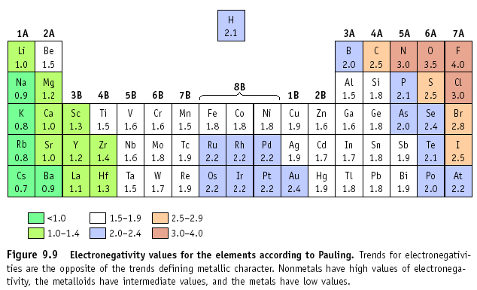
The type of bond can usually be calculated by finding the difference in electronegativity of the two atoms that are going together.

Slide 5
Electronegativity Difference
If the difference in electronegativities is between:
2.0 to 4.0: Ionic
0.4 to 1.99: Polar Covalent
0.0 to 0.39: Non-Polar Covalent
Example: NaCl
Na = 0.8, Cl = 3.0
Difference is 2.2, so
this is an ionic bond!

Slide 6
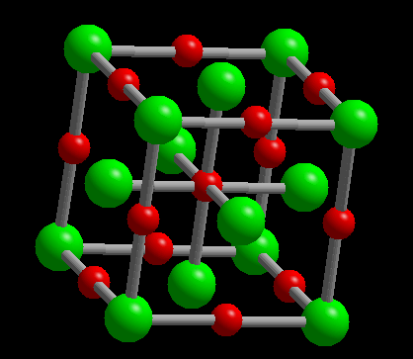
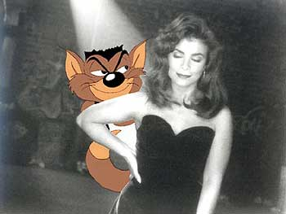
Ionic Bonds
All those ionic compounds were made from ionic bonds. We’ve been through this in great detail already. Positive cations and the negative anions are attracted to one another (remember the Paula Abdul Principle of Chemistry: Opposites Attract!)
Therefore, ionic compounds are usually between metals and nonmetals (opposite ends of the periodic table).

Slide 7
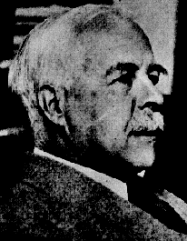
Electron Distribution in Molecules
Electron distribution is depicted with Lewis (electron dot) structures
This is how you decide how many atoms will bond covalently! (In ionic bonds, it was decided with charges)
G. N. Lewis
1875 - 1946

Slide 8
Bond and Lone Pairs
Valence electrons are distributed as shared or BOND PAIRS and unshared or LONE PAIRS.
••
H
Cl
•
•
••
lone pair (LP)
shared or
bond pair
This is called a LEWIS structure.

Slide 9
Bond Formation
A bond can result from an overlap of atomic orbitals on neighboring atoms.
••
••
H
+
Cl
•
H
Cl
•
•
•
••
••
Overlap of H (1s) and Cl (2p)
Note that each atom has a single, unpaired electron.

Slide 10
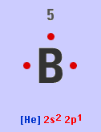
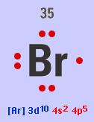
Review of Valence Electrons
Remember from the electron chapter that valence electrons are the electrons in the OUTERMOST energy level… that’s why we did all those electron configurations!
B is 1s² 2s² 2p¹; so the outer energy level is 2, and there are 2+1 = 3 electrons in level 2. These are the valence electrons!
Br is [Ar] 4s² 3d¹⁰ 4p⁵ How many valence electrons are present?

Slide 11
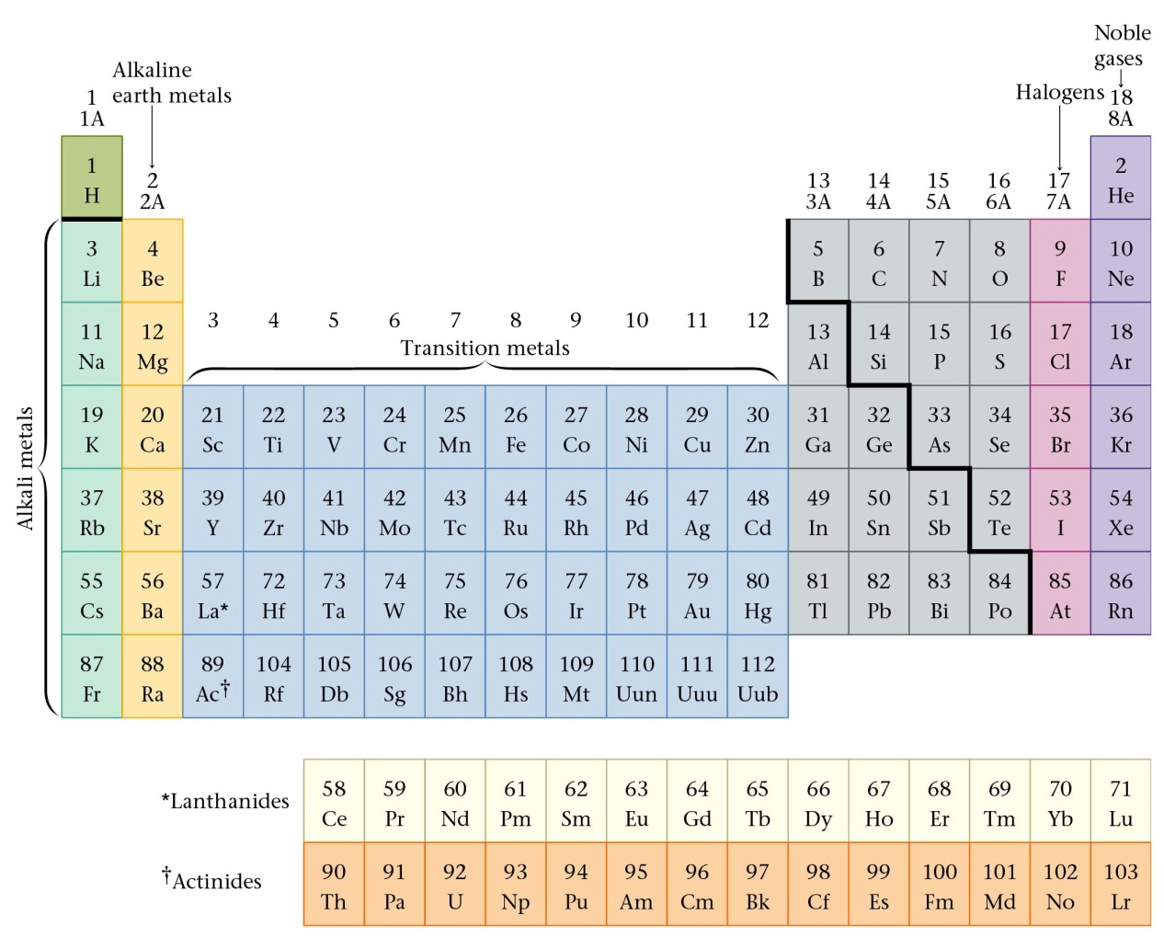
Review of Valence Electrons
Number of valence electrons of a main (A) group atom = Group number

Slide 12
Steps for Building a Dot Structure
N - A = S
Decide how many electrons are needed to achieve a full octet = every atom needs 8 except H (2), Be (4), and B (6)
N = needed electrons
Add up the number of valence electrons available for all the atoms
A = available valence electrons
Subtract available electrons from needed electrons. This equals the number of shared electrons
S = shared electrons

Slide 13
Building a Dot Structure
Let’s Practice!
NH_{3 N H}
Needed = 8 + (2 x 3) = 14 electrons
Available = 5 + (1 x 3) = 8 electrons
Shared = N – A = 6 electrons
CO₂ _{C O}
Needed = 8 + (8 x 2) = 24 electrons
Available = 4 + (6 x 2) = 16 electrons
Shared = N – A = 8 electrons

Slide 14
Steps for Building a Dot Structure
Determine on the central atom. This is always the least electronegative atom or the lone atom. Hydrogen is NEVER the central atom. Draw the “skeleton”
NH₃
H
N
H
H

Slide 15
Building a Dot Structure
5. From the NAS the number of shared electrons are represented by a line attached to the central atom
H
N
H
H
6. Remaining electrons form LONE PAIRS to complete the octet as needed (or duet in the case of H).
H
••
H
N
H
3 SHARED PAIRS and 1 LONE PAIR. (3/1)
Note that N has a share in 4 pairs (8 electrons), while H shares 1 pair.

Slide 16
Building a Dot Structure
7. Now check to be sure your NAS is the same as your structure. Here there are 3 shared pairs and 1 unshared pair
H
••
H
N
H
8. If you have more electrons in the drawing than in NAS, you must make double or triple bonds. If you have less electrons in the drawing than in NAS, you made a mistake!

Slide 17
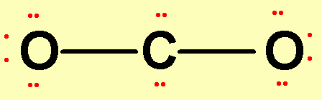
Carbon Dioxide, CO₂ N = 24 A = 16 S = 8
1. Central atom =
2. Draw “skeleton”
Carbon - least electronegative
This is only 4 shared electrons
& we need 8 shared electrons
4. Place lone pairs on outer atoms.
This is 20 electrons & we
should have 16 electrons
5. Check to see that all atoms have 8 electrons around it except for H, which can have 2.

Slide 18
Carbon Dioxide, CO₂ N = 24 A = 16 S = 8
6. To create DOUBLE BONDS: Instead of sharing only 1 pair, a double bond shares 2 pairs. So one pair is taken away from each atom and replaced with another bond.
2 SHARED PAIRS and 0 LONE PAIR. (2/0)

Slide 19
Double and even triple bonds are commonly observed for C, N, P, O, and S
H₂CO
SO₃
C₂F₄

Slide 20

Now You Try One! Draw Carbon tetrachloride, CCl₄
CCl₄ _{C Cl}
Needed =
Available =
Shared =
8 + (8 x 4) = 40 electrons
4 + (7 x 4) = 32 electrons
4 SHARED PAIRS and 0 LONE PAIR. (4/0)
N – A = 8 electrons
Central Atom =
Carbon
Draw structure
Cl
Cl
C
Cl
Cl

Slide 21
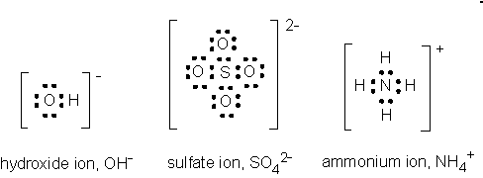
Keep an Eye on the Ions!
Anions – add the electrons gained from the charge to the valence electrons that are Available when calculating NAS
Cations – subtract the electrons lost from the charge to the valence electrons that are Available when calculating NAS
Put [ ] around the entire structure, and indicate the charge at the top right

Slide 22
Violations of the Octet Rule (Honors only)
Usually occurs with B and elements of higher periods. Common exceptions are: Be, B, P, S, and Xe.
Be: 4
B: 6
P: 8 OR 10
S: 8, 10, OR 12
Xe: 8, 10, OR 12
SF₄
BF₃

Slide 23
MOLECULAR GEOMETRY

Slide 24
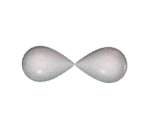
MOLECULAR GEOMETRY
Molecule adopts the shape that minimizes the electron pair repulsions.
VSEPR
Valence Shell Electron Pair Repulsion theory.
Most important factor in determining geometry is relative repulsion between electron pairs.

Slide 25
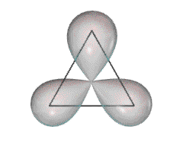
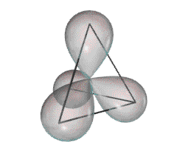
Some Common Geometries
Linear
Trigonal Planar
Tetrahedral

Slide 26
VSEPR charts
1. Use the Lewis structure to determine the geometry of the molecule
2. Determine the number of shared and unshared pairs of electrons around the CENTRAL atom only.
A double bond counts as 1 shared pair
A triple bond counts as 1 shared pair
3. The number of paired electrons determines hybridization
The first pair of electrons goes to the “s” orbital
The next three pairs go to the “p” orbital
The remaining pairs go to the “d” orbital

Slide 27
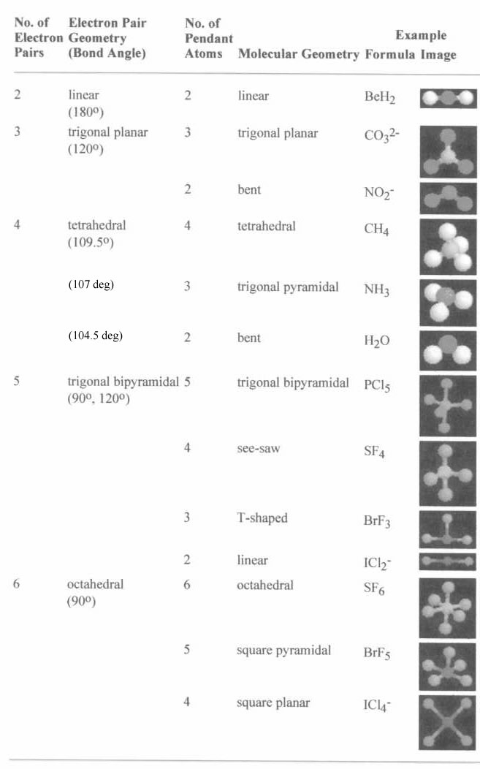
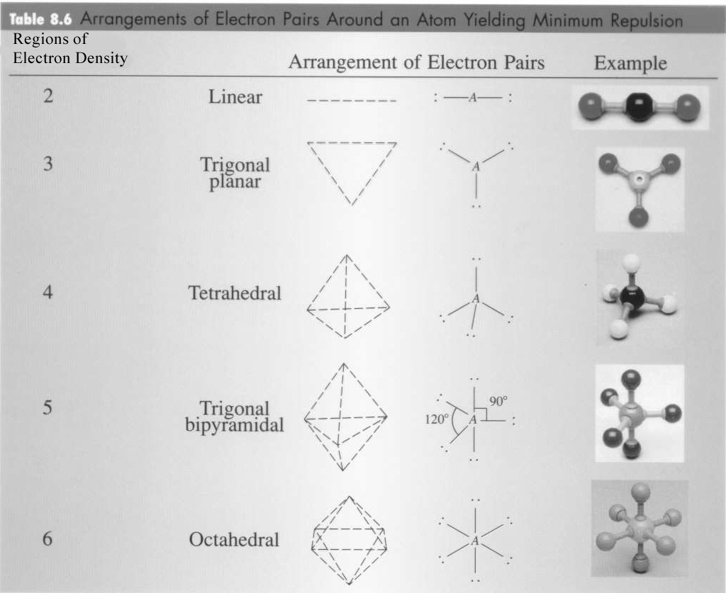
Other VSEPR charts

Slide 28
VSEPR charts
Look at your VSEPR chart to determine the molecular
geometry Use the CENTRAL atom only
Example: CCl₄
Shared pairs =
4
S
Unshared pairs =
0
P
Hybridization =
sp³
Molecular Geometry =
tetrahedral
P
P

Slide 29
VSEPR charts
PRACTICE: Remember to use the CENTRAL atom only
Example: H₂O
Shared pairs =
2
S
Unshared pairs =
2
P
Hybridization =
sp³
Molecular Geometry =
Bent
P
P

Slide 30
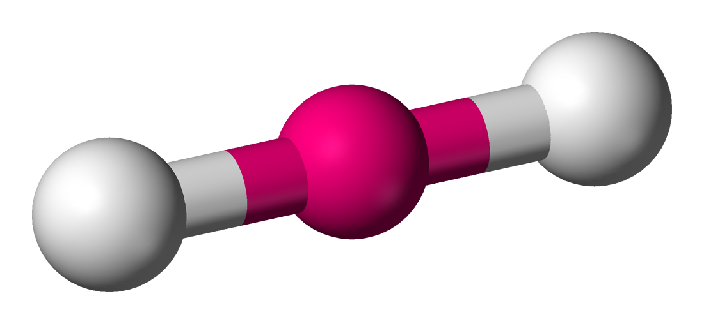
VSEPR charts
PRACTICE: Remember to use the CENTRAL atom only
Example: CO₂ (Double & triple bonds count as one shared pair)
Shared pairs =
2
P
Unshared pairs =
0
S
Hybridization =
sp
Molecular Geometry =
linear

Slide 31
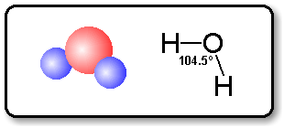
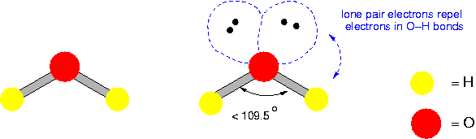
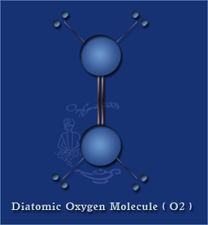
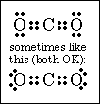
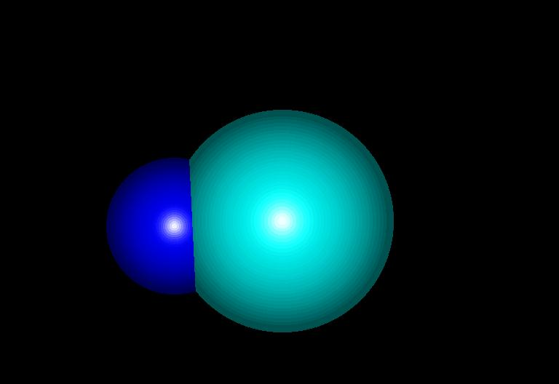
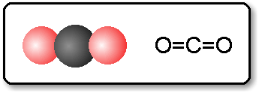
VSEPR Theory: Molecular Shapes
bent
Removing one side of the pyramid makes the _____________ shape.
Examples: H₂O H₂S
If there are only two atoms bonded, it is ______________.
Examples: O₂ HCl CO₂ (linear because of its double bonds.)
linear

Slide 32
Polar and Nonpolar Bonds
Even though the electrons in a covalent bond are shared, sometimes the attraction for the bonded pair, (the _____________________), is uneven. This gives rise to 3 bond types.
nonpolar covalent bonds: ____________ sharing of the e⁻ pair
polar covalent bonds: ________________ sharing of the e⁻ pair
ionic bonds: a ___________ of e⁻’s from the metal to the nonmetal
This last type of bond will be discussed in detail in Chapter 15.
How To Determine the Bond Type
Bond type is based on the electronegativity _____________ between the two bonded atoms.
(Look at the periodic table with the electronegativity values.)
electronegativity
equal
unequal
transfer
difference

Slide 33
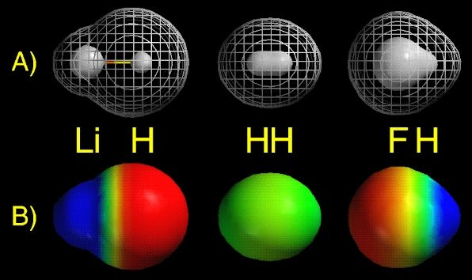
Polarity of Molecules
+
–
One side is slightly (__) and the other side is slightly (__).
Polar molecules are also known as _______________.
Polarity depends on the __________ and symmetry of the molecule.
symmetrical molecules (looks the same on all sides)= ___________
asymmetrical molecules = ___________
Polar molecules are moved by ____________ charges. (DEMO!)
dipole
shape
nonpolar
polar
static

Slide 34
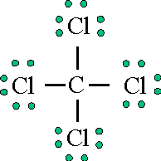
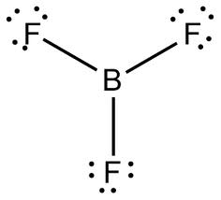
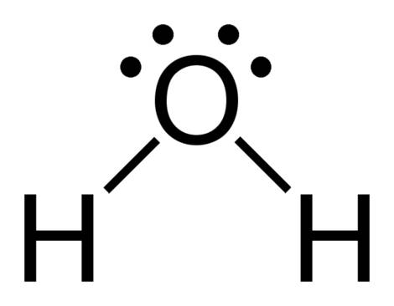
Molecular Polarity
Practice Problems: Determine if the following molecules are polar or nonpolar based on their shape.
a) CCl₄ b) NH₃ c) H₂O d) HCl e) BF₃
symmetrical tetrahedral
asymmetrical pyramid
asymmetrical bent
asymmetrical linear
symmetrical trigonal planar
nonpolar
polar
polar
polar
nonpolar
••
••
H
N
H
H Cl
••
••
H

Slide 35
Diatomic Elements H₂, N₂, O₂, F₂, Cl₂, Br₂, I₂
These elements do not exist as a single atom; they always appear as pairs
Their geometry is always linear
They are all NONPOLAR
NOT all sp hybridization

Slide 36
Bond Polarity
HCl is POLAR because it has a positive end and a negative end. (difference in electronegativity)
Cl has a greater share in bonding electrons than does H.
Cl has slight negative charge (-δ) and H has slight positive charge (+ δ)

Slide 37
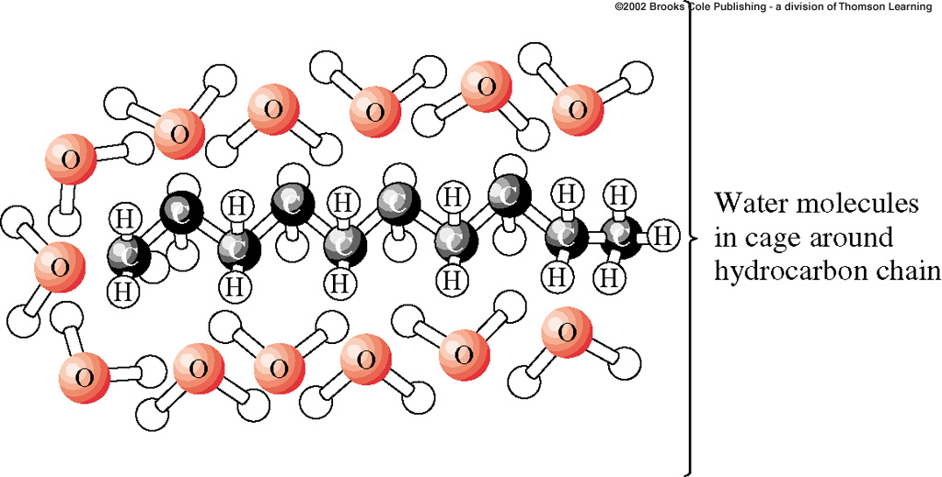
Bond Polarity
This is why oil and water will not mix! Oil is nonpolar, and water is polar.
The two will repel each other, and so you can not dissolve one in the other

Slide 38
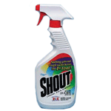
Bond Polarity
“Like Dissolves Like”
Polar dissolves Polar
Nonpolar dissolves Nonpolar

Slide 39
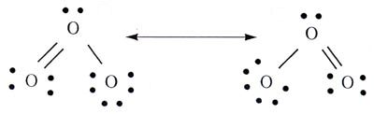




Resonance Structures
Resonance is the ability to draw 2 or more different e⁻ dot notations that obey the octet rule.
Examples: SO₂ has two resonance structures
O₃ has two resonance structures
Practice Problem: Draw the resonance structures for CO₃⁻².

