Slide 1
Moles to Grams Grams to Moles Liters to Moles Moles to Liters

Slide 2
Before we begin you will need your….
Calculator
Periodic Table
Mole Chart

Slide 3
Previously…
We learned that a mole is a new unit.
A mole can be used as a conversion factor.
We learned that 6.02 X 10²³ is known as Avogadro’s Constant/Number.
We also know that the molar mass of an element is the atomic mass of an element.

Slide 4
* New Conversion*
A mole can be used to calculate mass (g)..
molar mass (g)
1.00 mol
or
1.00 mol
molar mass (g)

Slide 5
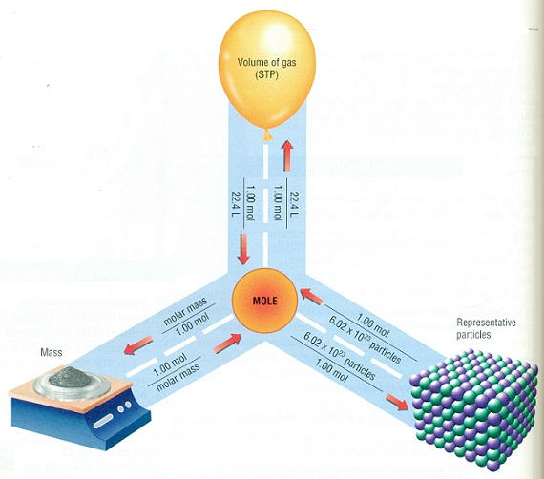
Mole Chart- Very Important!!!
Molecules
Atoms
Formula units
Ions
Grams

Slide 6
Question 1
Make sure you have your mole chart at all times.
Convert: 59 g hydrochloric acid (HCl) = ____ moles
Where do you start and where do you end? Follow the arrows.
Start= mass (g)
End= mole

Slide 7
Mole Chart- Very Important!!!
Molecules
Atoms
Formula units
Ions
End
Grams
Start

Slide 8
Question 1
Convert: 59 g hydrochloric acid (HCl) = ____ moles
=
=
59 g HCl X
1
mol HCl
36
g HCl
Molar mass of HCl
1.64 mol HCl

Slide 9
Question 2
Make sure you have your mole chart (green sheet) at all times.
4.6 moles of sodium hydroxide (NaOH) to grams
Where do you start and where do you end? Follow the arrows.
Start= moles
End= mass (g)

Slide 10
Mole Chart- Very Important!!!
Start
Molecules
Atoms
Formula units
Ions
Grams
End

Slide 11
Question 2
4.6 moles of sodium hydroxide (NaOH) to grams
=
=
Molar mass of NaOH
4.6 mol NaOH X
40
g NaOH
1
mol NaOH
184 g NaOH

Slide 12
Question 3
Make sure you have your mole chart (green sheet) at all times.
Convert 35.0 g of sulfuric acid (H3SO4) to molecules of H3SO4
Where do you start and where do you end? Follow the arrows.
Start= mass (g)
End= molecules

Slide 13
Mole Chart- Very Important!!!
You have to go through moles to get to molecules.
Molecules
Atoms
Formula units
Ions
Start
End

Slide 14
Question 3
35.0 g of sulfuric acid (H3SO4) to molecules of H3SO4
1
35 g H3SO4 X
mol H3SO4
X
6.02 X 10 ²³
Molecules H3SO4
99
g H3SO4
1
mol H3SO4
Molar mass of H3SO4
= 2.13 X 10²³ molecules H3SO4

Slide 15
Question 4
Make sure you have your mole chart at all times.
Convert 3.4 X 10 ²⁴ atoms of sodium chloride to grams
Where do you start and where do you end? Follow the arrows.
Start= atoms
End= mass (g)

Slide 16
Mole Chart- Very Important!!!
You have to go through moles to get to molecules.
Molecules
Atoms
Formula units
Ions
Start
End

Slide 17
Question 4
3.4 X 10 ²⁴ atoms of sodium chloride to grams
Molar mass of NaCl
3.4 X 10²⁴ atoms NaCl X
1
mol NaCl
X
58
g NaCl
6.02 X 10 ²³
1
mol NaCl
atoms NaCl
= 327.58 g NaCl

Slide 18
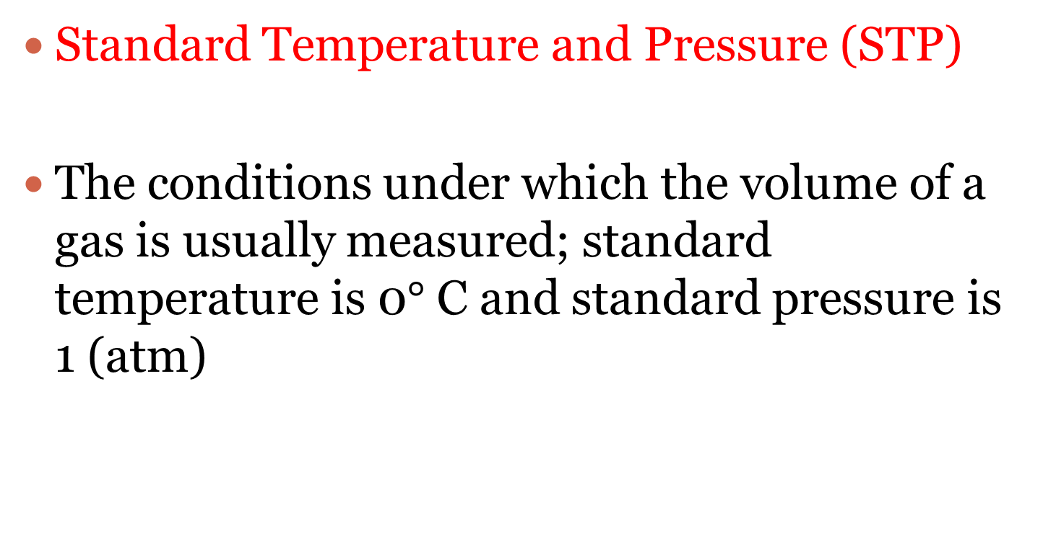
What is STP?
Standard Temperature and Pressure (STP)
The conditions under which the volume of a gas is usually measured; standard temperature is 0$°$ C and standard pressure is 1 (atm)

Slide 19
* New Conversion*
A mole can be used to calculate volume (L) at STP.
22.4 L
1.00 mol
or
1.00 mol
22.4 L

Slide 20
Mole Chart- Very Important!!!
Liters
Molecules
Atoms
Formula units
Ions

Slide 21
Question 5
What is the volume at STP of 2.66 mol of methane gas (CH4) in Liters?
Where do you start and where do you end? Follow the arrows.
Start= mole
End= volume (L)

Slide 22
Mole Chart- Very Important!!!
End
Molecules
Atoms
Formula units
Start

Slide 23
Question 5
What is the volume at STP of 2.66 mol of methane gas (CH4) in Liters?
2.66 mol CH4 X
22.4
L CH4
1
mol CH4
= 59.6 L CH4

Slide 24
Question 6
135 L of ammonia (NH3) = _________ mol
Where do you start and where do you end? Follow the arrows.
Start= volume (L)
End= mol

Slide 25
Mole Chart- Very Important!!!
Start
Molecules
Atoms
Formula units
End

Slide 26
Question 6
135 L of ammonia (NH3) = _________ mol
135 L of ammonia (NH3) X
1
mol NH3
22.4
L NH3
= 6.03 or 6.0 mol NH3

Slide 27
Question 7
What is the volume (L) of a 0.75 g sample of N2 at STP?
Where do you start and where do you end? Follow the arrows.
Start= mass(g)
End= volume (L)

Slide 28
Mole Chart- Very Important!!!
End
You have to go through moles to get to volume.
Molecules
Atoms
Formula units
Start

Slide 29
Question 7
What is the volume (L) of a 0.75 g sample of N2 at STP?
1
mol N2
22.4
0.75 g N2 X
X
L
28
g N2
1
mol N2
Molar mass of N2
= 0.6 L N2

Slide 30
Question 8
A sample NH3 of gas occupies 75.0 L at STP. How many molecules is that?
Where do you start and where do you end? Follow the arrows.
Start= volume (L)
End= molecules

Slide 31
Mole Chart- Very Important!!!
Start
You have to go through moles to get to moleclues.
Molecules
Atoms
Formula units
End

Slide 32
Question 8
A sample NH3 of gas occupies 75.0 L at STP. How many molecules is that?
mol NH3
75 L NH3 X
1
X
6.02 X 10²³
molecules of NH3
22.4
L NH3
1 mol NH3
= 2.02 X 10²⁴ molecules of NH3

