Slide 1
The Mole
Molar Mass

Slide 2
Units you already know…
3 singers
1 trio of singers =
1 pair socks =
1 dozen donuts =
1 gross of pencils =
2 socks
12 donuts
144 pencils

Slide 3
The Mole (Avogadro’s Constant)

Slide 4
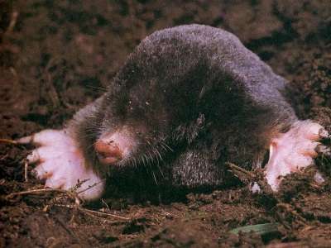
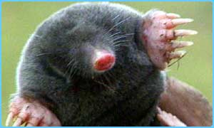
What is the mole?
We’re not talking about this kind of mole!

Slide 5
New Unit
A mole is particles.
Ex: A mole of beans are beans.
A mole of pencils are pencils.
A mole of Tic-Tacs is
Tic-Tacs.
6.02 X 10 ²³
6.02 X 10 ²³
6.02 X 10 ²³
6.02 X 10 ²³

Slide 6
The Mole (Avogadro’s Constant)
mole (mol)
A is the amount of a substance that contains 6.02 X 10 ²³ representative particles of that substance.

Slide 7
A Moles of Particles
Contains 6.02 x 10²³ particles
1 mole C =
1 mole H₂O =
1 mole NaCl =
6.02 x 10²³ C atoms
6.02 x 10²³ H₂O molecules
6.02 x 10²³ Na¹⁺ ions and
6.02 x 10²³ Cl¹⁻ ions

Slide 8
Avogadro’s Number can be used as a conversion factor
particles
1 mole
or
1 mole
6.02 x 10²³
6.02 x 10²³ particles

Slide 9
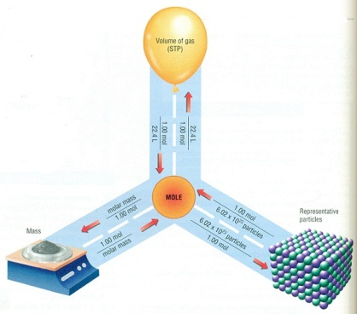
Example Problem #1 How many moles are equal to 2.41 x 10²⁴ formula units of magnesium?
Molecules
Atoms
Formula units
Ions
End
Start

Slide 10
Example Problem #1
How many moles are equal to 2.41 x 10²⁴ formula units of magnesium?
=
2.41 x 10²⁴ f.u. Mg X
1
mol mg
6.02 X 10 ²³
f.u. Mg
4.00 mols of Mg

Slide 11
Example Problem #2
How many moles are equal to 9.03 x 10²⁴ atoms of mercury?
X
=
9.03 x 10²⁴ atoms of Hg
1
mol of Hg
6.02 X 10 ²³
atoms Hg
15.00 mol of Hg

Slide 12
Example Problem #3 How many atoms are equal to 4.50 moles of copper?
Molecules
Atoms
Formula units
Ions
Start
End

Slide 13
Example Problem #3
How many atoms are equal to 4.50 moles of copper?
X
=
4.50 moles Cu
6.02 X 10 ²³
atoms
1
moles Cu
2.709 X 10 ²⁴ atoms

Slide 14
Example Problem #4
How many molecules are equal to 10.0 moles of carbon dioxide?
X
=
10.0 moles CO₂
6.02 X 10 ²³
molecules
1 mole
CO₂
6.02 X 10 ²⁴ molecules

Slide 15
Learning Check
5. Number of atoms in 0.500 mole of Al
0.500 mol Al x 6.02 x 10²³ Al atoms
1 mol Al
3.01 x 10²³ Al atoms

Slide 16
Molar Mass
Molar Mass = Number of grams in 1 mole
Equal to the numerical value of the atomic mass from periodic table
1 mole of C atoms = 12.0 g
1 mole of Mg atoms = 24.0 g
1 mole of Cu atoms = 64.0 g

Slide 17
Molar Mass of Compounds
Find Molar Mass:
1 mole of N₂O₄ =
N - 2 x 14.0 g =
+ O - 4 x 16.0 g =
28 g
64 g
92.0 g

Slide 18
Find Molar Mass
1 mole of antacid Al(OH)₃ =
Al - 1 x 27.0 g = 27 g
+ O - 3 x 16.0 g = 48 g
+ H - 3 x 1.0 g = 3 g
78.0 g

Slide 19
Learning Check
Prozac, C₁₇H₁₈F₃NO, is a widely used antidepressant that inhibits the uptake of serotonin by the brain. What is the molar mass?
SOLVE: Show all work

Slide 20
Solution
Prozac, C₁₇H₁₈F₃NO, is a widely used antidepressant that inhibits the uptake of serotonin by the brain. It has a molar mass of
C-17 (12.0) + H-18 (1.0) + F-3 (19.0) + N-1 (14.0) + O- 1 (16.0)
309 g

