Slide 1
Predicting Products Solubility Rules

Slide 2
Double Replacement
4) _______________ Replacement: (sometimes called “Ionic”)
A reaction between _____ ________________ that are dissolved in water that produces _____ ________________ , one of which is ________________.
Water or a gas may be one of the two compounds being produced.
General Form: ____ + ____ → ____ + ____
You must use the Solubility Chart to see which product is the precipitate.
Examples: CaCl_{2 (aq)} + AgNO_{3 (aq)} → _________ + ________
NaOH _{(aq)} + HCl _{(aq)} → ________ + ________
Double
two compounds
two compounds
insoluble
AB_{(aq)}
CD_{(aq)}
AD_{(aq)}
CB_{(s)}
+
+
Ca(NO₃)₂
_{(aq)}
AgCl
_{(aq)}
NaCl
H₂O _{(l)}

Slide 3
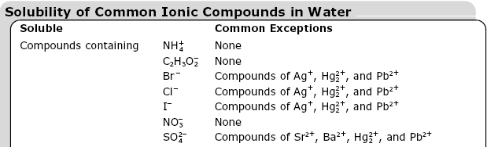
Solubility Rules
Soluble- the compound will dissolve in water. (aq)
The compounds listed will dissolve in water.
Take note of the common exceptions.

Slide 4
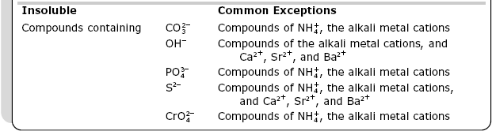
Solubility Rules
Insoluble- the compound will NOT dissolve in water. (s)
A precipitate (solid) is formed.
Take note of the common exceptions.

Slide 5
Practice Problem 1
NaCl + AgNO3 → NaNO3 + AgCl
Will a precipitate form?
(Look at solubility chart)
Yes. AgCl is insoluble.

Slide 6
Practice Problem 2
Na3PO4 + FeCl3 → 3 NaCl + FePO4
Will a precipitate form?
Yes. FePO4 is insoluble.

Slide 7
Practice Problem 3
NaCl + CuSO4 →
Predict products
Will a precipitate form?
No. Both NaSO4 + CuCl₂ are soluble. Therefore no precipitate will occur.
NaSO4 + CuCl₂

Slide 8
Practice Problem 4
ZnSO4 + SrCl2 →
Predict the products.
Will a precipitate form?
Yes. SrSO4 is insoluble.
SrSO4 + ZnCl2

Slide 9
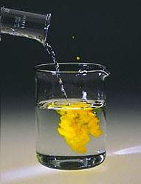
Double Replacement Reaction

Slide 10
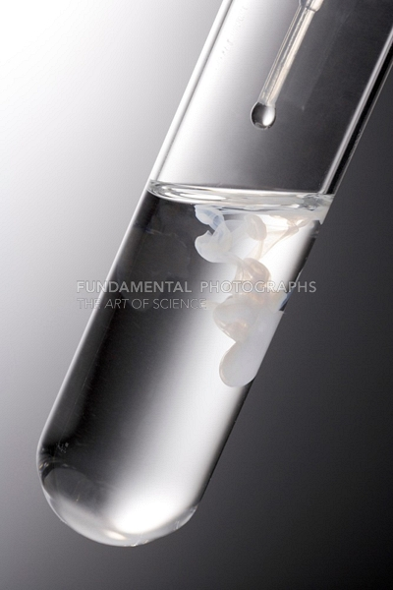
Double Replacement Reaction

Slide 11
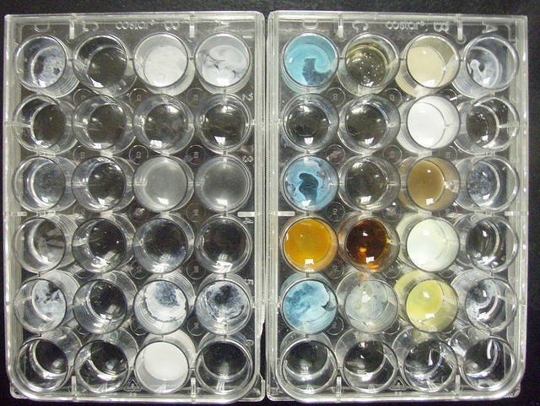
Preview of Lab

