Slide 1
Unit 7 Chemical Equations and Reactions
Types of Reactions

Slide 2
5 Basic Reactions
Synthesis
Decomposition
Combustion
Single Replacement
Double Replacement

Slide 3


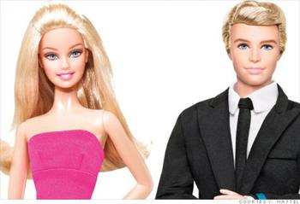

Synthesis reaction
A + B → AB
+
→
+
→

Slide 4
Synthesis Reaction
__Ca + __Cl₂ → __CaCl₂
1
1
1
Q: Where did that 2 come from?
Q: Where did that 2 come from?
A: Chorine is diatomic!
A: Crisscrossing charges!

Slide 5
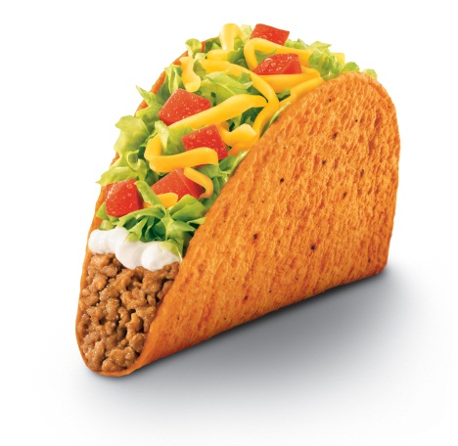
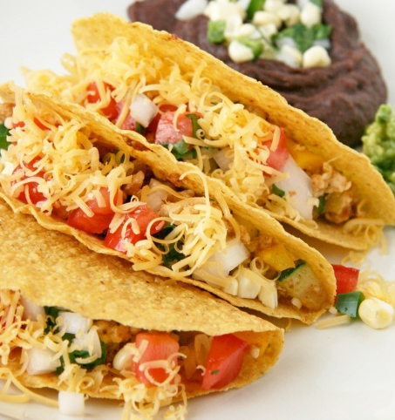
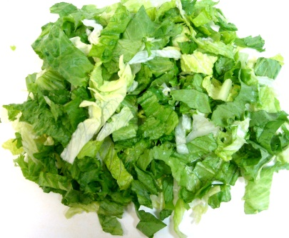
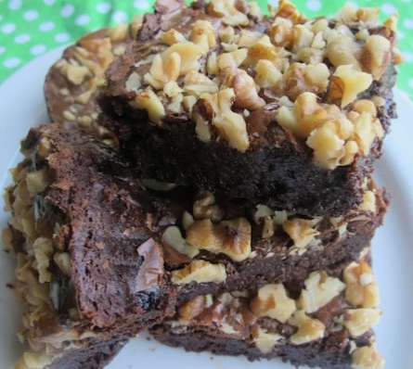
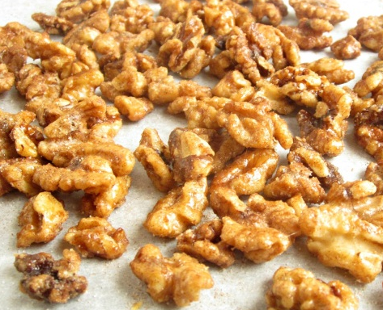
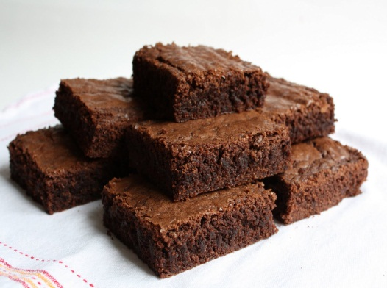
Decomposition Reaction
AB → A + B
→
+
→
+

Slide 6
Decomposition Reaction
2
2
1
__NaCl → __Na + __Cl₂
Q: Where did that 2 come from?
A: Chorine is diatomic!

Slide 7
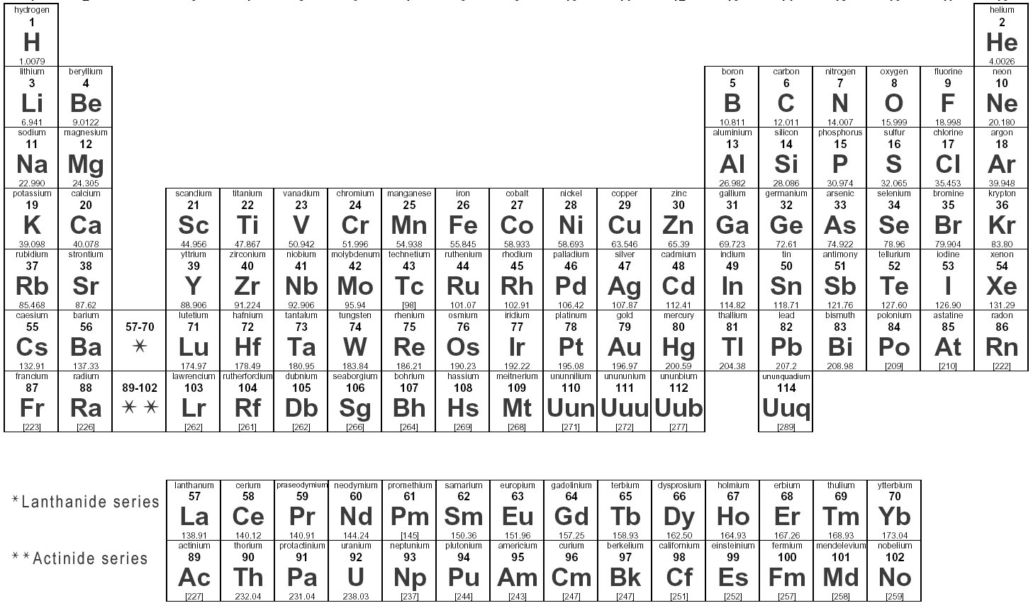



HYDROCARBONS
Hydrocarbon - a compound that ONLY contains and
Usually you see in the reaction too.
Makes a RAPID FLAME!
Always produces → CO₂ + H₂O
+

Slide 8
HYDROCARBONS
Which is a hydrocarbon?
C₂H₃O₄
CO₂
CH₂
F₄H₃
←
←

Slide 9
Combustion Reaction
2
11
6
8
__C₃H₈O + __O₂ → __CO₂ + __H₂O
→
+

Slide 10
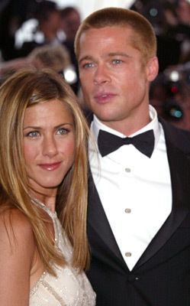
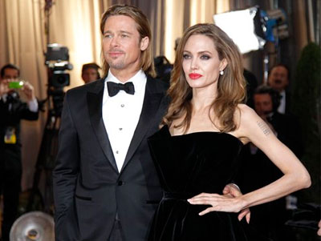
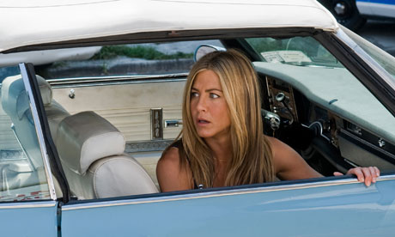
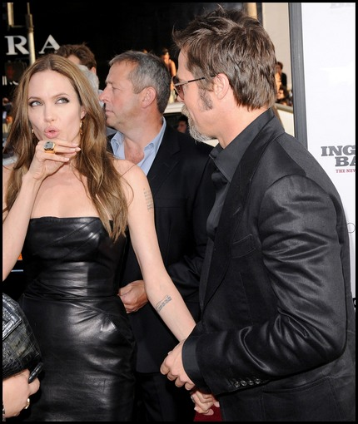
Single-replacement reaction
A + BC → AC + B
element
compound
compound
element
+
+
→

Slide 11
Single-replacement reaction
2
2
2
1
_Li + _H(NO₃) →
_Li(NO₃) + _H₂
Q: Where did that 2 come from?
A: Hydrogen
is diatomic!

Slide 12

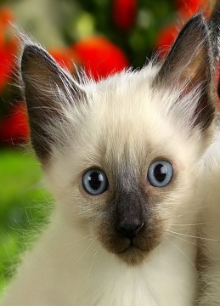
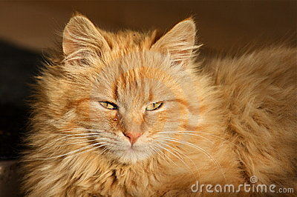
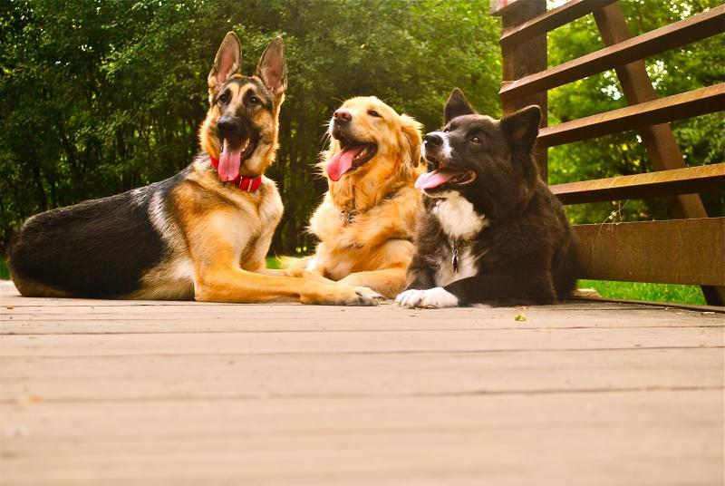
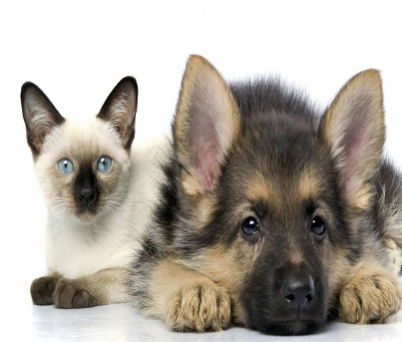
Double Replacement reaction
AB + CD → CB + AD
compound
compound
compound
compound
→

Slide 13
Double Replacement reaction
1
2
1
1
__Ca(CO₃) + __HCl → __H₂(CO₃) + __CaCl₂

