Slide 1
Unit 2: measurement notes
Scientific math

Slide 2
Objective
Distinguish between a qualitative and quantitative measurement

Slide 3
Did you get…….
Qualitative: “quality” uses words to describe. Observations made with your senses. Cannot use in court of law!
The person looked like a drug user because his hands were shaking.
Quantitative: “quantity”/ uses numbers to describe. Observations made with instruments such as rulers, balances, etc. Good stuff for a court of law!
The man had 20 kg of crack cocaine in his hands.
Qualitative
Quantitative

Slide 4
Qualitative vs. quantitative practice
Rotten eggs smell sour
The room is 33.2m long
I wear a size 4
My husband pants size is 34x36
The apple is red
Identify which is qualitative and which is quantitative

Slide 5
Objective
Evaluate measurements as accurate and/or precise

Slide 6
What is the difference?
ACCURACY occurs when your experimental data (the information or answer that you’ve found by performing an experiment, calculation, etc.) is very close with the known (true) value (the information or answer that you should have gotten by performing the experiment or calculation.
If a value is ACCURATE, that means that it is CORRECT. (You’re right!!)
If a value is NOT ACCURATE, that means that it is INCORRECT. (You’re wrong….)

Slide 7
What is the difference?
PRECISION refers to how well experimental values (the information or answers that you’ve found by performing an experiment, calculations, etc. more than once) agree with each other.
If your values are PRECISE, that means that they are very close to each other, whether or not they are correct (accurate).
If your values are NOT PRECISE, that means that they are not very close to each other, whether or not they are correct (accurate)

Slide 8
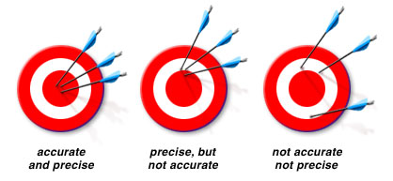
ACCURACY VS PRECISION

Slide 9
Accuracy vs precision
Accuracy: making the measurement close to correct
You wanted 9.5 mL, you got 9.58 mL
Precision: making several measurements close to each other.
You got 5.4 mL, 5.5 mL, and 5.6 mL

Slide 10

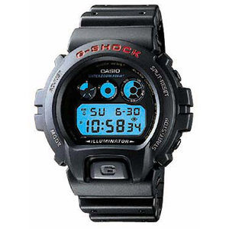
Does precision have a cost
List Price: $23,200.00
$47.00

Slide 11
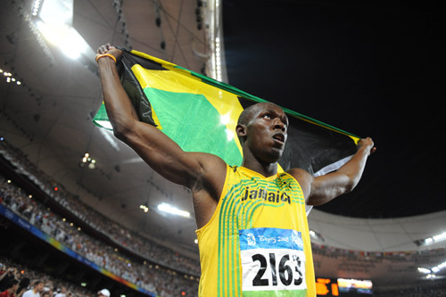
M ore significant digits = more confidence in the measurement!
2008 Olympics
9.69 seconds gold
9.89 seconds silver
9.91 seconds bronze
I bet Usain Bolt is glad the Olympics didn’t use the Wal-Mart watch.

Slide 12
No precision = 7 way tie
More digits past the decimal = more precision.
BOLT Usain9.63 OR
BLAKE Yohan9.75 =PB
GATLIN Justin9.79
GAY Tyson9.80
BAILEY Ryan9.88
MARTINA Churandy9.94
THOMPSON Richard9.98
POWELL Asafa11.99

Slide 13
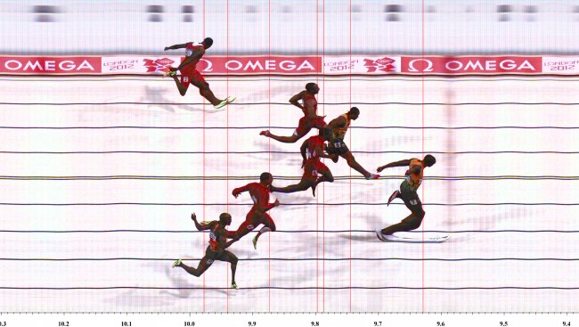
Incredible precision
AWESOME!

Slide 14

One way to gain precision is to estimate the last digit in a measurement.
Look where the arrow is, it is to the right of 2, but short of 3. It is to the right of 0.8, but short of 0.9. So, I can say the object is more than 2.8 cm, but less than 2.9 cm. We can say this with complete confidence because of the markings on the ruler.

Slide 15
Final answer: 2.82 cm

Slide 16

Look and determine the final measurement with estimated last digit.

Slide 17
So, the last digit is estimated……
The last digit is the least precise; you have the least confidence with it because you estimated it.
Example: 4.59 cm
The 9 is the least precise!

Slide 18
Objective
Calculate percent error

Slide 19
Human error equipment error
What causes error?

Slide 20
What is the difference between accepted and experimental value
Accepted value: Reference value, measurement that is agreed on by the masses!
Example: Look at the weight on bag of pretzels today in lab. This is the accepted value
Experimental value: The measurement you get in the lab!
Example: When you weigh the bag of pretzels you may get a different mass from what is recorded on bag.
Error = accepted - experimental

Slide 21
Percent error (aka how accurate are you?)
Determine the success of the experiment by calculating percent error.
Need to know 2 things:
  What you got
  What you wanted
  Got – wanted x 100 = percent error
  wanted

Slide 22
Percent Error
This is a formula! The answer is always positive because the error is calculated as an absolute value.
% error = IerrorI X 100
Accepted value
Error = accepted – experimental

Slide 23
Percent error practice
A student determined the density of copper to be 9.65 g/cm³. The correct value is 3.29 g/cm³.
  Got – wanted x 100 = percent error
  wanted
9.65- 3.29 x 100 = 193%
3.29

Slide 24
Percent error practice
A student determined the density of iron to be 6.59 g/cm3. The correct value is 7.87 g/cm3.
  Got – wanted x 100 = percent error
  wanted
6.59- 7.87 x 100 = -16% = 16%
7.87
Percent error is an absolute value, no negative values

Slide 25
Percent error practice
After heating a 10.00 g sample of potassium chlorate, a student obtains an amount of oxygen calculated to be 3.90 g. Theoretically, there should be 3.92 g of oxygen in this amount of potassium chlorate.
  Got – wanted x 100 = percent error
  wanted
3.90- 3.92 x 100 = .51%
3.92

Slide 26
objective
Operate all pertinent keys on the scientific calculator

Slide 27
Calculators-EE
Calculators - EE
Used for entering numbers in scientific notation.
The button says EE, the screen says E
EE stands for * 10 ^ (“times ten to the”)
1.23 x 10⁴ →1.23E4
1.23*E4
1.23*10E4

Slide 28
Ee practice
1.7 x 10²³ / 4.9725 x 10¹⁴= 341880341.9
7.01 x 10³ * 5.002 x 10⁻³ =35.06402
1.951 x 10⁵ + 2.31 x 10⁴ =218200
4 x 10⁻³ - 9.65 x 10²= -964.996

Slide 29
Calculators – ()
Used for making sure the calculator adds or subtracts first.
Or for resolving numerators and denominators before dividing.
Used mainly during division.
1.3 * 56
0.003 * 8.7 either enter the calculation
  (1.3 * 56) /( 0.003 * 8.7) OR
  1.3 * 56 / 0.003 / 8.7
= 2789

Slide 30
() practice
15 * 94 = 0.3996
72 * 49
3.5 * 0.09 = 5.6 x 10⁻⁶
56 * 1002
7.6 + 45 = -17.08
9 – 12.08
4690 – 1029= 90.17
7.6 + 33

Slide 31
objective
Scientific notation

Slide 32
Scientific notation
Please be mindful of units. Like m x m = m²
Scientific Notation
  Coefficient raised to power of 10
Useful when working with really large or really small numbers!

Slide 33
Exponent can be one of three types of numbers:
Negative: 1.23 x 10⁻⁴
number is less than 1 (a decimal)
Standard notation=0.000123
Positive: 1.23 x 10⁴
number is greater than 1
=12300
Zero: 1.23 x 10⁰
number is itself
Standard notation = 1.23
(any number under the sun raised to the zero power is one)

Slide 34
In and out rules
Steps to put a number into scientific notation:
Move decimal so that only one number before.
Write x 10
If you had to move the decimal left, exponent positive
If you had to move the decimal right, exponent negative
Exponent is number of spaces you had to move decimal.

Slide 35
example
0.0049 convert standard notation to scientific notation
Step 1 → 4.9
Step 2 →4.9x10
Step 3→4.9x10^{- (negative} bc^{number less than 1)}
Step 4→4.9x10⁻³

Slide 36
In practice
37000
0.000709
12
8.6
3.7 x 10⁴
7.09 x 10⁻⁴
1.2x10¹
8.6 x 10⁰
Standard notation
Scientific notation

Slide 37
In and out rules
Steps to take a number out of scientific notation (to write long way):
1. The sign of the exponent tells you which way to move.
- means left
+ means right
2. The number of the exponent tells you how many spaces.
3. Eliminate x 10

Slide 38
Example
3.94 x 10³ → 3940
Notice the exponent is positive; move to the right (greater than 1)
Notice the decimal was moved 3 times because the exponent was 3.

