Slide 1
Matter Notes
Matter vs. Mass
Matter is anything that has _________ and takes up ___________.
Examples: ________, __________, and ________... (the three states of matter)
Things that are NOT matter: __________, heat, ________, sound...
A. Mass is the amount of ___________ contained in an object.
B. Weight is the measure of ___________ pulling on a certain mass.
C. ____________ is the amount of space an object occupies.
The standard metric unit for mass is the ______________.
mass
space
solids
liquids
gases
light
emotions
matter
gravity
Volume
kilogram

Slide 2
States of Matter
III. There are 3 states (or phases) of matter.
phase | definite shape | definite volume | compressible
solid
liquid
gas
YES
YES
NO
NO
YES
NO
NO
NO
YES
Solids– are ____________ They have a definite shape and volume
Liquids – are ___________ They take the shape of their container, but still have a definite ________________.
Gases – are also _________ They take the shape of their container, and they completely _____________ any volume of container in which they are placed
matter
matter
volume
matter
fill

Slide 3
States of Matter
A _________ is a term used for the gaseous form of a substance that is normally a ________ or _______ at room temperature.)
Example: _______ vapor (steam)
There is a fourth state of matter called _________. It consists of superheated “soup” of bits and pieces of atoms. It only exists at temperatures above _____________ °C, so it is not found naturally on earth. The two best known locales for plasma are the interior of _________ and during the detonation of a hydrogen bomb.
Vapor
liquid
solid
water
plasma
100,000
stars

Slide 4
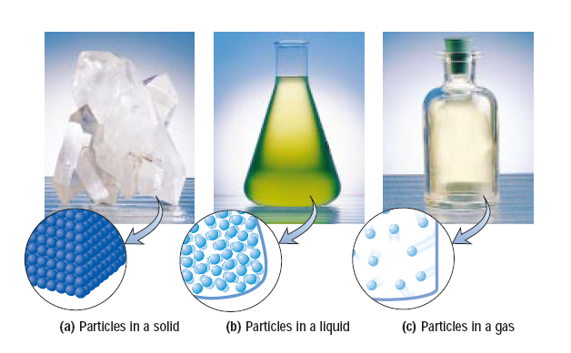
States of Matter

Slide 5
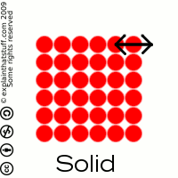
IV. States of matter can be described in terms of the Particle Model Theory
There are attractive forces between particles.
SOLIDS
In solids, the particles are arranged in an orderly manner with __________________ between particles. The particles ________ ___ ________ but do not move from place to place.
strong attraction
vibrate in
place

Slide 6
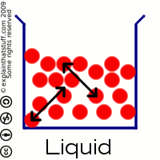
LIQUIDS
In liquids, the particles move more __________ from place to place, and slide past each other in constant motion. However, they essentially remain in __________ with each other at all times as the slide around, so there is not much change in __________. The forces are strong enough to keep the particles from flying away.
freely
contact
energy

Slide 7
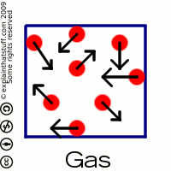
GASES
In gases, the particles move around very ________.
The gas particles collide violently with each other and bounce away, so they _________ stay in contact with each other.
fast
do not

Slide 8
V. Two Categories of Matter
A. Pure Substances - a substance whose component parts are always uniform matter. They have the same phase and properties throughout. They can not be physically separated into simpler substances.
Example - oxygen, nitrogen, water (pure)

Slide 9
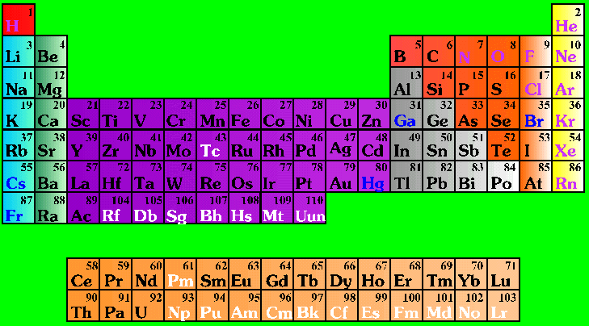
Types of Pure Substances
Elements - * Basic
building block of all
matter.
114 known elements,
approx. 90 are naturally
occurring. The rest are
man made.
85 of them make up
99 % of the earth's
crust.

Slide 10
Elements vs. Compounds
Elements are pure substances that cannot be broken down by an ordinary _____________ change.
Elements are the _________ forms of matter that can exists in normal laboratory conditions.
Examples: _______, Helium, __________
Compounds are homogeneous substances made up of ____ or ________ different elements which are chemically combined.
Compounds can only be broken down into simpler substances by ____________ ____________. Cannot be separated by __________ changes.
Examples: _______ (H2O), _______________
physical
simplest
Gold
Mercury
2
more
chemical reactions
physical
Water
Salt (NaCl)

Slide 11

I. Mixtures
Mixture - A physical blend of
two or more substances. d) Can
be created or separated into
its components by a ___________
change- does not require a chemical reaction
( magnetism, distillation, sifting, etc. )
physical

Slide 12
Types of Mixtures
f) Heterogeneous mixture - a mixture that
is not uniform in composition – samples __________ a great deal in composition if tested in different locations.
Example -soil, concrete, granite, sand and
water at the beach.
differ

Slide 13
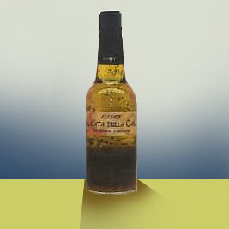
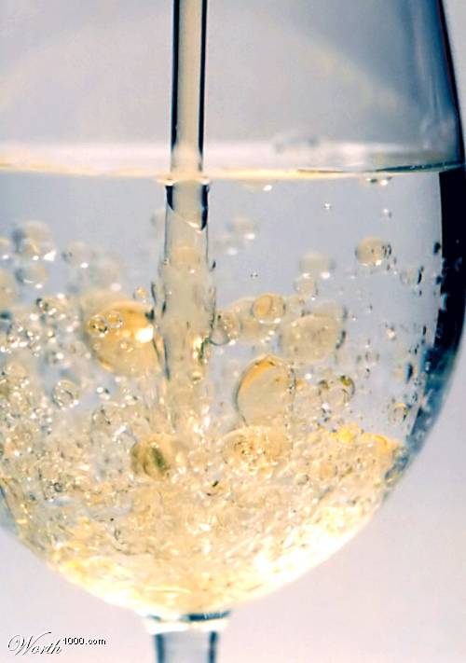
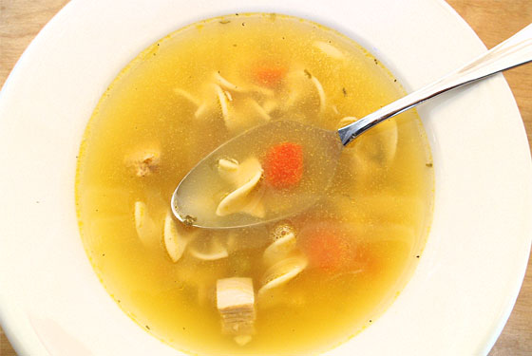
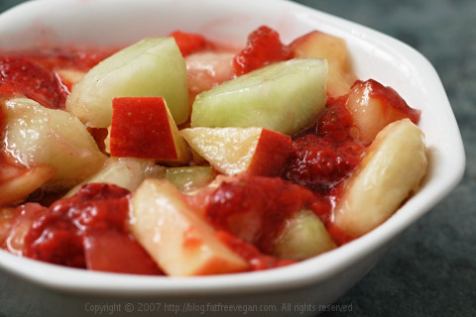
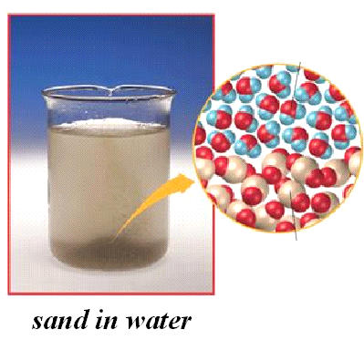
Heterogeneous Mixtures

Slide 14
Types of Mixtures
Homogeneous mixture - a mixture that
has uniform composition
Example - air, salt water in the ocean,
blood, most toothpaste ( not Aquafresh,
etc.)

Slide 15
Solutions
Solutions - a special type of homogeneous
mixture that does not scatter light ( can see
through it. Doesn‘t have to be clear. One
substance dissolves into another. )
Characteristics - Usually a single
phase (tap water, air) , more than
two ingredients ( mixture ) , clear
( Does not scatter light )

Slide 16
Solutions
molecule
Mixed ___________ to molecule
The mixing is so complete that solution
are considered to be ____________
mixture
Can occur between any state of matter
  Table 2.3, page 33
  gas in gas; liquid in gas; gas in liquid; solid in liquid; solid in solid (alloys), etc.
homogeneous

Slide 17

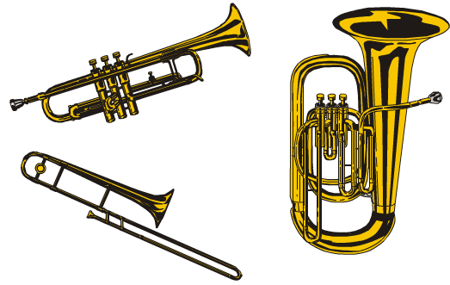
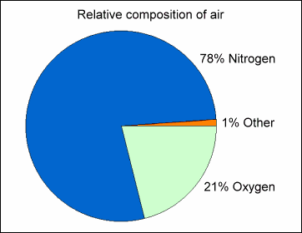

Homogeneous Mixtures

Slide 18

Classification of Matter
hetero-
geneous
mixture
uniform
properties?
no
no
solution
fixed
composition?
no
element
chemically
decomposable?
yes
compound
http://antoine.frostburg.edu/chem/senese/101/matter/slides/sld003.htm
Notes:
http://antoine.frostburg.edu/chem/senese/101/matter/slides/sld003.htm

Slide 19
Elements, Compounds, and Mixtures
hydrogen
atoms
oxygen atoms
hydrogen
atoms
(a)
an element
(hydrogen)
(b)
a compound
(water)
(c)
a mixture
(hydrogen
and oxygen)
(d)
a mixture
(hydrogen
and oxygen)
Dorin, Demmin, Gabel, Chemistry The Study of Matter , 3rd Edition, 1990, page 68
Notes:
“Elements, Compounds, and Mixtures”
Description: This slide shows the molecular composition of an element, a compound, and two mixtures.
Basic Concepts
All samples of a substance have the same molecular composition and intensive properties and are homogeneous.
Elements and compounds are substances; mixtures are not.
The elements making up a compound combine in fixed ratios.
Mixtures can be separated by physical methods.
Mixtures that have a uniform composition throughout are homogeneous; those that have parts with different compositions are heterogeneous.
Teaching Suggestions
Use this transparency to help students visualize the molecular composition of elements, compounds, and mixtures and to review the definitions of these terms. Make sure students understand the difference between the terms matter and substance. Remind students that elements and compounds are always homogeneous, while mixtures can be either homogeneous or heterogeneous.
Questions:
Which of the bottles pictured above contain(s) matter? Which contain(s) a single substance? Explain your answers.
How many elements are present in each molecule of water shown in bottle (b)? What is the relative number of atoms of each element in a water molecule?
As you know, ice is frozen water. In other words, ice and water are the same substance, in different phases. What would you expect the ratio of hydrogen atoms to oxygen atoms to be in a molecule of ice? Explain your reasoning.
Bottle (c) and bottle (d) both contain mixtures. How are these mixtures similar? How are they different?
Suppose you find an unlabeled bottle containing a clear liquid. Can you tell by looking at it whether the material is a compound or a mixture? Explain your answer.
How can you prove that a sample of sea water is a mixture?
Classify the following items as elements, compounds or mixtures; rice pudding, copper, carbon dioxide, air, milk, magnesium chloride, granite, mercury, and maple syrup.
A chocolate-chip cookie with more chips in one part of the cookie than another can be used to demonstrate a heterogeneous mixture. Name two other materials that can be classified as heterogeneous mixtures. Explain your reasoning.

Slide 20

Elements, Compounds, and Mixtures
hydrogen
atoms
oxygen atoms
hydrogen
atoms
(a)
an element
(hydrogen)
(b)
a compound
(water)
(c)
a mixture
(hydrogen
and oxygen)
(d)
a mixture
(hydrogen
and oxygen)
Dorin, Demmin, Gabel, Chemistry The Study of Matter , 3rd Edition, 1990, page 68
Notes:
“Elements, Compounds, and Mixtures”
Description: This slide shows the molecular composition of an element, a compound, and two mixtures.
Basic Concepts
All samples of a substance have the same molecular composition and intensive properties and are homogeneous.
Elements and compounds are substances; mixtures are not.
The elements making up a compound combine in fixed ratios.
Mixtures can be separated by physical methods.
Mixtures that have a uniform composition throughout are homogeneous; those that have parts with different compositions are heterogeneous.
Teaching Suggestions
Use this transparency to help students visualize the molecular composition of elements, compounds, and mixtures and to review the definitions of these terms. Make sure students understand the difference between the terms matter and substance. Remind students that elements and compounds are always homogeneous, while mixtures can be either homogeneous or heterogeneous.
Questions:
Which of the bottles pictured above contain(s) matter? Which contain(s) a single substance? Explain your answers.
How many elements are present in each molecule of water shown in bottle (b)? What is the relative number of atoms of each element in a water molecule?
As you know, ice is frozen water. In other words, ice and water are the same substance, in different phases. What would you expect the ratio of hydrogen atoms to oxygen atoms to be in a molecule of ice? Explain your reasoning.
Bottle (c) and bottle (d) both contain mixtures. How are these mixtures similar? How are they different?
Suppose you find an unlabeled bottle containing a clear liquid. Can you tell by looking at it whether the material is a compound or a mixture? Explain your answer.
How can you prove that a sample of sea water is a mixture?
Classify the following items as elements, compounds or mixtures; rice pudding, copper, carbon dioxide, air, milk, magnesium chloride, granite, mercury, and maple syrup.
A chocolate-chip cookie with more chips in one part of the cookie than another can be used to demonstrate a heterogeneous mixture. Name two other materials that can be classified as heterogeneous mixtures. Explain your reasoning.

Slide 21
Mixture vs. Compound
Different
Alike
Different
Involve
substances
Variable
Composition
Fixed
Composition
Topic
Topic
No bonds
between
components
Contain
two or more
elements
Bonds
between
components
Mixture
Compound
Can be
separated by
physical means
Can be
separated
into
elements
Can ONLY be
separated by
chemical means
Notes:
Compounds have different properties than the elements they are made from. In a mixture, the mixture retains the properties of the materials it is made from.
A chemical formula can always be written for a compound.

Slide 22
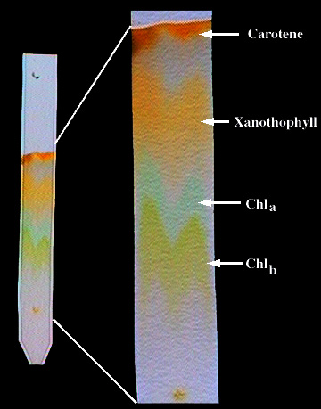
Chromatography
inks
One way to separate a _________ and ___________ is by chromatography. It is the physical separation of a mixture into its individual components. It involves using a solvent to pass through the mixture. What solvent should I use? The solvent used depends upon the solubility of the mixture you are trying to separate. Examples are water, isopropyl alcohol, ethyl alcohol, acetone, and petroleum ether.
dyes
Paper Chromatography
Can be used to separate the components of inks, dyes, plant compounds (chlorophyll), make-up, and many other substances

