Slide 1

Metric Conversions Ladder Method
T. Trimpe 2008 http://sciencespot.net/

Slide 2
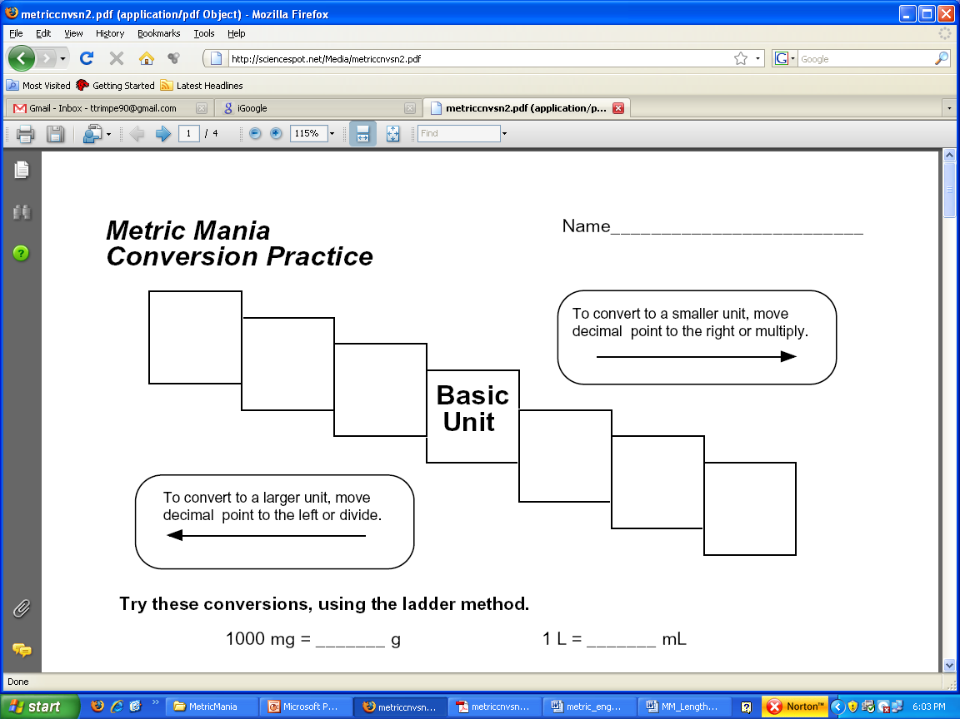
The “Ladder” Method
KILO 1000 Units
HECTO 100 Units
DEKA 10 Units
DECI 0.1 Unit
CENTI 0.01 Unit
MILLI 0.001 Unit
Meters Liters Grams
Notes:
Kids have dropped over dead converting metrics – Make a mnemonic! Symbols??

Slide 3
How to write in “metrics”
Meter - distance
Liter - volume Base Units
Gram – weight/mass
Once you have established what you’re measuring, figure out your appropriate prefixes!
Prefixes: kilo, hecto, deka, deci, centi, milli

Slide 4
Writing in Metrics
Distance - meter | Volume - liter | Weight/Mass - gram
kilometer | kiloliter | Kilogram
hectometer | hectoliter | hectogram
dekameter | dekaliter | dekagram
meter | liter | gram
decimeter | deciliter | decigram
centimeter | centiliter | centigram
millimeter | milliliter | milligram

Slide 5
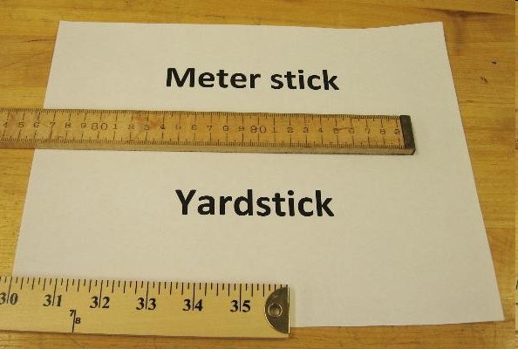
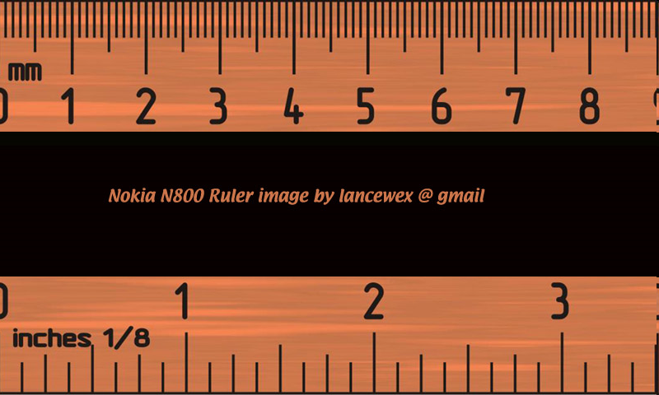
English vs. Metric Units
Which is longer?
A. 1 mile or 1 kilometer
B. 1 yard or 1 meter
C. 1 inch or 1 centimeter
1 mile
1.6 kilometers
1 inch = 2.54 centimeters
1 yard = 0.9444 meters
Left Image: http://webapps.lsa.umich.edu/physics/demolab/controls/imagedemosm.aspx?picid=1167 Right Image: http://share.lancealan.com/N800%20ruler.jpg

Slide 6
km
Metric Units
m
cm
mm
The SI basic unit of length, the distance between two points, in the metric system is the meter and is represented by a lowercase m.
Standard: The distance traveled by light in absolute vacuum in 1⁄299,792,458 of a second. Measured with a meter stick in class.
Metric Units
1 Kilometer (km) = 1000 meters
1 Meter = 100 Centimeters (cm)
1 Meter = 1000 Millimeters (mm)
Which is larger?
A. 1 meter or 105 centimeters
B. 4 kilometers or 4400 meters
C. 12 centimeters or 102 millimeters
D. 1200 millimeters or 1 meter

Slide 7
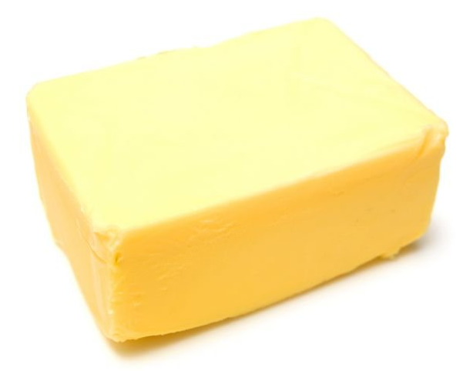
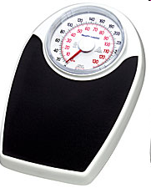
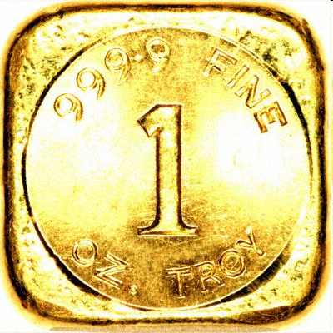
English vs. Metric Units
Which is larger?
1. 1 Pound or 100 Grams
2. 1 Kilogram or 1 Pound
3. 1 Ounce or 1000 Milligrams
1 pound = 453.6 grams
1 ounce of gold = 28,349.5 milligrams
100 kilogram = 220 pounds

Slide 8
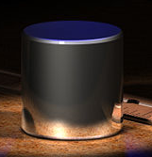
kg
Metric Units
g
cg
mg
Mass refers to the amount of matter in an object.
The base unit of mass in the metric system in the kilogram and is represented by kg. We will be using grams in class.
Standard: 1 kilogram is equal to the mass of the International Prototype Kilogram (IPK), a platinum-iridium cylinder kept by the BIPM at Sèvres, France.
Kilogram Prototype
Metric Units
1 Kilogram (km) = 1000 Grams (g)
1 Gram (g) = 1000 Milligrams (mg)
Which is larger?
A. 1 kilogram or 1500 grams
B. 1200 milligrams or 1 gram
C. 12 milligrams or 12 kilograms
D. 4 kilograms or 4500 grams
Kilogram Prototype Image - http://en.wikipedia.org/wiki/Kilogram

Slide 9
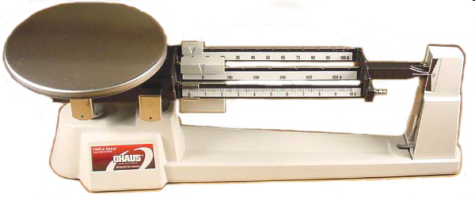
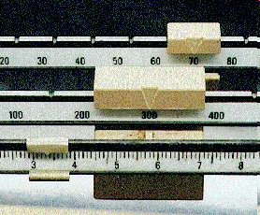
Measuring Mass
We will be using triple-beam balances (and electronic balances) to find the mass of various objects.
The objects are placed on the scale and then you move the weights on the beams until you get the lines on the right-side of the scale to match up.
Once you have balanced the scale, you add up the amounts on each beam to find the total mass.
What would be the mass of the object measured in the picture?
_______ + ______ + _______ = ________ g
Top Image: http://www.southwestscales.com/Ohaus_Triple_Beam_750-SO.jpg Bottom Image: http://www.regentsprep.org/Regents/biology/units/laboratory/graphics/triplebeambalance.jpg

Slide 10
Measuring Mass – Triple-Beam Balance
1st – Place the film canister on the scale.
2nd – Slide the large weight to the right until the arm drops below the line. Move the rider back one groove. Make sure it “locks” into place.
3rd – Repeat this process with the top weight. When the arm moves below the line, back it up one groove.
4th – Slide the small weight on the front beam until the lines match up.
5th – Add the amounts on each beam to find the total mass to the nearest tenth of a gram.
Click here to try an online activity.

Slide 11

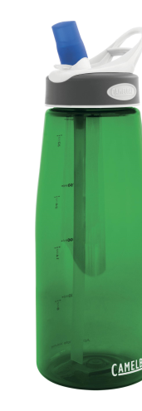
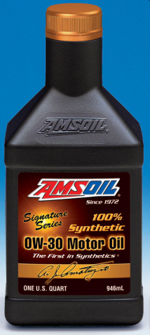
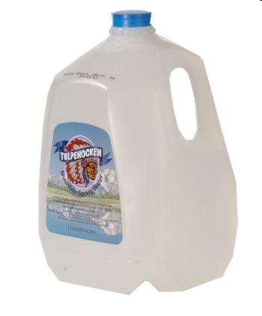
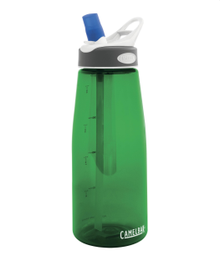
English vs. Metric Units
Which is larger?
A. 1 liter or 1 gallon
B. 1 liter or 1 quart
C. 1 milliliter or 1 fluid ounce
1 fl oz = 29.573 ml
1 12-oz can of soda would equal approximately 355 ml.
1 quart = 0.946 liters
1 gallon = 3.79 liters
It would take approximately 3 ¾ 1-liter bottles to equal a gallon.

Slide 12
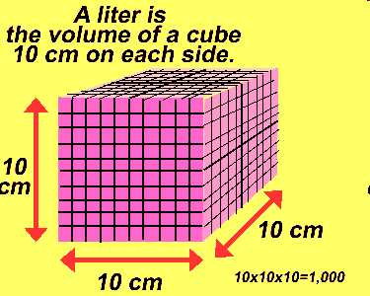
kL
Metric Units
L
cL
mL
Volume is the amount of space an object takes up.
The base unit of volume in the metric system in the liter and is represented by L or l.
Standard: 1 liter is equal to one cubic decimeter
Metric Units
1 liter (L) = 1000 milliliters (mL)
1 milliliter (mL) = 1 cm³ (or cc) = 1 gram*
Which is larger?
A. 1 liter or 1500 milliliters
B. 200 milliliters or 1.2 liters
C. 12 cm³ or 1.2 milliliters*

Slide 13
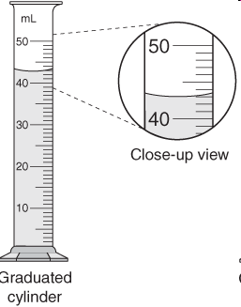
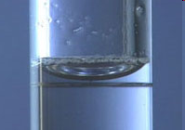
Measuring Volume
We will be using graduated cylinders to find the volume of liquids and other objects.
Read the measurement based on the bottom of the meniscus or curve. When using a real cylinder, make sure you are eye-level with the level of the water.
What is the volume of water in the cylinder? _____mL
What causes the meniscus?
A concave meniscus occurs when the molecules of the liquid attract those of the container. The glass attracts the water on the sides.
Top Image: http://www.tea.state.tx.us/student.assessment/resources/online/2006/grade8/science/images/20graphicaa.gif Bottom Image: http://morrisonlabs.com/meniscus.htm

Slide 14
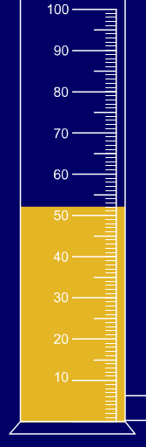
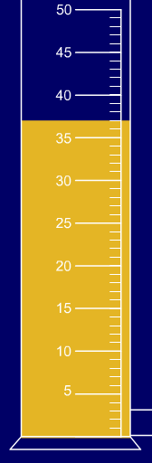
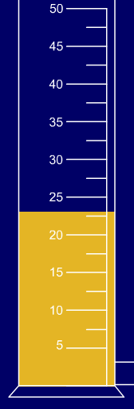
Measuring Liquid Volume
What is the volume of water in each cylinder?
Images created at http://www.standards.dfes.gov.uk/primaryframework/downloads/SWF/measuring_cylinder.swf
A
B
C
Pay attention to the scales for each cylinder.

Slide 15
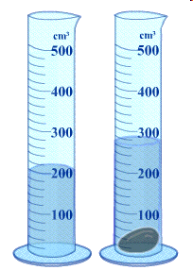
Measuring Solid Volume
We can measure the volume of regular object using the formula length x width x height.
9 cm
_____ X _____ X _____ = _____
8 cm
10 cm
We can measure the volume of irregular object using water displacement.
Amount of H₂O with object = ______ About of H₂O without object = ______ Difference = Volume = ______
http://resources.edb.gov.hk/~s1sci/R_S1Science/sp/en/syllabus/unit14/new/testingmain1.htm
Click here for an online activity about volume. Choose Lessons → Volume & Displacement

Slide 16
Other Common Metric Units
Density = Mass/volume
Time - second (s)
SI Unit for Temperature – Kelvin (K)
Temperature on a lab thermometer – Celsius (Cº)
Force/Weight – Newton (N)
Pressure – kiloPascal (kPa)
Power – Watt (W)
Energy – Joule (J)

Slide 17
Ladder Method
1
2
KILO 1000 Units
3
HECTO 100 Units
DEKA 10 Units
DECI 0.1 Unit
CENTI 0.01 Unit
MILLI 0.001 Unit
Meters Liters Grams
How do you use the “ladder” method?
4 km = _________ m
1st – Determine your starting point and ending point.
2nd – Count the “jumps” to your ending point.
3rd – Move the decimal the same number of jumps in the same direction.
Starting Point
Ending Point
How many jumps does it take?
4.
__.
__.
__.
= 4000 m
1
2
3

Slide 18
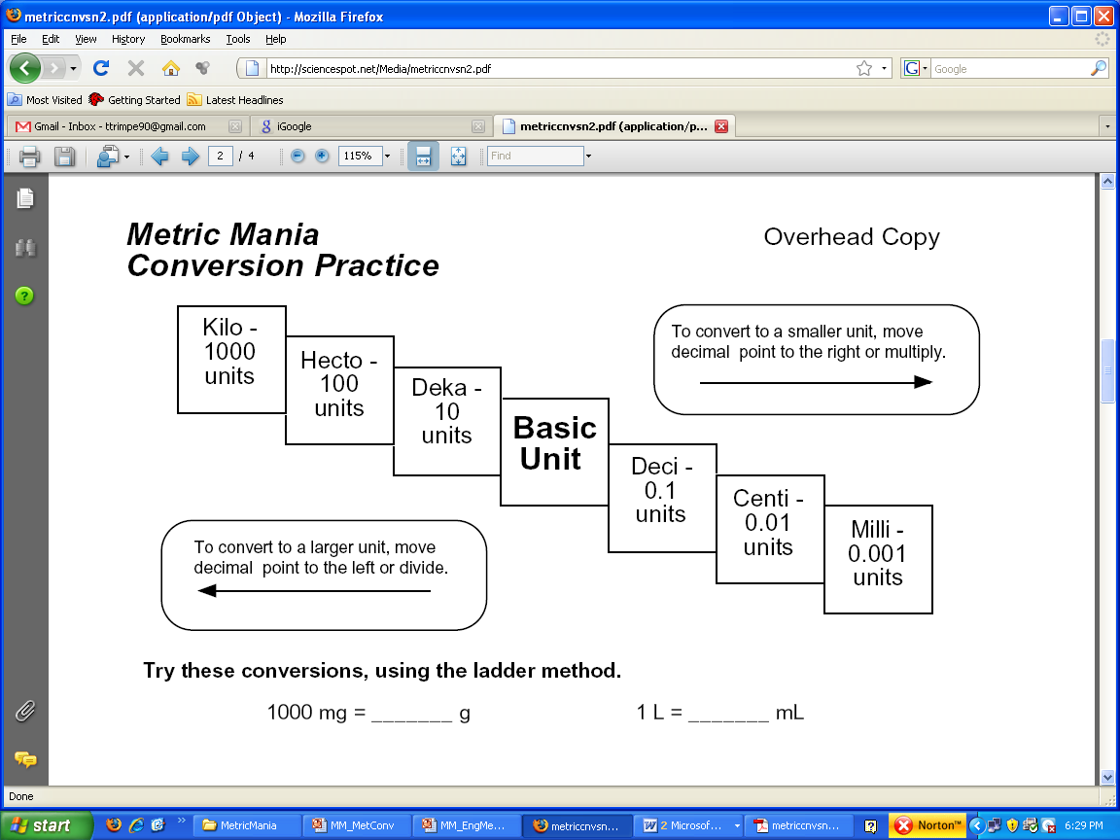
Conversion Practice
Try these conversions using the ladder method.
a) 1000 mg = _______ g b) 1 L = _______ mL c) 160 cm = _______ mm
d) 14 km = _______ m e) 109 g = _______ kg f) 250 m = _______ km
Compare using <, >, or =.
g) 56 cm 6 m h) 7 g 698 mg

Slide 19
Answers
a) 1 g b) 1000 mL c) 1600 mm
d) 14,000 m e) 0.109 kg f) 0.25 km
g) < h) >

