Slide 1
Scientific Measurement
Qualitative vs. Quantitative
Qualitative measurements give results in a descriptive nonnumeric form. (The result of a measurement is an _____________ describing the object.)
*Examples: ___________, ___________, long, __________...
The person looked like a drug user because his hands were shaking.
QuaNtitative measurements give results in Numeric form. (The results of a measurement contain a _____________.)
*Examples: 4’6”, __________, 22 meters, __________...
The man had 20kg of crack cocaine in his shaky hands.
adjective
short
heavy
cold
number
600 lbs.
5 ºC

Slide 2
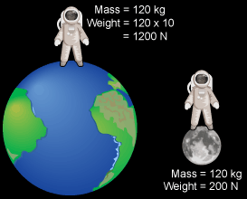
Mass vs. Weight
Mass depends on the amount of ___________ in the object.
Weight depends on the force of ____________ acting on the object.
______________ may change as you move from one location to another; ____________ will not.
You have the same ____________ on the moon as on the earth, but you ___________ less since there is less _________ on the moon.
matter
gravity
Weight
mass
Mass = 80 kg
Weight = 176 lbs.
mass
weigh
gravity
Mass = 80 kg
Weight = 29 lbs.

Slide 3
Measuring Temperature
Temperature is the ____________ or ____________ of an object.
The Celsius temperature scale is based on the freezing point and boiling point of __________.
F.P.= 0˚C B.P.= 100˚C
The Kelvin temperature scale, sometimes called the “absolute temp. scale”, is based on the ____________ temperature possible, absolute zero. (All molecular motion would __________.)
Absolute Zero = 0˚ Kelvin = −273˚ C
To convert from one temp. scale to another:
˚C = Kelvin − 273
K= Celsius + 273
Practice Problems: Convert the following
25˚C = _______ K
473 K = _______˚C
hotness
coldness
water
lowest
stop
298
(25 + 273)
200
(473 – 273)

Slide 4
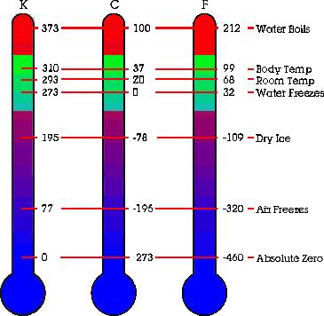
Temperature Scales
Liquid Nitrogen

