Slide 1
Significant Figures

Slide 2
Definition
Measures the degree
of confidence of a
measurement.

Slide 3
Includes all digits
that are known
accurately plus a
digit that is
estimated.

Slide 4
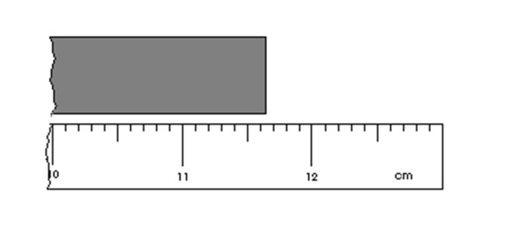
This means that you will be recording all the known measurements of the device and then estimate what the next number is.
We know that the object is 11.6 cm for sure. We can estimate that the last digit will be 5. So the object has a length of 11.65 cm.

Slide 5
Rules
Read the four rules given and answer the questions. These are the rules from the EOC Chemistry Chart. We can sum up the four rules into only TWO rules!!!

Slide 6
Rules
There are ONLY two
rules to remember to
tell the # of Sig Figs.

Slide 7
Ask yourself:
Is there a shown
decimal point?

Slide 8
Answer:YES
Count from first non-
zero number moving
from the left to the
right.

Slide 9
Examples
2.35
3 S.F.
0.2500
4 S.F.
100.25
5 S.F.

Slide 10
Examples
12.50
4 S.F.
0.0050
2 S.F.
0.0003
1 S.F.

Slide 11
Ask yourself:
Is there a shown
decimal point?

Slide 12
Answer:NO
Count from first non-
zero number moving
from the right to the
left.

Slide 13
Examples
135
3 S.F.
100
1 S.F.
10500
3 S.F.

Slide 14
Examples
350
2 S.F.
17500
3 S.F.
135.0
4 S.F.

Slide 15
Give the number of significant figures in each of the following measurements:
6
1. 1278.50 __________
2. 120000 __________
3. 90027.00 _________
7. 8.002 __________
43.050 __________
Now complete the rest of the worksheet on your own!!!
2
7
4
5

Slide 16
Rounding Numbers
Four or less
round down.

Slide 17
Round off the following numbers to three significant figures: (Hint: Put number in scientific notation.
1.20 x 10⁵
19. 120000 __________
20. 5.457 __________
21. 0.0008769 _________
22. 4.53619 __________
23. 43.659 __________
24 876493 __________
0.000877 or 8.77 x 10⁻⁴
5.46
4.54
43.7
876,000 or 8.76 x 10⁵

Slide 18
Using in calculations

Slide 19
Rules
There are ONLY two
rules to remember to
use S.F. in calculations

Slide 20
For multiplication and division.

Slide 21
Your answer can not be more accurate than the least accurate measurement.

Slide 22
Your answer MUST
have the same number
of sig figs as the least
number of sig figs.

Slide 23
Examples

Slide 24
135 x 32 = 4320
3 S.F.
2 S.F.
2 S.F.
Answer must be 4300
it has 2 sig figs.

Slide 25
610 x 6.20 = 3782
2 S.F.
3 S.F.
3800
What is the correct answer?

Slide 26
Multiplication & Division Examples:
330 or 3.2 x 10²
25. 23.4 x 14 _______________
27. 0.0945 x 1.47 _______________
29. 7.895 / 34 _______________
30. 0.2 / 0.0005 _______________
0.139 or 1.39 x 10⁻¹
0.23 or 2.3 x 10⁻¹
400 or 4 x 10²

Slide 27
For addition and subtraction

Slide 28
Your answer can not contain more decimal points than the least accurate measurement.

Slide 29
Line up the decimal points in the numbers.
2.515 + 1.3 +12.00 =????

Slide 30
2.515
1.3
+ 12.00
15.815
Answer stops here

Slide 31
Addition and Subtraction Examples:
26. 7.895 + 3.4 _______________
28. 0.005 - 0.0007 _______________
11.3
0.004

Slide 32
Scientific notation

Slide 33
Any number written
correctly in Sci. Not.
before the times sign
must be a SIG FIG.

Slide 34
Examples
3.50 x 10²³
3 S.F.
5.0 x 10 ⁻⁴
2 S.F.
3 x 10⁻⁴
1 S.F.

Slide 35
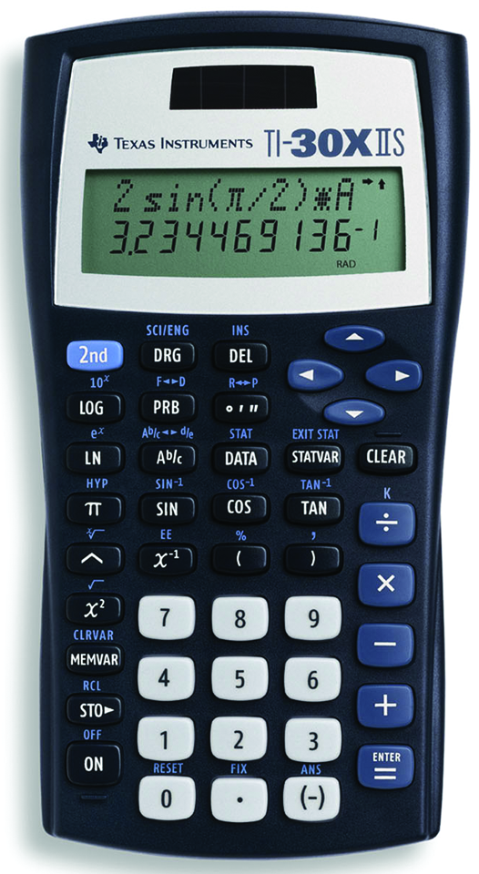
Using A Calculator
[2nd] [SCI] = regular notation to scientific notation
To convert a number from regular notation to scientific notation:
Example: enter .00163 then hit [2nd] [SCI] and arrow over to SCI and press enter twice. The display will read 1.63 x 10 ⁻⁰³.

Slide 36
Using A Calculator
[2nd] [FLO] = scientific notation to regular notation
To convert a number from scientific notation to regular notation:
Example: The display reads 1.63 x 10 ⁻⁰³. Press [2nd] [SCI] and arrow over to FLO and press enter. The display will read 0.00163

Slide 37
Using A Calculator
EE = scientific notation
How to put a number that is in scientific notation into the calculator
Example: to enter 6.02 x 10²³ type [6.02][2nd][EE] [23]. The display will read 6.02E23. DO NOT ENTER x 10!!!

Slide 38
Calculator Practice
Practice putting numbers in scientific notation into the calculator. See if you get the same answer.
2.78 x 10⁷
1) 2.73 x 10⁷ + 4.78 x 10⁵ =
2) 9.90 x 10⁻⁵ x 3.3 x 10⁻⁴ =
3.267 x 10⁻⁸

