Slide 1
Density
Density is a ___________ of an object’s mass and its volume.
Density does not depend on the _________ of the sample you have. (Intensive property)
The density of an object will determine if it will float or sink in another phase. If an object floats, it is _______ dense than the other substance. If it sinks, it is ________ dense.
The density of water is 1.0 g/mL, and air has a density of 0.00129 g/mL (or 1.29 g/L).
Density = Mass/Volume
ratio
size
less
more
m
Mass = D x V
Volume = m/D
X
D
V
Density = m/V

Slide 2
Methods to Find Density
Measurement
Water Displacement
Density Column
Solve

Slide 3
Water Displacement
A solid displaces a matching volume of water when the solid is placed in water.
33 mL
25 mL

Slide 4
Learning Check
What is the density (g/mL) of 48 g of a metal if the metal raises the level of water in a graduated cylinder from 25 mL to 33 mL?
1) 0.2 g/mL 2) 6 g/mL 3) 252 g/mL
33 mL
25 mL

Slide 5
Solution
6 g/cm³
Volume (mL) of water displaced
= 33 mL - 25 mL = 8 mL
Density of metal =
mass = 48 g = 6 g/mL volume 8 mL

Slide 6
Density Column
Which diagram represents the liquid layers in the cylinder?
(K) Karo syrup (1.4 g/mL),
(V) vegetable oil (0.91 g/mL,)
(W) water (1.0 g/mL)
1) 2) 3)
V
W
K
V
W
K
V
W
K

Slide 7
Solution
(K) Karo syrup (1.4 g/mL), (V) vegetable oil (0.91 g/mL,) (W) water (1.0 g/mL)
1)
V
W
K

Slide 8
Density
Practice Problems:
The density of gold is 19.3 g/cm³. How much would the mass of a bar of gold be? Assume a bar of gold has the following dimensions: L= 27 cm W= 9.0 cm H= 5.5 cm
Steps to solve:
1. Volume = L x W x H
Volume = 27 x 9.0 x 5.5 = 1336.5 cm³
2. Mass = D x V
mass = 19.3 g/cm³ x 1336.5 cm³ = 25,794.45 g

Slide 9
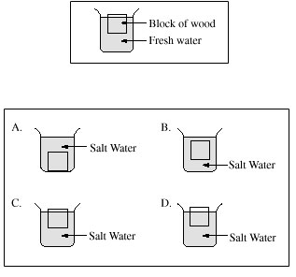
Density
Practice Problems:
(2) Which picture shows the wood
block’s position when placed in
salt water?
(3) Will the following object float in water? Yes or No
Object’s mass = 27 g
Object’s volume= 25 mL
Density = 27 g / 25 mL = 1.08 g/mL
No! It will sink because density > 1.00

Slide 10
Density
Density is an
INTENSIVE property
of matter.
- does NOT depend
on quantity of
matter.
- color, melting point, boiling point, odor, density
Styrofoam
Brick
Contrast with
EXTENSIVE
- depends on
quantity of matter.
- mass, volume, heat content (calories)

Slide 11
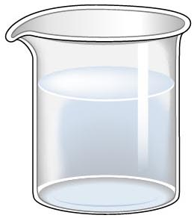
Properties of Matter
Pyrex
Pyrex
Extensive
Properties
volume:
100 mL
15 mL
mass:
99.9347 g
14.9902 g
Intensive
Properties
density:
0.999 g/mL
0.999 g/mL
temperature:
20ºC
20ºC
http://antoine.frostburg.edu/chem/senese/101/matter/slides/sld001.htm
Notes:
http://antoine.frostburg.edu/chem/senese/101/matter/slides/sld001.htm

Slide 12
It appears that the brick is ~40x
more dense than the Styrofoam.
?
Styrofoam
Brick
Notes:
Ask the students, "which weighs more...a ton of feathers or a ton of bricks?" You'll be surprised how many will answer "the bricks!"
The students are confusing / misusing the terms density and mass.

Slide 13
Styrofoam
Brick
M
M
D
D
=
=
V
V
Styrofoam
Brick

Slide 14
Which liquid has the highest density?
least dense 1 < 3 < 5 < 2 < 4 most dense
1
3
2
5
4
Coussement, DeSchepper, et al. , Brain Strains Power Puzzles 2002, page 16

Slide 15
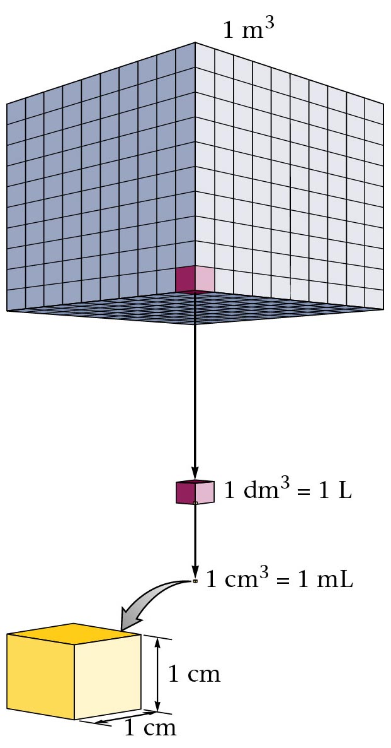
Cube Representations
1 m³ = 1 000 000 cm³
Zumdahl, Zumdahl, DeCoste, World of Chemistry 2002, page 119

Slide 16
Volume and Density
Relationship Between Volume and Density for Identical Masses of Common Substances
Cube of substance Mass Volume Density
Substance (face shown actual size) (g) (cm³) (g/cm³)
Lithium
Water
Aluminum
Lead
10 19 0.53
10 10 1.0
10 3.7 2.7
10 0.58 11.4
Notes:
Density is a derived unit.
Mathematically: Density = ^{mass} / _{volume}
Density is an intensive property of matter.
Water has a density (specific gravity) of 1 g/mL.
Substances with a density greater than 1 g/mL will sink in water.
Substances with a density less than 1 g/mL will float in water.

Slide 17
Density of Some Common Substances
Density of Some
Common Substance
Substance Density
(g / cm³)
Air 0.0013*
Lithium 0.53
Ice 0.917
Water 1.00
Aluminum 2.70
Iron 7.86
Lead 11.4
Gold 19.3
*at 0ºC and 1 atm pressure

Slide 18
Consider Equal Volumes
Mass
Density =
Volume
Equal volumes…
…but unequal masses
The more massive object
(the gold cube) has the
_________ density.
GREATER
aluminum
gold
Dorin, Demmin, Gabel, Chemistry The Study of Matter , 3rd Edition, 1990, page 71
Notes:
Question: Which weighs more a ton of feathers or a ton of bricks?
(They weigh the same)
Question: Which occupies a larger volume; a ton of feathers or a ton of bricks?
(the feathers will occupy a larger volume)

Slide 19
Consider Equal Masses
Equal masses…
…but unequal volumes.
The object with the
larger volume
(aluminum cube) has
the density.
gold
aluminum
smaller
Christopherson Scales
Made in Normal, Illinois USA
Dorin, Demmin, Gabel, Chemistry The Study of Matter , 3rd Edition, 1990, page 71

Slide 20
Consider Equal Masses
Equal masses…
…but unequal volumes.
The object with the
larger volume
(aluminum cube) has
the density.
gold
aluminum
smaller
Christopherson Scales
Dorin, Demmin, Gabel, Chemistry The Study of Matter , 3rd Edition, 1990, page 71

Slide 21
Two ways of viewing density
(A)
Equal volumes…
…but unequal masses
The more massive object
(the gold cube) has the
greater density.
aluminum
gold
Equal masses…
…but unequal volumes.
gold
(B)
aluminum
The object with the
larger volume
(aluminum cube) has
the smaller density.
Dorin, Demmin, Gabel, Chemistry The Study of Matter , 3rd Edition, 1990, page 71
Notes:
“Two Ways of Viewing Density”
Description
This slide illustrates (density) = ^{mass} / _{volume} relationships for gold and aluminum.
Basic Concepts
Density is an intensive property, that it, it does not depend on the size of the sample.
The density of an object can be calculated using the following formula: density = ^{mass} / _{volume}.
The density of a substance changes with changes in temperature.
Teaching Suggestions
Use this slide to review the definition of density. Remind students that density is an intensive property. Review the equation for calculating the density of a sample.
Point out that density describes the relationship between the mass and the volume of a sample.
To make this concept more concrete, use numbers with the concept of density. In the case of aluminum and gold, there is less mass in 1 cm³ of aluminum (2.7 grams) than in 1 cm³ of gold (19.3 grams). Put another way, 1 gram of aluminum occupies a larger volume (0.37 cm³) than 1 gram of gold (0.05 cm³).
Questions
1. What does diagram (A) show about density?
2. What does diagram (B) show about density?
3. Would a knowledge of density be useful in
a. Choosing a material with which to construct a 10-kilogram barbell?
b. Selecting a head of lettuce that will give you the most lettuce for your money if lettuce sells for 99 cents a head?
c. Predicting whether an object would float or sink in water?
For each, explain why or why not.
4. Suppose a 20-gram cube of aluminum were cut into four equal parts. How would the density of one part be related to the density of the whole cube?
5. Metals expand when heated. If gold is heated, what will happen to its density? Explain.
6. The density of ice is 0.9 g/cm³, and the density of water is 1.0 g/cm³. Suppose a glass containing ice is filled with water so the ice is even with the rim of the glass. As the ice melts, would you expect any water to spill out of the glass? Why or why not?

Slide 22


Specific Gravity
0.25
cork
0.9
ice
water 1.0
aluminum
2.7
Jaffe, New World of Chemistry, 1955, page 66
Notes:
Specific gravity
A quantity that is very closely related to density, and which is frequently used in its place, is specific gravity.
Specific gravity is the ratio of the mass of a material to that of an equal volume of water. Because the density of water is about 1.00 g mL^{–1}, the specific gravity is numerically very close to that of the density, but being a ratio, it is dimensionless.
The relationship of specific gravity and buoyancy. Aluminum has a specific gravity greater than that of water and does not float. Ice has a specific gravity slightly less than that of water and floats largely submerged. Cork has a low specific gravity and floats with most of its mass above water. The weight of the ice and cork push down, while a buoyant force lifts the objects upward. The aluminum’s weight is larger than the buoyant force of the water.
Specific gravity is relative to water that is 1.0 g/mL.
Note: 90% of the ice is submerged below the water (its specific gravity is 0.9)
and 25% of the cork is below the water (its specific gravity is 0.25).

Slide 23
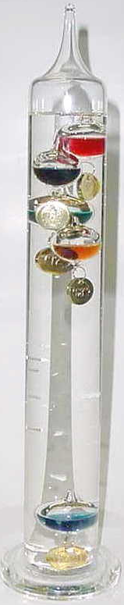
Galilean Thermometer
Density = Mass / Volume
Mass is constant
Volume changes with temperature
  Increase temperature → Increase volume
Temp = 68 ºC

Slide 24
Galilean Thermometer
In the Galilean thermometer, the small glass bulbs are partly filled with a different (colored) liquid. Each is filled with a slightly different amount, ranging from lightest at the uppermost bulb to heaviest at the lowermost bulb. The clear liquid in which the bulbs are submerged is not water, but some inert hydrocarbon (probably chosen because its density varies with temperature more than that of water does).
The correct temperature is the lowest floating bulb. As temperature increases, density of the clear medium decreases (and bulbs sink).
76ºF 68 ºF
80º
80º
76º
76º
72º
72º
68º
68º
64º
64º

