Slide 1
Matter Properties & Changes
Matter vs. Mass
Matter is anything that has _________ and takes up ___________.
Examples: ________, __________, and ________... (the three states of matter)
Things that are NOT matter: __________, heat, ________, sound...
A. Mass is the amount of ___________ contained in an object.
B. Weight is the measure of ___________ pulling on a certain mass.
C. ____________ is the amount of space an object occupies.
The standard metric unit for mass is the ______________.
mass
space
solids
liquids
gases
light
emotions
matter
gravity
Volume
kilogram

Slide 2
Physical Properties and Chemical Properties
Properties of matter describe what can be observed or how a substance behaves.
A. Physical properties can be determined/measured without changing the substance’s composition.
Examples: _______, odor, __________, mass, ________, _________ point, ____________ point, hardness, solubility, malleability, ductility, etc.
color
taste
density
boiling
melting
Substance | State | Color | Melting Point (°C) | Boiling Point (°C) | Density (g/mL)
Chlorine | Gas | Greenish-yellow | -101 | -34 | 0.0032
Water | Liquid | Colorless | 0 | 100 | 1.00
Sodium chloride | Solid | White | 801 | 1413 | 2.17

Slide 3
Physical Properties can be:
II. Intensive vs. Extensive Properties
Intensive Properties – DO NOT depend on the ___________________ of matter present (examples: density, temperature, malleability, conductivity, boiling point, crystal shape)
Extensive Properties – DO depend on the ________________________ of matter present (examples: length, mass, volume, heat content)
shape or size
Shape and size
B. Chemical properties cannot be determined/measured without changing the substance’s composition
Examples: ____________, whether or not it reacts with an acid or a base, flammability, rusting, rotting, decaying, tarnishes
burning

Slide 4
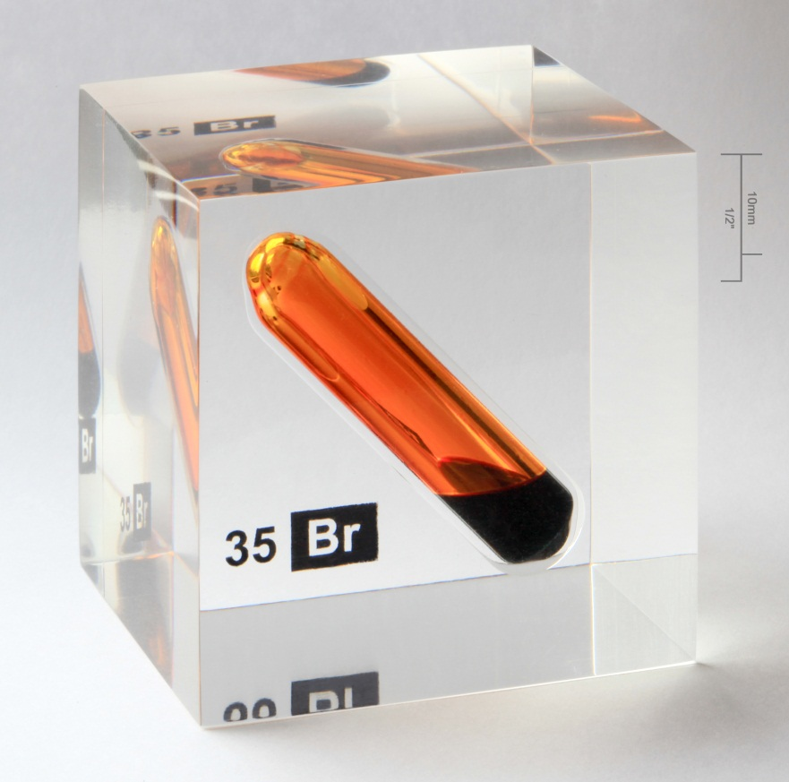
Physical vs. Chemical Properties
Ex) Physical & chemical properties of bromine
Physical Properties
Orange-brown color
Fuming liquid
Boiling point = 58∘C
Chemical Properties
Ability to corrode tissue upon contact
Ability to react with metals to from salts
Ability to react with hydrogen ions in aqueous solutions to form hydrobromic acid
By Alchemist-hp (pse-mendelejew.de) (Own work) [FAL or CC-BY-SA-3.0–de]
Notes:
Let’s practice distinguishing the physical properties from the chemical properties of a substance. For example, let’s determine some of the chemical and physical properties of the element bromine. Some physical properties of bromine include its orange–brown color, its state as a fuming liquid, and its boiling point at 58∘C. Some of its chemical properties include its ability to corrode tissue upon contact, react with metals to form salts, and react with hydrogen ions in aqueous solutions to form hydrobromic acid.

Slide 5
Physical Change vs. Chemical Change
A. Physical Changes alter a substance without changing its composition.
Examples: crushing, ripping, breaking, and any _________ changes…(boiling, freezing, melting, etc.)
Most physical changes just alter the size of the particles and are usually reversible.
A very common set of physical changes are changes of state:
Solid to liquid = ____________________ (Ex: Ice to Water)
Liquid to Solid = ____________________ (Ex: Water to Ice)
Liquid to Gas = ____________________
Fast = ____________________ Slow = ________________________
Gas to Liquid = ____________________ (Ex: Morning Dew)
Solid to gas = ____________________ (Ex: Dry Ice “clouds”)
phase
melting
freezing
evaporation
vaporization
evaporation
condensation
sublimation

Slide 6
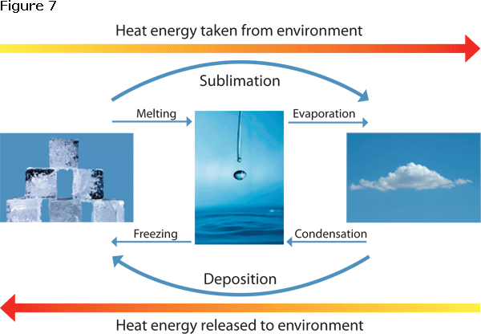
Physical Changes: Names of the Phase Changes
Solid
Gas
Liquid
Solid→Aqueous = ___________ Aqueous → Solid = ___________
dissolving
crystallizing

Slide 7
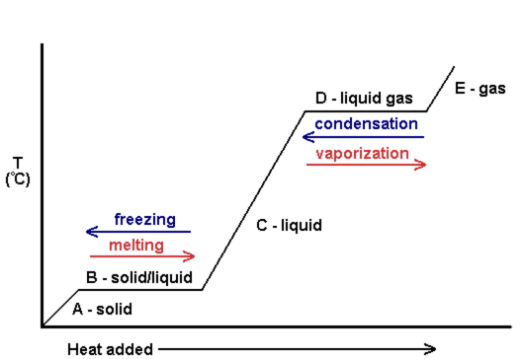
Phase Change Diagram Changes of state occur as temperature increases

Slide 8
Physical Changes Continued
Changes in _____________ or _______________ (stretching, flattening, crushing)
Mixtures result from physical changes and can be separated again by _______________ methods.
Solutions – can be separated by distillation - __________________ the water and leaving the solid particles behind.
Particles suspended in water can be separated by _________________.
size
shape
physical
boiling off
filtration

Slide 9
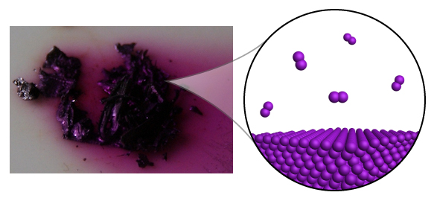
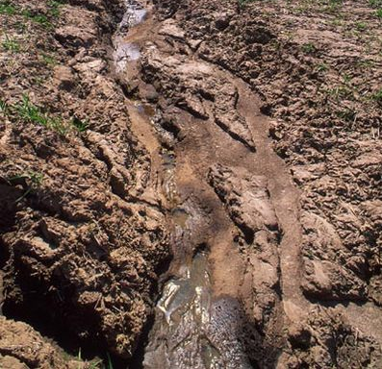
Physical Change
Physical change – transformation that does not change the chemical composition of the material
Change of state
Melting
Freezing
Vaporization
Condensation
Deposition
Sublimation
Change in position
Ex) Sublimation of iodine
Ex) Erosion
Notes:
A physical change is a transformation that does not change the chemical composition of the material.
Changes of state are some of the most common physical changes and include the following: melting, freezing, vaporization, condensation, deposition, and sublimation. For example, the sublimation of iodine is a physical change. Although the state of iodine is changing from solid to gas, the chemical composition of the iodine does not change.
Another common type of physical change is the change in position of a material. You can alter the position of materials, moving or breaking them up, without changing their chemical composition. An example of this type of change in nature is erosion. Erosion is the change in position of rocks and soil due to the movement of water. Though the soil has been moved, its chemical make up has not changed.

Slide 10
Chemical Changes
Chemical Change – a new ______________________ is formed
Chemical changes are irreversible. Ex: You can’t “reverse” the burning of paper.
Evidence of a chemical change includes:
A change in ________________ occurs.
Bubbles are released (indicating that a new ___________ has formed).
A precipitate forms (small particles ___________ from a solution)
The temperature _______________ or ________________ ( with no external
heat source)
A new ___________ is present in the air.
The substance just ____________ different.
A change in color.
substance
composition
gas
form
gets hot
gets cold
odor
looks

Slide 11
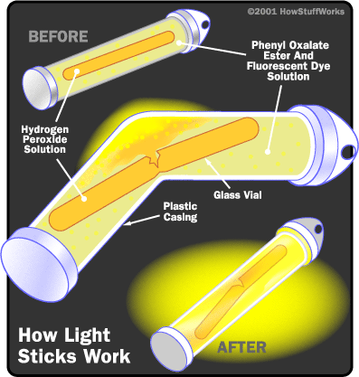
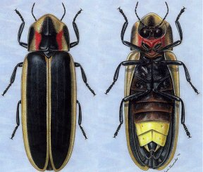
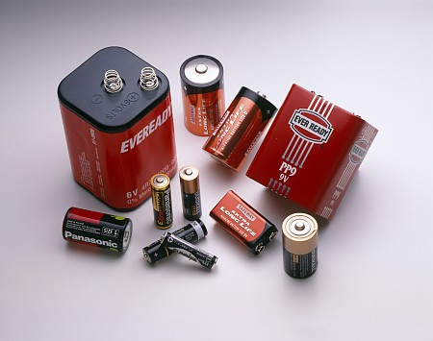
Indications of Chemical Reactions
1) ________ is produced: (________)
2) ________ is produced: (_____________ bugs/_____________)
3) ______________ is produced:
(______________)
Heat
matches
Light
lightning
fireflies
Electricity
batteries

Slide 12
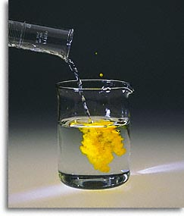

Indications of Chemical Reactions
4) ___________________ forms: (_______ ________)
5) gas/smoke/odor/bubbles produced:
(________ ______)
Precipitate
soap scum
Two liquids chemically react to form a solid.
Gas Forms

Slide 13
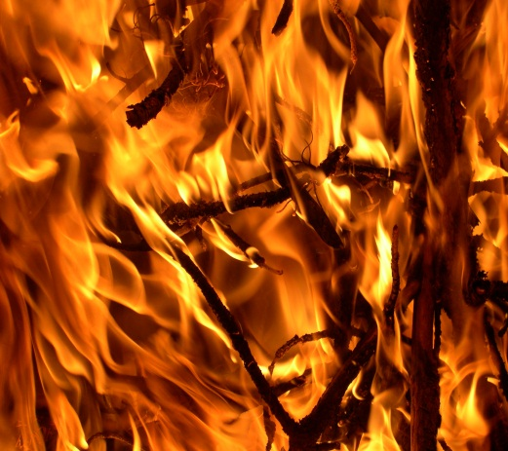
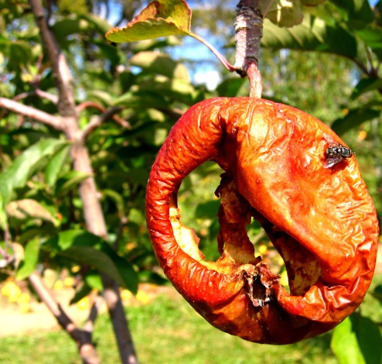
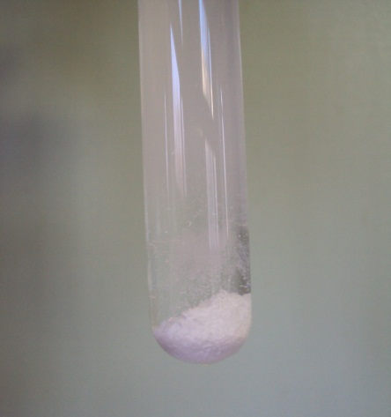
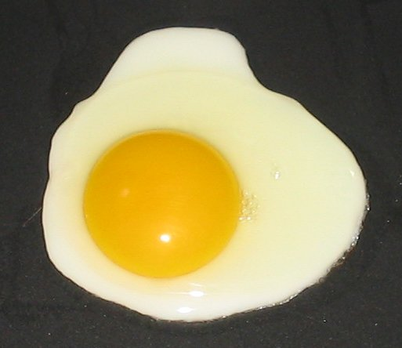
Chemical Change
Signs of chemical change
Light or heat is absorbed or released
Change in color or odor
Production of a gas or solid from a liquid
Precipitate – a solid that forms from a reaction between liquids
Irreversibility
I, MarcusObal [GFDL ]
Nickomargolies [GFDL ]
By Dr.T (Own work) [CC-BY-SA-3.0 ]
Notes:
Since chemical reactions form new substances, the products of a chemical reaction will have different properties than the original substances. These changes in properties are signs that chemical changes have occurred. Typically, a chemical change will exhibit several of the following signs.
Chemical change often causes light or heat, which are both forms of energy, to be absorbed or released. An example of this is the chemical change that occurs when wood is burned, giving off energy in the form of heat and light.
Another potential sign of chemical change is a change in color or odor. For example the chemical change that occurs as food rots displays both these signs. When food rots, the reaction converts the original substances in the food to new substances that have fowl odors and a brown color.
The production of a gas or solid from a liquid can also signify that a chemical change has occurred. A precipitate is a solid that forms from the reaction between liquids. An example of a chemical reaction in which a precipitate is formed is the reaction between silver nitrate solution and potassium chloride solution. When the two substances react an insoluble solid is formed and sinks to the bottom of the reaction vessel. An example of a chemical reaction that produces gas is the reaction between baking soda and vinegar.
Another sign that often accompanies chemical change is irreversibility. For example, the chemical changes that occur when food is cooked cannot be reversed. Once the food is cooked it can no longer be return to its original composition.
The presence of one of the signs listed here does not guarantee that a chemical change took place, but the presence of more than one signifies that a chemical change most likely took place.

Slide 14
Conservation of Mass
During chemical (or physical) reactions, mass (or matter) is neither _____________ nor _________________.
The mass of all the reactants _________ the mass of all the products.
The ___________ of each kind of atom is the same.
Sometimes it appears that the reactant and product masses are not equal, but a _______ was probably a reactant or product in the reaction, and that is making the difference!
Example: 2H₂ + O₂ → 2H₂O
If 4 grams of hydrogen reacted with oxygen to produce 36 grams of water, how many grams of oxygen were used? _______
Notice that the ____ of H’s and O’s on each side is __________!
created
destroyed
equals
number
gas
32
#
constant

Slide 15
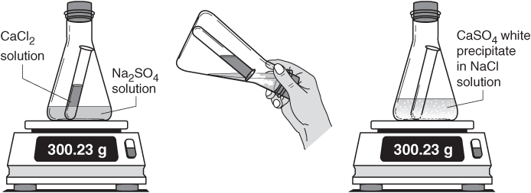
Conservation of Mass
CaCl₂ + Na₂SO₄ → CaSO₄ + 2NaCl
mass before = mass after
# atoms before = # atoms after

