Slide 1
Unit 4: Development of Atomic Theory
#1 PPT
Notes:
1

Slide 2
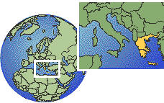
The Greeks
History of the Atom
Not the history of atom, but the idea of the atom
In 400 B.C the Greeks tried to understand matter (chemicals) and broke them down into earth, wind, fire, and air.
Democritus and Leucippus Greek philosophers
∼
∼
2
Notes:
2

Slide 3
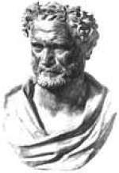
Democritus
DEMOCRITUS (400 BC) – First Atomic Hypothesis
Atomos: Greek for “uncuttable”. Chop up a piece of matter until you reach the atomos.
Properties of atoms:
  indestructible.
  changeable, however, into different forms.
  an infinite number of kinds so there are an infinite number of elements.
  hard substances have rough, prickly atoms that stick together.
  liquids have round, smooth atoms that slide over one another.
  smell is caused by atoms interacting with the nose – rough atoms hurt.
  sleep is caused by atoms escaping the brain.
  death – too many escaped or didn’t return.
  the heart is the center of anger.
  the brain is the center of thought.
  the liver is the seat of desire.
“Nothing exists but atoms and space, all else is opinion”.
3
Notes:
3

Slide 4
Dalton Model of the Atom
Late 1700’s - John Dalton- England
Teacher- summarized results of his experiments and those of others
Combined ideas of elements with that of atoms in Dalton’s Atomic Theory
4
Notes:
4
Objective: To describe the Dalton model of the atom.
John Dalton (1766 -1844) established a continuing tradition of chemical atomism.

Slide 5
The First Atomic Theory of Matter
In 1803, Dalton proposed that elements consist of individual particles called atoms.
His atomic theory of matter contains four hypotheses:
    1. All matter is composed of tiny particles called atoms.
    2. All atoms of an element are identical in mass and
    fundamental chemical properties.
    3. Atoms of different elements chemically combine to form
    chemical compounds. A chemical compound is a
    substance that always contains the same atoms in the
    same ratio.
    4. In chemical reactions, atoms from one or more
    compounds or elements redistribute or rearrange in
    relation to other atoms to form one or more new
    compounds. Atoms themselves do not undergo a
    change of identity in chemical reactions.
5
Copyright © 2007 Pearson Benjamin Cummings. All rights reserved.
Notes:
5

Slide 6
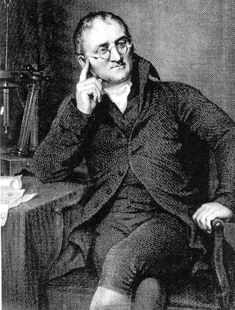
Daltons Atomic Theory
Dalton stated that elements consisted of tiny particles called atoms
He also called the elements pure substances because all atoms of an element were identical and that in particular they had the same mass.
6
Notes:
6

Slide 7
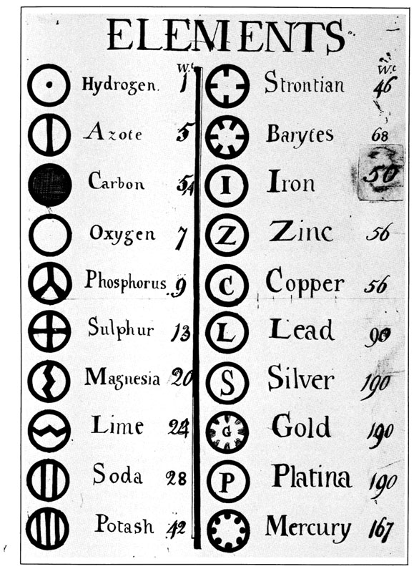
Dalton’s Symbols
John Dalton
1808
7
Notes:
7
Jons Jakob Berzelius (1799 -1848) Swedish chemist who invented modern chemical symbols.
Berzelius discovered the elements silicon, selenium, cerium, and thorium.

Slide 8
Thomson Model of the Atom
J. J. Thomson - English physicist. 1897
Made a piece of equipment called a cathode ray tube.
It is a vacuum tube - all the air has been pumped out.
8
Notes:
8
Objectives:
To describe the Thomson plum-pudding model of the atom.
To state the relative charge on an electron and a proton.

Slide 9
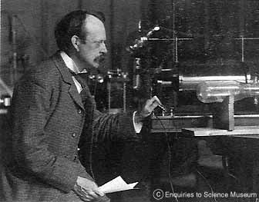
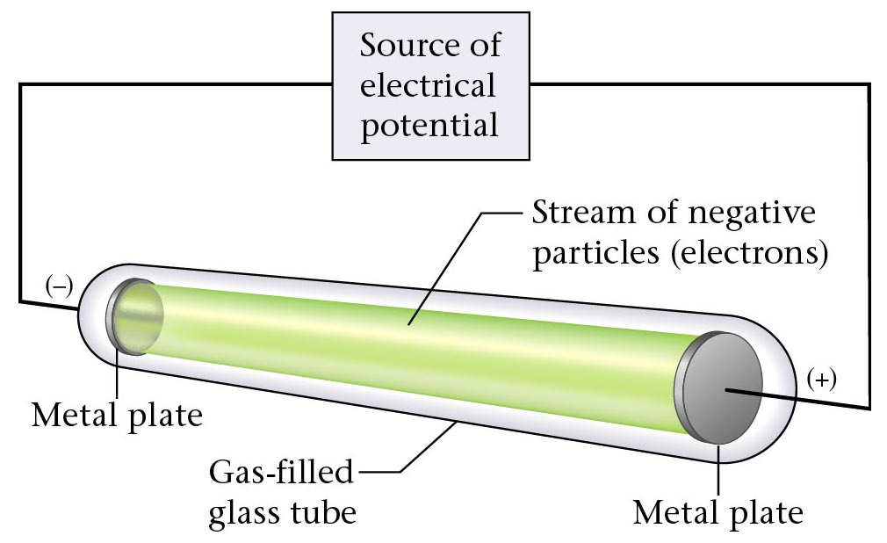
A Cathode Ray Tube
9
Zumdahl, Zumdahl, DeCoste, World of Chemistry 2002, page 58
Notes:
9

Slide 10
Thomson’s Experiment
voltage
source
-
+
vacuum tube
metal disks
10
Notes:
10
J. J. Thomson - English physicist. 1897
Made a piece of equipment called a cathode ray tube.
It is a vacuum tube - all the air has been pumped out.

Slide 11
Thomson’s Experiment
ON
voltage
source
-
OFF
+
Passing an electric current makes a beam appear
to move from the negative to the positive end
11
Notes:
11

Slide 12
Thomson’s Experiment
ON
voltage
source
-
OFF
+
+
-
By adding an electric field (magnet)…
he found that the ray bent toward the positive end of a magnet, and away from the negative end.
12
Notes:
12

Slide 13
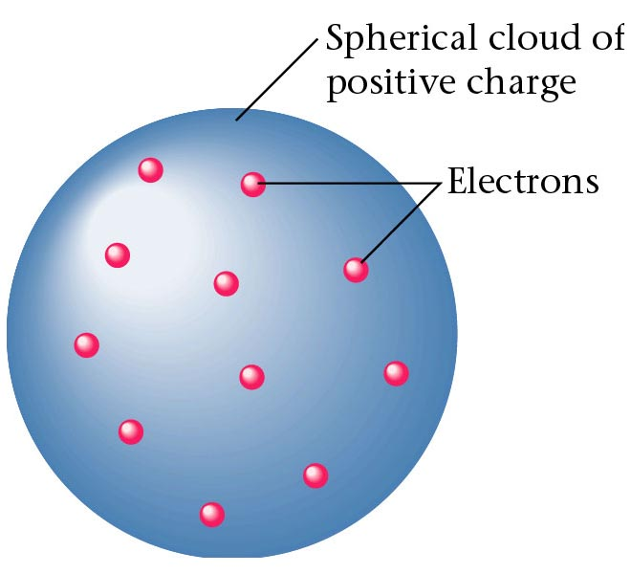
Thomson’s Plum-Pudding Model
13
Zumdahl, Zumdahl, DeCoste, World of Chemistry 2002, page 56
Notes:
13

Slide 14
Thomson Model of the Atom
J.J. Thomson discovered the electron and knew that electrons could be emitted from matter (1897).
William Thomson proposed that atoms consist of small, negative electrons embedded in a massive, positive sphere.
The electrons were like raisins in a plum pudding.
This is called the ‘plum pudding’ model of the atom.
-
-
electrons
-
-
-
-
-
-
14
Notes:
14
Found the electron
Couldn’t find (proton) positive (for a while)
Said the atom was like plum pudding
…. bunch of positive stuff, with the electrons able to be removed.

Slide 15
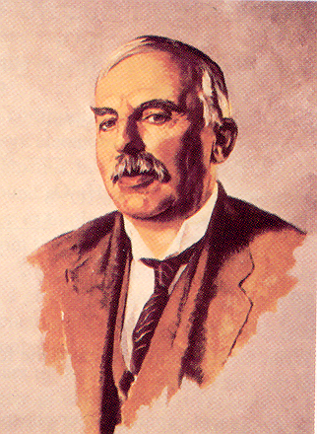
Ernest Rutherford (1871-1937)
Rutherford
PAPER
Learned physics in J.J. Thomson’s lab.
Noticed that ‘alpha’ particles were sometimes deflected by something in the air.
Gold-foil experiment
15
Animation by Raymond Chang – All rights reserved.
Notes:
15
Ernest Rutherford received the Nobel Prize in chemistry (1908) for his work with radioactivity.
Ernest Rutherford (1871-1937) was born in Nelson, New Zealand in 1871. He began work in J.J. Thompson’s laboratory in 1895. He later moved to McGill University in Montreal
where he became one of the leading figures in the field of radioactivity. From 1907 on he was professor at the University of Manchester where he worked with Geiger and Marsden. He was awarded the Nobel Prize for Chemistry in 1908 for his work on radioactivity. In 1910, with co-workers Geiger and Marsden he discovered that alpha-particles could be deflected by thin metal foil. This work enabled him to propose a structure for the atom. Later on he proposed the existence of the proton and predicted the existence of the neutron. He died in 1937 and like J.J. Thompson is buried in Westminster Abbey. He was one of the most distinguished scientists of his century.
Is the Nucleus Fundamental?
Because it appeared small, solid, and dense, scientists originally thought that the nucleus was fundamental. Later, they discovered that it was made of protons (p+), which are positively charged, and neutrons (n), which have no charge.

Slide 16
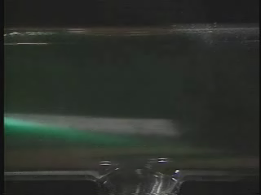
Rutherford ‘Scattering’
In 1909 Rutherford undertook a series of experiments
He fired α (alpha) particles at a very thin sample of gold foil
According to the Thomson model the α particles would only
be slightly deflected
Rutherford discovered that they were deflected through large angles and could even be reflected straight back to the source
Lead collimator
Gold foil
α
particle
source
θ
16
Notes:
16
Rutherford’s results strongly suggested that both the mass and positive charge are concentrated in a tiny fraction of the volume of the atom, called the nucleus.
Rutherford established that the nucleus of the hydrogen atom was a positively charged particle, which he called a proton.
Also suggested that the nuclei of elements other than hydrogen must contain electrically neutral particles with the same mass as the proton.
The neutron was discovered in 1932 by Rutherford’s student Chadwick.
Because of Rutherford’s work, it became clear that an α particle contains two protons and neutrons—the nucleus of a helium atom.

Slide 17

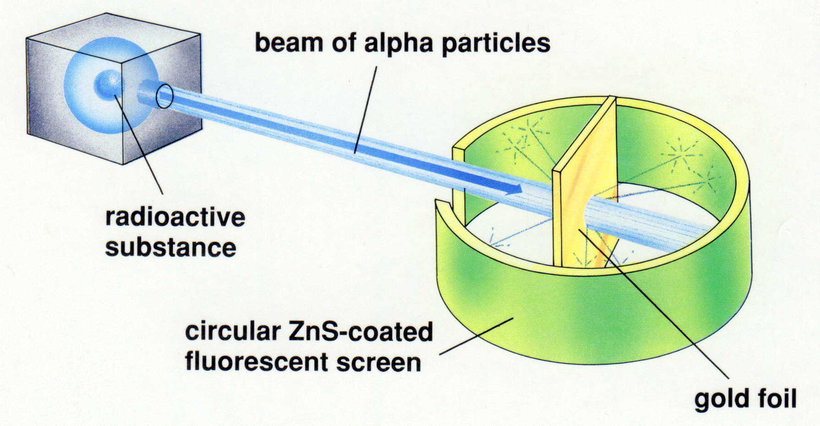
Rutherford’s Apparatus
Rutherford received the 1908 Nobel Prize in Chemistry for his pioneering work in nuclear chemistry.
beam of alpha particles
radioactive
substance
circular ZnS - coated
fluorescent screen
gold foil
17
Dorin, Demmin, Gabel, Chemistry The Study of Matter , 3rd Edition, 1990, page 120
Notes:
17
MODERN ALCHEMY
“Ernest Rutherford (1871-1937) was the first person to bombard atoms artificially to produce transmutated elements. The physicist from New Zealand described atoms as having a central nucleus with electrons revolving around it. He showed that radium atoms emitted “rays” and were transformed into radon atoms. Nuclear reactions like this can be regarded as transmutations – one element changing into another, the process alchemists sought in vain to achieve by chemical means.”
Eyewitness Science “Chemistry” , Dr. Ann Newmark, DK Publishing, Inc., 1993, pg 35
When Rutherford shot alpha particles at a thin piece of gold foil, he found that while most of them traveled straight through, some of them were deflected by huge angles.

Slide 18
What he expected…
18
Notes:
18

Slide 19
Because he thought the mass was evenly distributed in the atom
-
-
-
-
-
-
-
-
-
-
-
-
-
-
-
-
-
-
-
-
-
-
-
-
-
-
-
-
-
-
-
-
-
-
-
-
-
-
-
-
-
-
-
-
-
-
-
-
-
-
19
Notes:
19

Slide 20
What he saw…
richocheting
alpha particles
20
Notes:
20

Slide 21
The Predicted Result:
expected
path
expected
marks on screen
Observed Result:
mark on
screen
likely alpha
particle path
21
Notes:
21

Slide 22
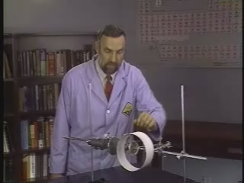
Interpreting the
Observed Deflections
.
.
.
.
.
.
beam of
alpha
particles
undeflected
particles
.
.
.
.
.
.
.
.
.
deflected particle
.
.
gold foil
22
Dorin, Demmin, Gabel, Chemistry The Study of Matter , 3rd Edition, 1990, page 120
Notes:
22
The observations:
(1) Most of the alpha particles pass through the foil un-deflected.
(2) Some alpha particles are deflected slightly as the penetrate the foil.
(3) A few (about 1 in 20,000) are greatly deflected.
(4) A similar small number do not penetrate the foil at all, but are reflected back toward the source.
Rutherford believed that when positively charged alpha particles passed near the positively charged nucleus, the resulting strong repulsion caused them to be deflected at extreme angles.
Rutherford's interpretation: If atoms of the foil have a massive, positively charged nucleus and light electrons outside the nucleus, one can explain how:
(1) an alpha particle passes through the atom un-deflected (a fate share by most of the alpha particles);
(2) an alpha particle is deflected slightly as it passes near an electron;
(3) an alpha particle is strongly deflected by passing close to the atomic nucleus; and
(4) an alpha particle bounces back as it approaches the nucleus head-on.

Slide 23
Density and the Atom
Since most of the particles went through, the atom was mostly empty space.
Because the alpha rays were deflected so much, the positive pieces it was striking were heavy.
Majority of mass is in the center of atom.
Small volume and big mass = big density
This small dense positive area is the nucleus
23
Notes:
23

Slide 24
Explanation of Alpha-Scattering Results
Alpha particles
Nucleus
+
+
-
-
+
+
+
-
-
+
+
-
-
-
+
-
Plum-pudding atom
Nuclear atom
Thomson’s model
Rutherford’s model
24
Notes:
24

Slide 25
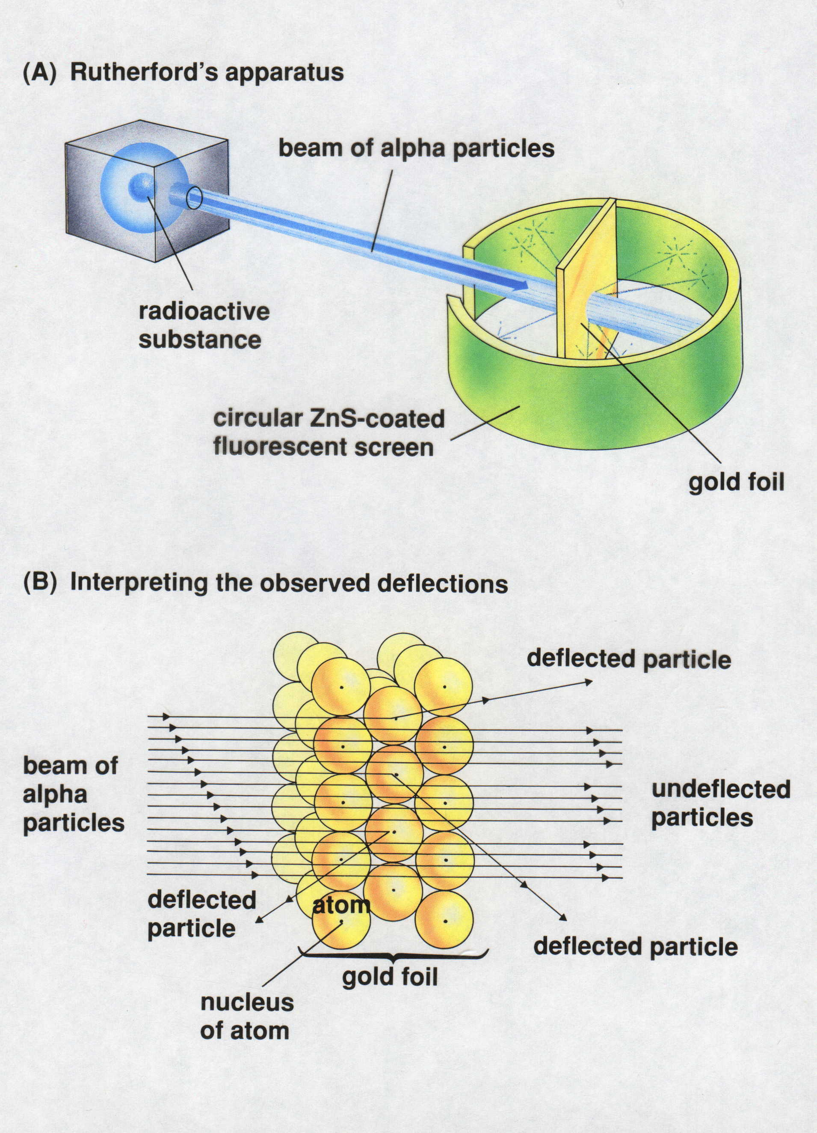
Rutherford’s
Gold-Leaf Experiment
Conclusions:
1. Atom is mostly empty space
2. Nucleus has (+) charge
3. Electrons float around nucleus
25
Dorin, Demmin, Gabel, Chemistry The Study of Matter , 3rd Edition, 1990, page 120
Notes:
25
“Rutherford’s Gold-Leaf Experiment”
Description
This slide illustrates Ernest Rutherford’s experiment with alpha particles and gold foil and his interpretation of the results.
Basic Concepts
When charged particles are directed at high speed toward a metal foil target, most pass through with little or no deflection, but some particles are deflected at large angles.
Solids are composed of atoms that are closely packed. The atoms themselves are mostly empty space.
All atoms contain a relatively small, massive, positively charged nucleus. The nucleus is surrounded by negatively charged electrons of low mass that occupy a relatively large volume.
Teaching Suggestions
Use this slide to describe and explain Rutherford’s experiment. Rutherford designed the apparatus shown in figure (A) to study the scattering of alpha particles by gold. Students may have difficult with the concepts in this experiment because they lack the necessary physics background. To help students understand how it was determined that the nucleus is relatively massive, use questions 3 and 4 to explain the concept of inertia.
Explain that the electrostatic force is directly proportional to the quantity of electric charge involved. A greater charge exerts a greater force. (Try comparing the electrostatic force to the foce of gravity, which is greater near a massive object like the sun, but smaller near an object of lesser mass, such as the moon.) The force exerted on an alpha particle by a concentrated nucleus would be much greater that the force exerted on an alpha particle by a single proton. Hence, larger deflections will result from a dense nucleus than from an atom with diffuse positive charges.
Point out that Rutherford used physics to calculate how small the nucleus would have to be produce the large-angle deflections observed. He calculated that the maximum possible size of the nucleus is about 1/10,000 the diameter of the atom. Rutherford concluded that the atom is mostly space.
Questions
If gold atoms were solid spheres stacked together with no space between them, what would you expect would happen to particles shot at them? Explain your reasoning.
When Ernest Rutherford performed the experiment shown in diagram (A) he observed that most of the alpha particles passed straight through the gold foil. He also noted that the gold foil did not appear to be affected. How can these two observations be explained?
Can you explain why Rutherford concluded that the mass of the f\gold nucleus must be much greater than the mass of an alpha particle? (Hint: Imagine one marble striking another marble at high speed. Compare this with a marble striking a bowling ball.)
Do you think that, in Rutherford’s experiment, the electrons in the gold atoms would deflect the alpha particles significantly? Why or why not? (Hint: The mass of an electron is extremely small.)
Rutherford experimented with many kinds of metal foil as the target. The results were always similar. Why was it important to do this?
A friend tries to convince you that gold atoms are solid because gold feels solid. Your friend also argues that, because the negatively charged electrons are attracted to the positively charged nucleus, the electrons should collapse into the nucleus. How would you respond?
As you know, like charges repel each other. Yet, Rutherford determined that the nucleus contains all of an atom’s positive charges. Invent a theory to explain how all the positive charges can be contained in such a small area without repelling each other. Be creative!

Slide 26
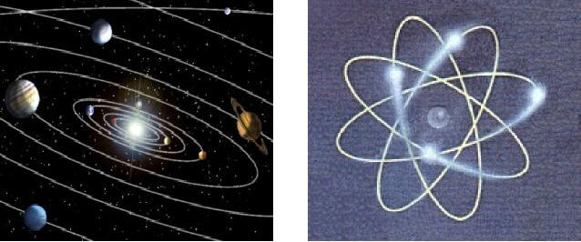
The Rutherford Atom
26
Zumdahl, Zumdahl, DeCoste, World of Chemistry 2002, page 57
Notes:
26

Slide 27
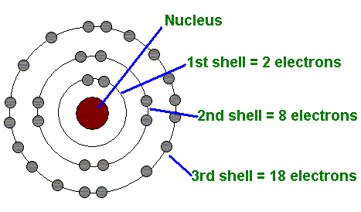
Bohr’s Model
27
Notes:
27

Slide 28
Bohr Model of Atom
The Bohr model of the atom, like many ideas in the history of science, was at first prompted by and later partially disproved by experimentation. Bohr studied hydrogen’s line emission spectrum. Bohr modified Rutherford’s model to specify that the electrons travel in an orbit that is a set distance from the nucleus. This results in each electron orbit containing a specific amount of energy.
Increasing energy
of orbits
n = 3
e⁻
n = 2
e⁻
e⁻
e⁻
n = 1
e⁻
e⁻
e⁻
e⁻
e⁻
e⁻
e⁻
A photon is emitted
with energy E = hf
http://en.wikipedia.org/wiki/Category:Chemistry
28
Notes:
28
In 1913, Niels Bohr proposed a theoretical model for the hydrogen atom that explained its emission spectrum.
– His model required only one assumption: The electron moves around the nucleus in circular orbits that can have only certain allowed radii.
– Bohr proposed that the electron could occupy only certain regions of space
– Bohr showed that the energy of an electron in a particular orbit is
E_{n} = – ℜhc
n²
where ℜ is the Rydberg constant, h is the Planck’s constant, c is the speed of light, and n is a positive integer corresponding to the number assigned to the orbit.
n = 1 corresponds to the orbit closest to the nucleus and is the lowest in energy.
A hydrogen atom in this orbit is called the ground state, the most stable arrangement for a hydrogen atom.
As n increases, the radii of the orbit increases and the energy of that orbit becomes less negative.
A hydrogen atom with an electron in an orbit with n >1 is in an excited state — energy is higher than the energy of the ground state.
Decay is when an atom in an excited state undergoes a transition to the ground state — loses energy by emitting a photon whose energy corresponds to the difference in energy between the two states.

