Slide 1
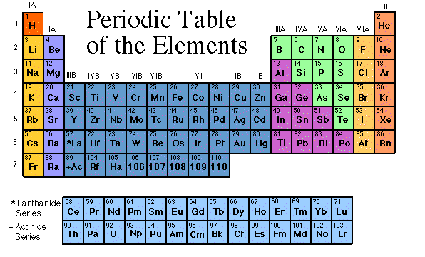
Periodic Table of Elements

Slide 2
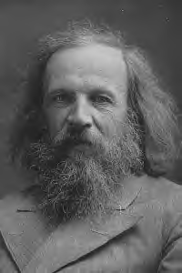
Mendeleev
Hey Baby!
In 1869, Dmitri Ivanovitch Mendeléev created the first accepted version of the periodic table.
He grouped elements according to their atomic mass, and as he did, he found that the families had similar chemical properties.
Blank spaces were left open to add the new elements he predicted would occur.

Slide 3
Periodic Table
The periodic table organizes the elements in a particular way. A great deal of information about an element can be gathered from its position in the period table.
For example, you can predict with reasonably good accuracy the physical and chemical properties of the element. You can also predict what other elements a particular element will react with chemically.
Understanding the organization and plan of the periodic table will help you obtain basic information about each of the 118 known elements.

Slide 4
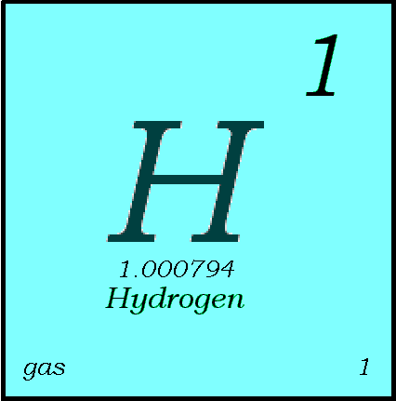
Key to the Periodic Table
Elements are organized on the modern periodic table according to their atomic number, usually found near the top of the square.
  The atomic number refers to how many protons an atom of that element has.
  For instance, hydrogen has 1 proton, so it’s atomic number is 1.
  The atomic number is unique to that element. No two elements have the same atomic number.

Slide 5
What’s in a square?
Different periodic tables can include various bits of information, but usually:
  atomic number
  symbol
  atomic mass
  number of valence electrons
  state of matter at room temperature.

Slide 6
Metals and Nonmetals
The periodic table can be separated into metals and nonmetals. Everything to the left of the stair step line is a metal and everything to the right of the stair step line is a nonmetal. Most elements are classified as metals.
Transition metals
NONMETALS
METALS
METALS
Outline the black stair step line on your periodic table

Slide 7
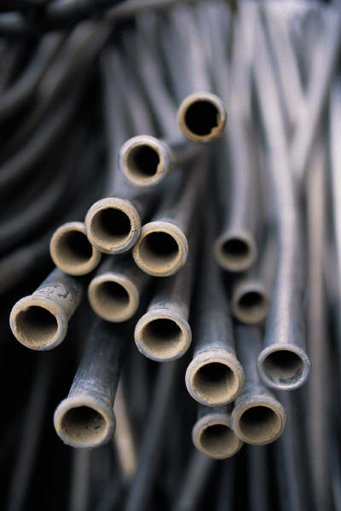
Properties of Metals
Metals are good conductors of heat and electricity.
Metals are shiny.
Metals are ductile (can be stretched into thin wires).
Metals are malleable (can be pounded into thin sheets).
A chemical property of metal is its reaction with water which results in corrosion.

Slide 8
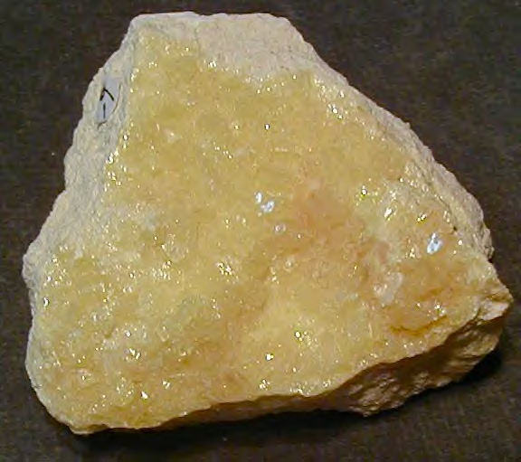
Properties of Non-Metals
Non-metals are poor conductors of heat and electricity.
Non-metals are not ductile or malleable.
Solid non-metals are brittle and break easily.
They are dull.
Many non-metals are gases.
Sulfur

Slide 9
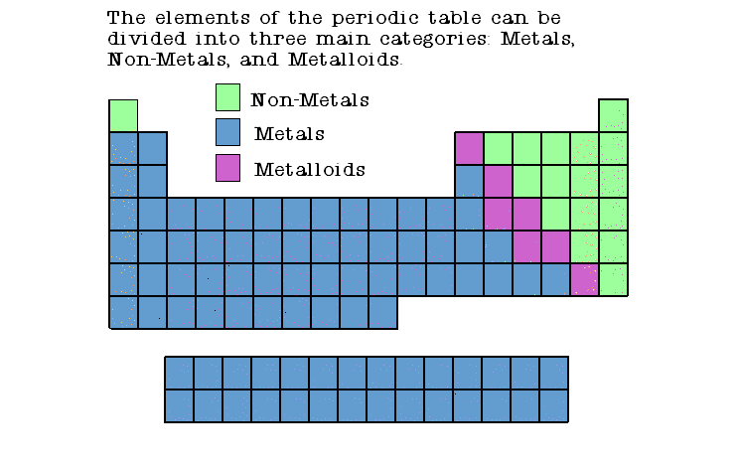

Slide 10
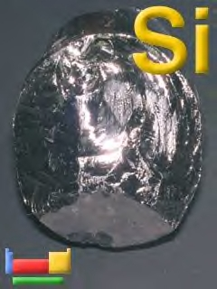
Properties of Metalloids
Metalloids (metal-like) have properties of both metals and non-metals.
They are solids that can be shiny or dull.
They conduct heat and electricity better than non-metals but not as well as metals.
They are ductile and malleable.
Silicon

Slide 11
Periods on the Periodic Table
Horizontal (left to right) rows are called periods.
Numbered 1, 2, 3, 4, 5 & 6
Each horizontal row of elements is called a period.
The elements in a period are not alike in properties.
In fact, the properties change greatly across even given row.
The first element in a period is always an extremely active solid. The last element in a period, is always an inactive gas.

Slide 12
Periods on the Periodic Table
Number the periods on your periodic table
1
2
3
4
5
6

Slide 13
FAMILIES
Vertical columns of elements are called groups or families.
Elements in each family have similar but not identical properties. Similar physical properties and similar chemical properties.
For example, lithium (Li), sodium (Na), potassium (K), and other members of family IA are all soft, white, shiny metals.
All elements in a family have the same number of valence electrons.

Slide 14
Groups (families) on the Periodic Table
1 2 13 14 15 16 17 18

Slide 15
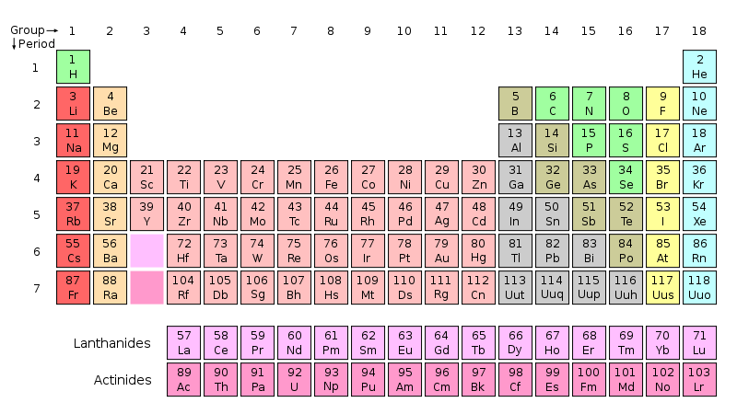
Label your periodic table with the correct group numbers and period numbers as shown below.

Slide 16
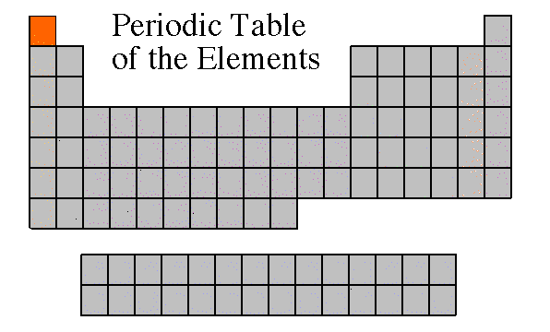
Hydrogen is the “The lone wolf” of the periodic table. Outline hydrogen in Black and lightly shade RED

Slide 17

Hydrogen
The hydrogen square sits atop Group 1, but it is not a member of that family. Hydrogen is in a class of its own.
It’s a gas at room temperature.
It has one proton and one electron in its one and only energy level.
Hydrogen only needs 2 electrons to fill up its valence shell.

Slide 18
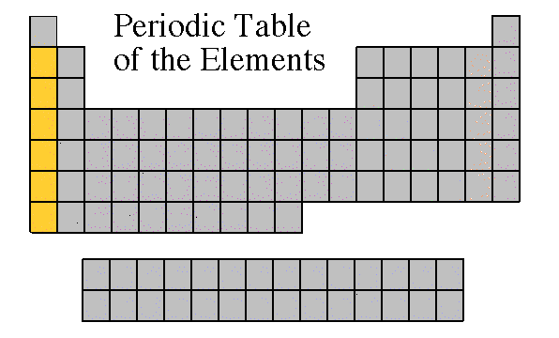
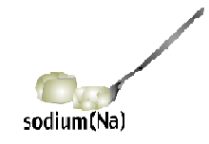
Alkali Metals
The alkali metal group is found in the first column of the periodic table.
Atoms of the alkali metals have a single electron in their outermost level, in other words, 1 valence electron.
They are shiny, have the consistency of clay, and are easily cut with a knife.

Slide 19
Group 1 are the Alkali Metals. Color them orange.

Slide 20
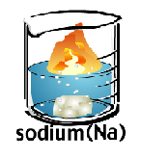
Alkali Metals
They are the most reactive metals.
They react violently with water & must be stored in oil
Alkali metals are never found as free elements in nature. They are always bonded with another element.

Slide 21
What does it mean to be reactive?
We will be describing elements according to their reactivity.
Elements that are reactive bond easily with other elements to make compounds.
Some elements are only found in nature bonded with other elements.
What makes an element reactive?
  An incomplete valence electron level.
  All atoms (except hydrogen) want to have 8 electrons in their very outermost energy level (This is called the rule of octet.)
  Atoms bond until this level is complete. Atoms with few valence electrons lose them during bonding. Atoms with 6, 7, or 8 valence electrons gain electrons during bonding.

Slide 22
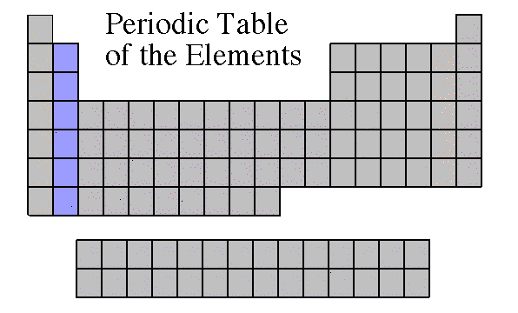
Alkaline Earth Metals
Alkaline earth metals are located in group 2.
They are never found uncombined in nature.
They have two valence electrons.
Alkaline earth metals include magnesium and calcium, among others.

Slide 23
Group 2 is the Alkaline Earth Metals. Color them light blue.

Slide 24
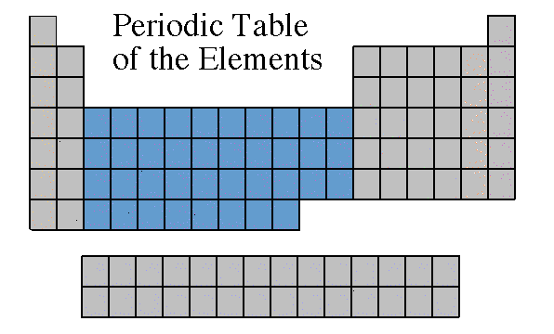
Transition Metals
Transition Elements include those elements in Groups 3 through 12.
These are the metals you are probably most familiar: copper, tin, zinc, iron, nickel, gold, and silver.
They are good conductors of heat and electricity.

Slide 25
Transition metals are Groups 3-12. Color them purple.

Slide 26
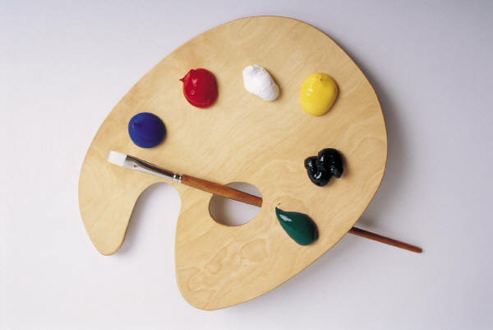
Transition Metals
The compounds of transition metals are usually brightly colored and are often used to color paints.
Transition elements have properties similar to one another and to other metals, but their properties do not fit in with those of any other family.

Slide 27
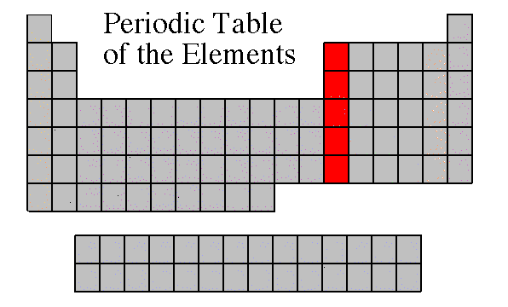
GrOUP 13 IS THE BORON family
Color the Boron Group Red.

Slide 28
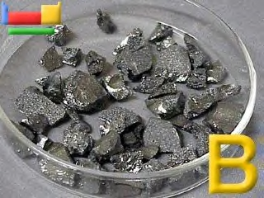
Boron Family
The Boron Family is named after the first element in the family.
Atoms in this family have 3 valence electrons.
This family includes a metalloid (boron), and the rest are metals.
This family includes the most abundant metal in the earth’s crust (aluminum).

Slide 29
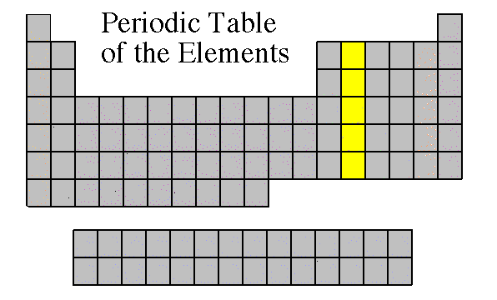
Group 14 is the carbon family
Color the Carbon Family Yellow.

Slide 30
Carbon Family
Atoms of this family have 4 valence electrons.
This family includes a non-metal (carbon), metalloids, and metals.
The element carbon is called the “basis of life.” There is an entire branch of chemistry devoted to carbon compounds called organic chemistry.

Slide 31
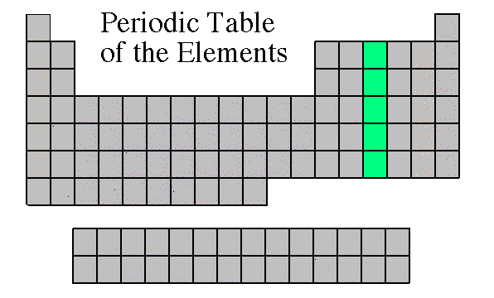
Group 15 is the nitrogen family
Color the Nitrogen Group Green.

Slide 32

Nitrogen Family
The nitrogen family is named after the element that makes up 78% of our atmosphere.
This family includes non-metals, metalloids, and metals.
Atoms in the nitrogen family have 5 valence electrons. They tend to share electrons when they bond.
Other elements in this family are phosphorus, arsenic, antimony, and bismuth.

Slide 33
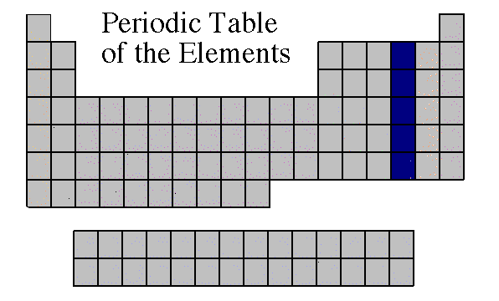
Oxygen Family
Atoms of this family have 6 valence electrons.
Most elements in this family share electrons when forming compounds.
Oxygen is the most abundant element in the earth’s crust. It is extremely active and combines with almost all elements.

Slide 34
Group 16 is the oxygen family
Color the Oxygen Group Dark Blue.

Slide 35
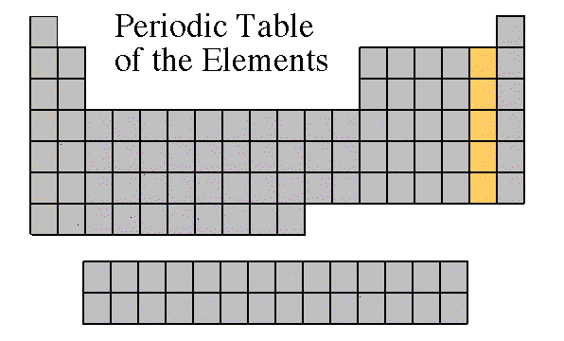
Halogen Family
Group 17
Halogen atoms only need to gain 1 electron to fill their outermost energy level.
They react with alkali metals to form salts.

Slide 36
Halogen Family
The halogens are five non-metallic elements found in group 17 of the periodic table. The term "halogen" means "salt-former" and compounds containing halogens are called "salts". All halogens have 7 electrons in their outer shells, giving them an oxidation number of -1. The halogens exist, at room temperature, in all three states of matter:
Solid- Iodine, Astatine
Liquid- Bromine
Gas- Fluorine, Chlorine
Halogens have 7 valence electrons, which explains why they are the most active non-metals. They are never found free in nature. They are very poisonous

Slide 37
GROUP 17 IS THE HALOGEN FAMILY
Color the Halogen group brown.

Slide 38
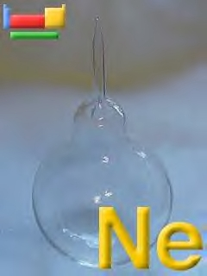
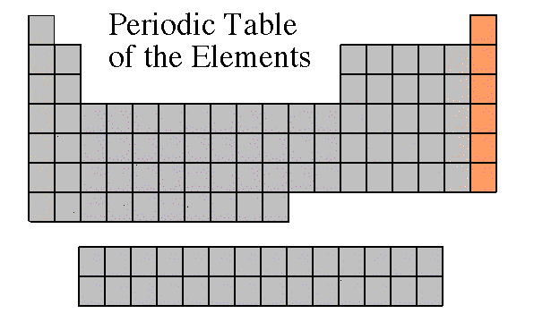
Noble Gases
Noble Gases are colorless gases that are extremely un-reactive (inert).
One important property of the noble gases is their inactivity. They are inactive because their outermost energy level is full.
Because they do not readily combine with other elements to form compounds, the noble gases are called inert.
The family of noble gases includes helium, neon, argon, krypton, xenon, and radon.
All the noble gases are found in small amounts in the earth's atmosphere.
Contain 8 valence electrons

Slide 39
GROUP 18 IS THE NOBLE GASES
Color the Noble Gases pink.

Slide 40
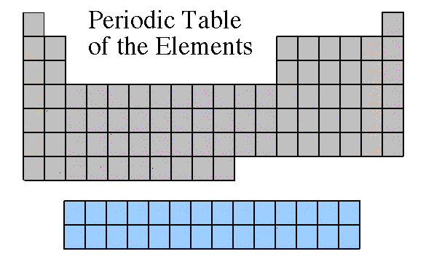
INNER TRANSITION METALS
Bottom two rows of periodic table
The thirty rare earth elements (inner transition elements) are composed of the lanthanide series (first row) and actinide series (second row).
One element of the lanthanide series and most of the elements in the actinide series are called trans-uranium, which means synthetic or man-made.
Notice how these elements are part of Periods 6 and 7.

Slide 41
THE BOTTOM TWO ROWS ARE THE RARE EARTH METALS.
Color the Lanthanides (top row) dark green & color the Actinides (bottom row) grey.

