Slide 1
Periodic Table How to use the Periodic Table in Determining Electron Shells and Valence Electrons

Slide 2
GET THE PERIODIC TABLE YOU COLORED

Slide 3
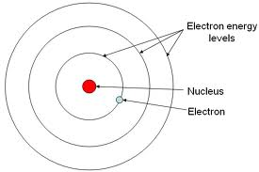
Electrons and Shells
Electron Shell Basics
Let's cover some basics of atomic shells: 1. The center of the atom is called the nucleus. 2. Electrons are found in areas called shells. A shell is sometimes called an energy level or electron orbital. 3. Shells are areas that surround the center of an atom.

Slide 4
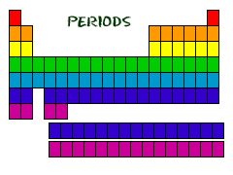
Periods
Each row is called a “period”
The elements in each period have the same number of electron shells (place around the nucleus where the electrons are located.
1st Period = 1 energy level
2nd Period = 2 energy levels
3rd Period = 3 energy levels
4th Period = 4 energy levels
www.chem4kids.com

Slide 5
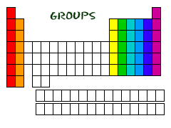
Groups
Group 18 = 8 electrons
Group 1 = 1 electron
Except for He, it has 2 electrons
Group 2 = 2 electrons
Each column is called a “group”
13, 14, 15, 16, 17
Each element in a group has the same number of electrons in their outer energy level.
The electrons in the outer level are called “valence electrons”
www.chem4kids.com

Slide 6
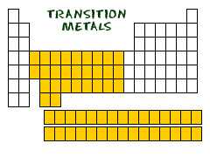
Transition Metals
Transition Metals have slightly different rules for shells and valence electrons. For right now, skip the transition metals.
www.chem4kids.com

Slide 7
Determining Number of Electrons
Each energy level can hold a certain number of electrons. How many can each hold? Just look at your periodic table.
How many elements are located in period 1?
2
How many electrons can fit in period 1?
2

Slide 8
Determining Number of Electrons
Each energy level can hold a certain number of electrons. How many can each hold? Just look at your periodic table.
How many elements are located in period 2?
8
How many electrons can fit in period 2?
8

Slide 9
Determining Number of Electrons
Each energy level can hold a certain number of electrons. How many can each hold? Just look at your periodic table.
How many elements are located in period 3?
8
How many electrons can fit in period 3?
8
YOU GET THE IDEA

Slide 10
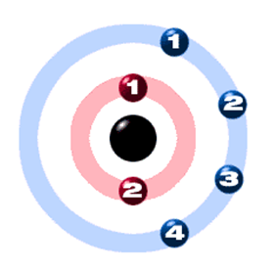
Determine the number of shells and the number of valence electrons for:
Carbon - C
Located in 2nd Period = 2 shells
Group 14 =
4 valence
electrons
www.chem4kids.com

Slide 11
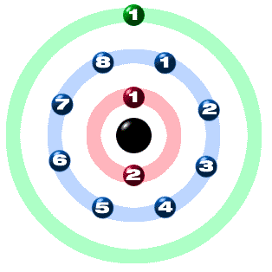
Determine the number of shells and the number of valence electrons for:
Sodium - Na
Located in 3rd Period = 3 shells
Group 1 =
1 valence
electron
www.chem4kids.com

Slide 12
Write your answers on your handout.
Ne
Name the element.
Number of shells ?
Valence electrons ?

Slide 13
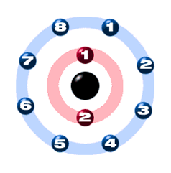
Write your answers on your handout.
Ne
Name the element.
Number of shells ?
Valence electrons ?
Neon
2nd Period = 2 shells
Group 18 = 8 valence
electrons

Slide 14
Write your answers on your handout.
H
Name the element.
Number of shells ?
Valence electrons ?

Slide 15
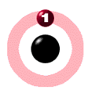
Write your answers on your handout.
H
Name the element.
Number of shells ?
Valence electrons ?
Hydrogen
1st Period = 1 shell
Group 1 = 1 valence
electron

Slide 16
Write your answers on your handout.
Be
Name the element.
Number of shells ?
Valence electrons ?

Slide 17
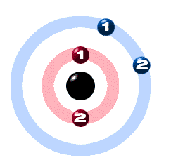
Write your answers on your handout.
Be
Name the element.
Number of shells ?
Valence electrons ?
Beryllium
2nd Period = 2 shells
Group 2 = 2 valence
electrons

Slide 18
Write your answers on your handout.
S
Name the element.
Number of shells ?
Valence electrons ?

Slide 19
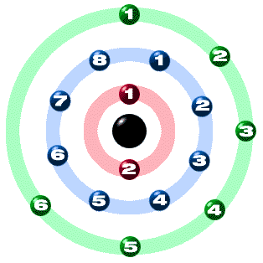
Write your answers on your handout.
S
Name the element.
Number of shells ?
Valence electrons ?
Sulfur
3rd Period = 3 shells
Group 16 = 6 valence
electrons

Slide 20
Write your answers on your handout.
K
Name the element.
Number of shells ?
Valence electrons ?

Slide 21
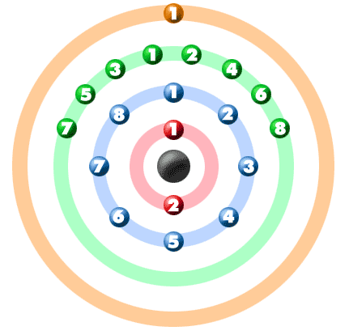
Write your answers on your handout.
K
Name the element.
Number of shells ?
Valence electrons ?
Potassium
4th Period = 4 shells
Group 1 = 1 valence
electron

Slide 22
Write your answers on your handout.
He
Name the element.
Number of shells ?
Valence electrons ?

Slide 23
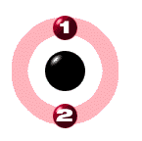
Write your answers on your handout.
He
Name the element.
Number of shells ?
Valence electrons ?
Helium
1st Period = 1 shell
Group 18 = 2 valence
electrons
Helium is the exception in Group 8.
Since it has just one shell, that shell can only fit 2 electrons instead of 8.
It is in this group because all the elements have a full outer shell.

Slide 24
Be sure to have all your answers on the worksheet.
End of Study Guide

