Slide 1
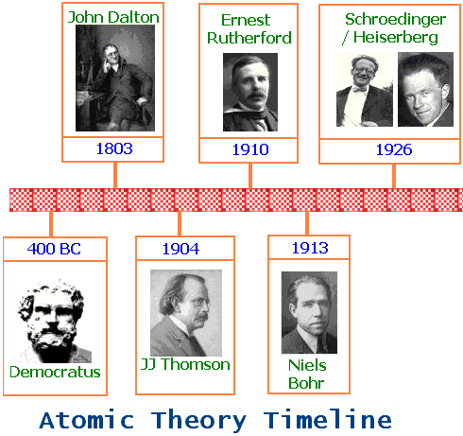

First Atomc Theory
Discovered nucleus & that atom is mostly empty space
First guy to use the term “atoms”
Plum pudding model

Slide 2

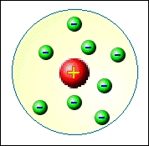
Electrons Arrangement in Atoms
Atomic Models
(1) Model:
a ball of (+) charge containing a number of e⁻
no ________________
often described as the “________ _______________” atom.
(2) Model:
a ____________ of (+) charge surrounded by a number of e⁻ . Atom is mostly empty space.
no _____________ and no e⁻ orbitals
Thomson
nucleus
plum pudding
Rutherford
nucleus
neutrons

Slide 3

Atomic Models
Bohr
(3) Model:
a nucleus of (+) charge that also contains ______________
nucleus is encircled by e⁻’s located in definite orbits (or paths).
e⁻’s have ___________ energies in these orbits
e⁻’s do not lose energy as they orbit the nucleus
(4) Mechanical Model:
no definite ____________ to the e⁻ path (“fuzzy” cloud)
orbits of e⁻’s based on the _________________ of finding the e⁻ in the particular orbital shape.
neutrons
fixed
Quantum
shape
probability

Slide 4
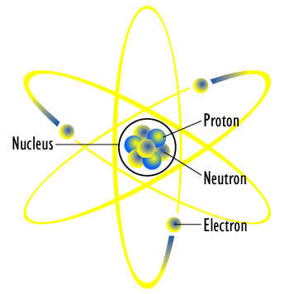
Bohr Atomic Model

Slide 5
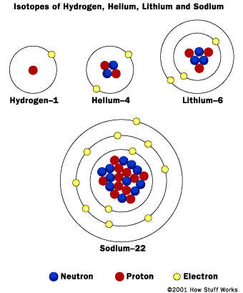
Bohr Atomic Model

Slide 6
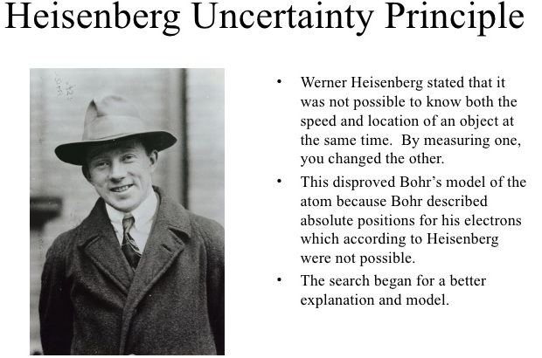
http://www.slideshare.net/laburkett/history-of-the-atom
The real Heisenberg!!!

Slide 7
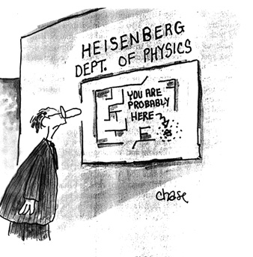

Slide 8
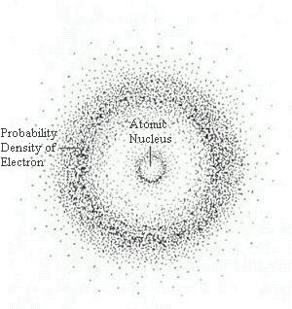
Quantum Mechanical Model

Slide 9
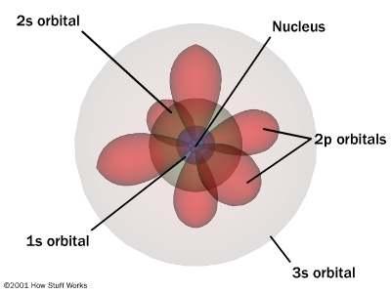
Quantum Mechanical Model

Slide 10
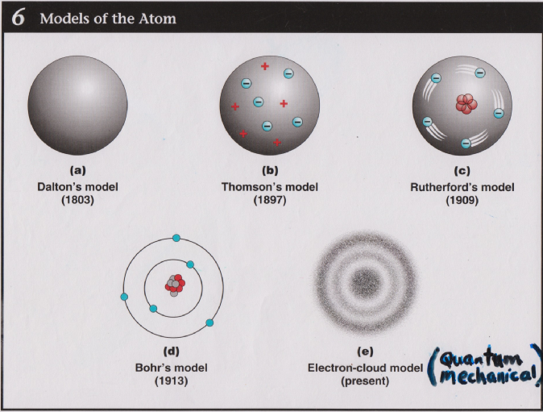
Quantum Mechanical Model

Slide 11
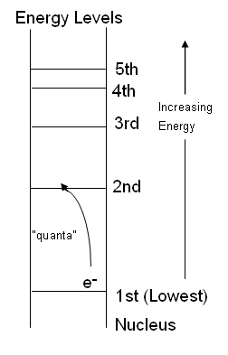
Energy Levels
Diagram:
The energy levels in an atom are sort of like _________ of a ladder.
The more energy an electron has, the __________ away from the nucleus it usually will be.
The energy levels are not evenly spaced. They get ___________ together as you travel farther away.
To move from one “rung” to another requires a “____________” of energy.
rungs
farther
closer
quantum

Slide 12
Quantum Numbers
Describe the ______________ of the e⁻’s around the nucleus.
Electron configurations are sort of like a home _____________ for the electron.
This information about the location of the e⁻’s in an atom can be used to:
(1) determine chemical & physical _____________ for the elements.
(2) show how the _______________ __________ is organized.
(3) show _____ and _____ elements combine to form compounds.
location
address
properties
Periodic Table
how
why

Slide 13
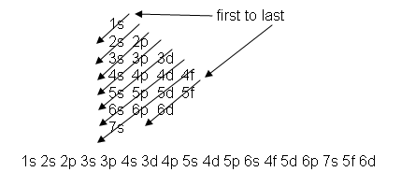
Electron Configurations
Electron configurations are notations that represent the four Quantum #’s for all of the electrons in a particular atom. Here are the rules for these notations:
Rule #1 (Aufbau Principle): Electrons fill ________ energy orbitals first.
Examples: 1s would be filled before ____
3s would fill before ____
lowest
2s
3p

Slide 14
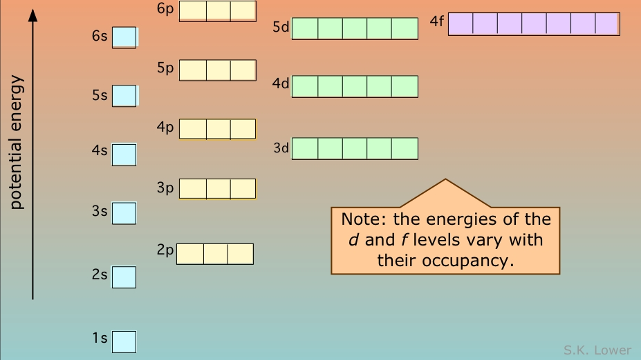
Electron Configurations
Silicon
↑
↑
↑
↓
↑
↓
↑
↓
↑
↓
↑
↓
(Energy Level Diagram)
↑
↓
1s, 2s, 2p, 3s, 3p, 4s, 3d, 4p, 5s, 4d, 5p, 6s, 4f, 5d, 6p, 7s, 5f, 6d, 7p…

Slide 15
Rule #2: Only ___ electrons can fit into each orientation.
Example: ___ ___ not ____
1s 2s 1s
Rule #3 (Pauli Exclusion Principle): Electrons in the same orientation have ______________ spin.
Example: ___ not ___
1s 1s
Rule #4 (Hund’s Rule): “_______________ rule” or “Bus Seating” rule---> Every “□” in an orbital shape gets an electron before any orientation gets a second e⁻.
Example: □□□ not □□□
2p 2p
2
↑
↓
↑
↑
↓
↑
opposite
↑
↓
↑
↑
Monopoly
↑
↑
↑
↑
↓
↑

Slide 16
Rule #5: The Exceptions
Half-filled or completely filled d & f sublevels have ________ energies and are more stable than partially filled d’s and f’s.
This means that an atom can “borrow” one of its “s” electrons from the previous orbital to become more stable.
Example: Silver #47 ___ ___ ___ ___ ___ ___
5s 4d
becomes ___ ___ ___ ___ ___ ___
5s 4d
Because the 4d sublevel is now full, the atom is at a ________ energy state and therefore _________ stable.
lower
↓
↓
↓
↓
↓
↑
↑
↑
↑
↑
↑
↑
↓
↓
↓
↓
↑
↓
↑
↑
↑
↑
lower
more

Slide 17
How Electron Configurations Relate to the Organization of the Periodic Table
s
p
d
f

Slide 18
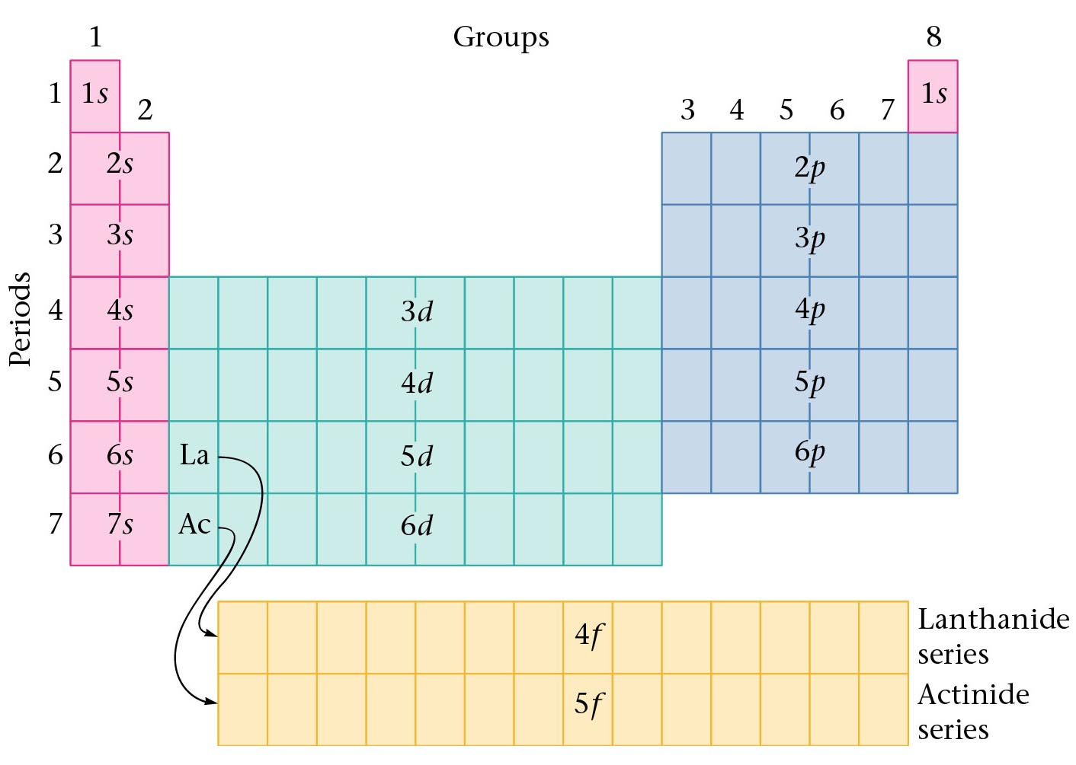
Figure 11.31: Orbitals being filled for elements in various parts of the periodic table.

Slide 19
Electron Configurations & Properties
How do electron configurations relate to the chemical and physical properties of an element?
All elements with the _________ outer shell e⁻ configurations have the ________ properties.
This means that elements in the same ____________ group have similar properties.
Examples: (1) Li, Na, K, Rb, and Cs all have __ lone “__” e⁻ for their last orbital... (_____, _____, _____, etc.) This makes all of them ___________ reactive. They all react with __________ to produce hydrogen gas.
(2) Ne, Ar, Kr, Xe, and Rn all have the outer energy level completely __________ with electrons...(________, ________, ________, etc.) This makes all of them ______________. They do not produce __________________!
same
similar
vertical
1
s
1s¹
2s¹
3s¹
very
water
filled
2s² 2p⁶
3s² 3p⁶
4s² 4p⁶
inert
compounds

Slide 20
More Practice Problems
(1) What does 3p4 mean? _____ principle quantum number (energy level), ____ sublevel, ______ electrons. What element is this?_________sulfur_____
(2) Which element has its last electron as a 4p⁵? ___________
(3) Which elements are similar in properties as Bromine? __________
(4) What would the outer shell electron configuration look like for the element underneath Radon, (Rn)?
(5) Which electron is added after 6s²? ________
3rd
p
4
Bromine
F, Cl, I, At
…7s² 5f¹⁴ 6d¹⁰ 7p⁶
4f¹

