Slide 1
Periodic Trends of the Elements

Slide 2
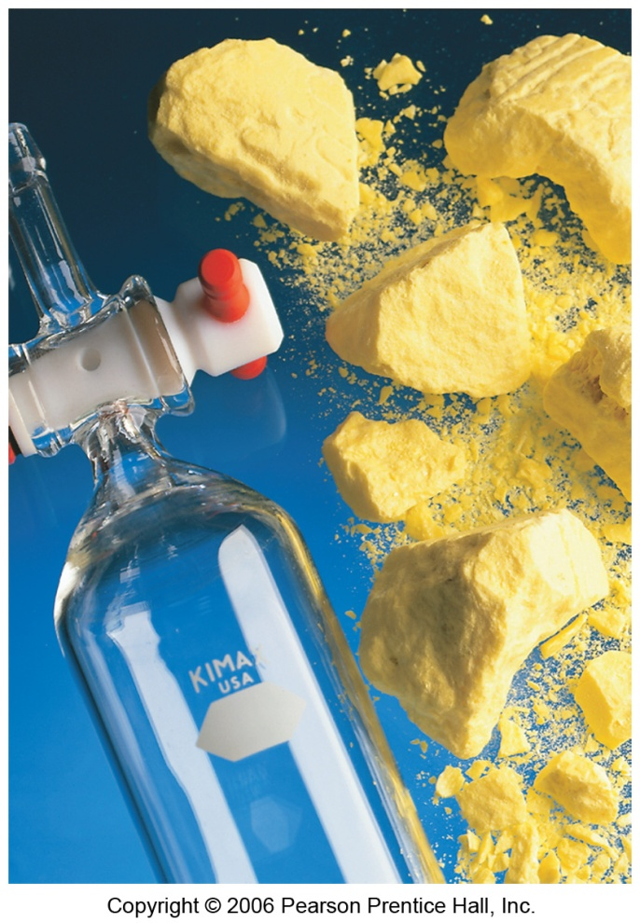
Periodic Table Revisited
Elements in the same group generally have similar chemical & physical properties.
Properties are not identical, however.

Slide 3
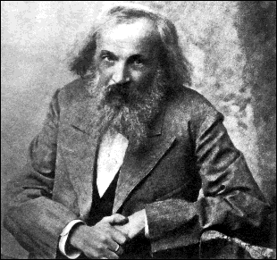
Periodic Table Revisited
Chemist begin the process of organizing elements by sorting them into groups based on their properties.
Dmitri Mendeleev arranged the elements according to atomic mass and used the arrangement to predict the properties of missing elements.

Slide 4
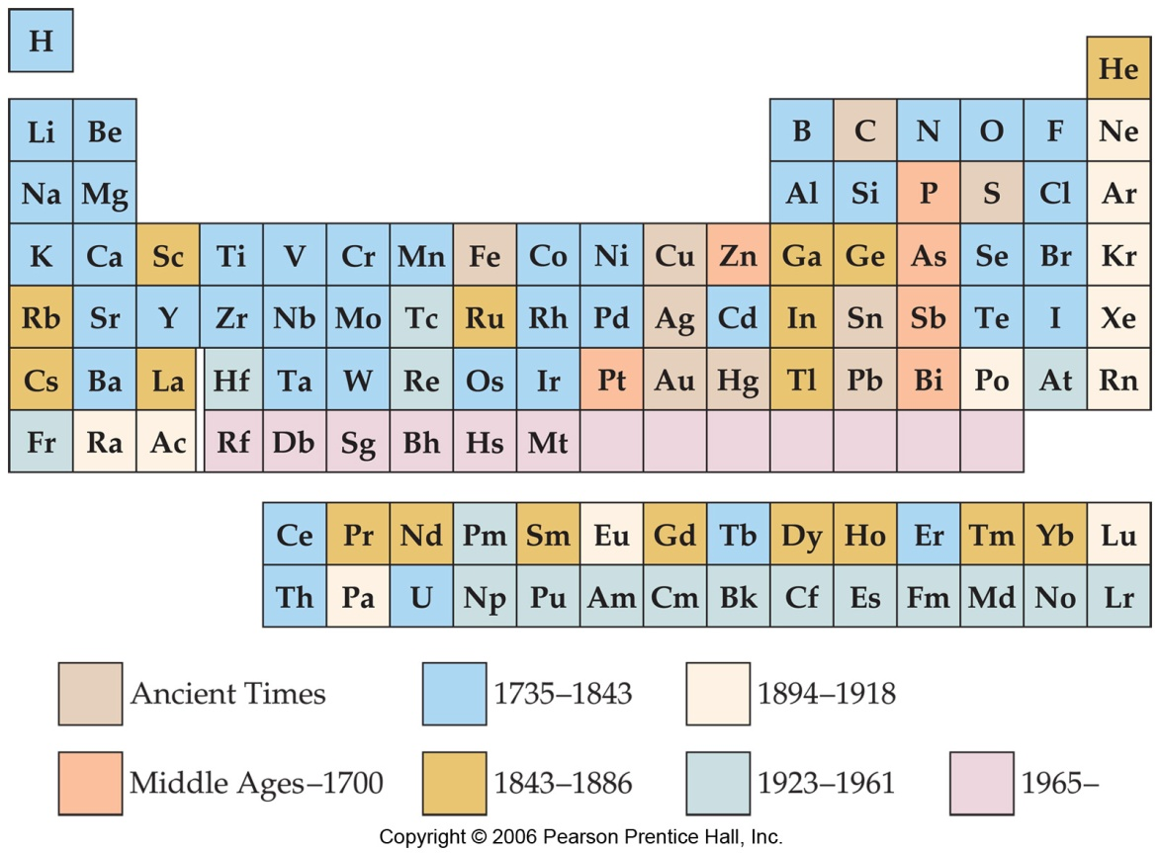
Development of Periodic Table
Dmitri Mendeleev and Lothar Meyer independently came to the same conclusion about how elements should be grouped.

Slide 5
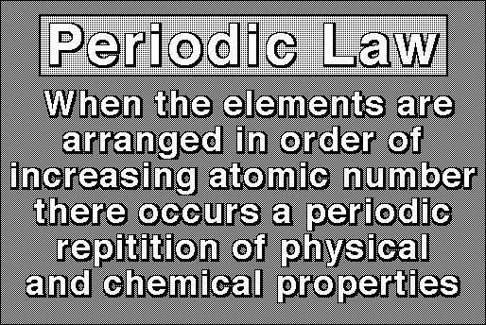

Slide 6
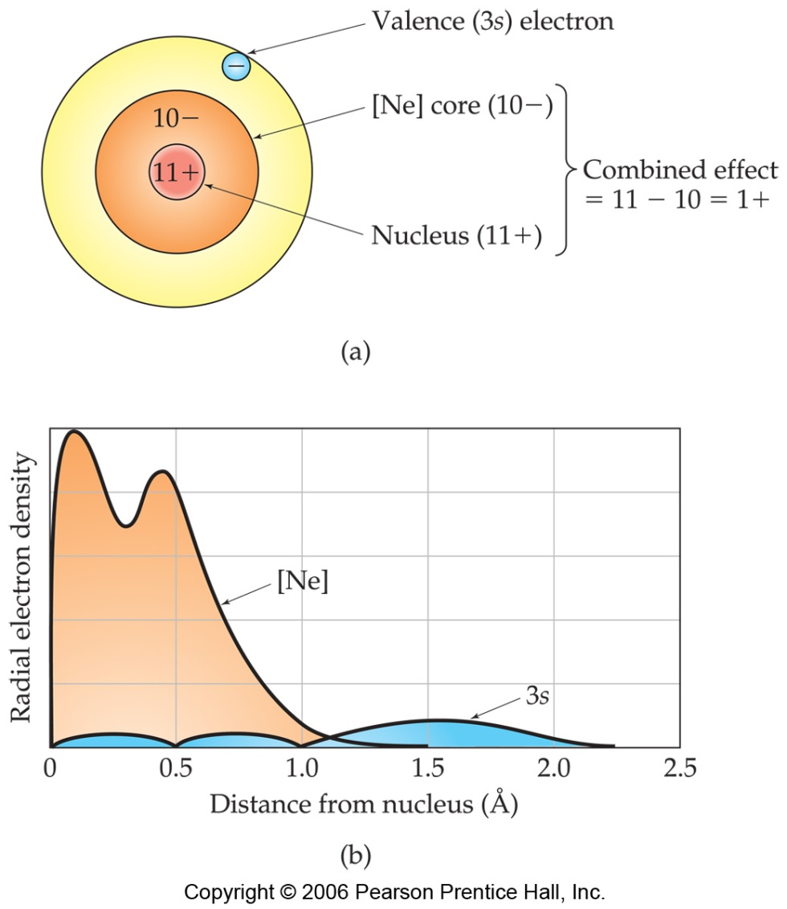
Effective Nuclear Charge
In a many-electron atom, electrons are both attracted to the nucleus and repelled by other electrons.
The nuclear charge that an electron experiences depends on both factors.
Increases left to right across the periodic table.

Slide 7
Shielding Effect
Valence
Occurs when the electrons in the inner energy levels repel the electrons in the outer energy level (valence e-) and block the attractive force of the nucleus
Increases as you go down a group
+
nucleus
-
-
-
Electrons
-
Electron
Shield
“kernel”
electrons
Notes:
Some schools use the term “screening” as I use the term “shielding”.

Slide 8
Shielding Effect and Effective Nuclear Charge
12
Mg
24.305
attractions
repulsions
+
_
_
_
Mg = [Ne]3s²
Hill, Petrucci, General Chemistry An Integrated Approach 2nd Edition, page 336
Notes:
"The simplified sketch of a magnesium atom shows the two valence electrons as discrete particles.
The remaining 9 core electrons are shown as a circular cloud of negative electric charge.
Interactions between valence electrons, core electrons, and the atomic nucleus determine an
effective nuclear charge. Attractions are indicated in red and repulsion in blue.“
For an atom or ion that has only a single electron, the potential energy can be calculated by considering only the electrostatic attraction between the positively charged nucleus and the negatively charged electron.
When more than one electron is present, the total energy of the atom or ion depends not only on the attractive electron-nucleus interactions but also on repulsive electron-electron interactions.
One must use approximate methods to deal with the effect of electron-electron repulsions on orbital energies
If an electron is far from the nucleus, then at any given moment, most of the other electrons will be between that electron and the nucleus.
The electrons will cancel a portion of the positive charge of the nucleus and will decrease the attractive interaction between it and the electron farther away.
Electrons farther away experiences an effective nuclear charge, Z_{eff}. that is less than the actual nuclear charge Z (an effect called electron shielding).

Slide 9
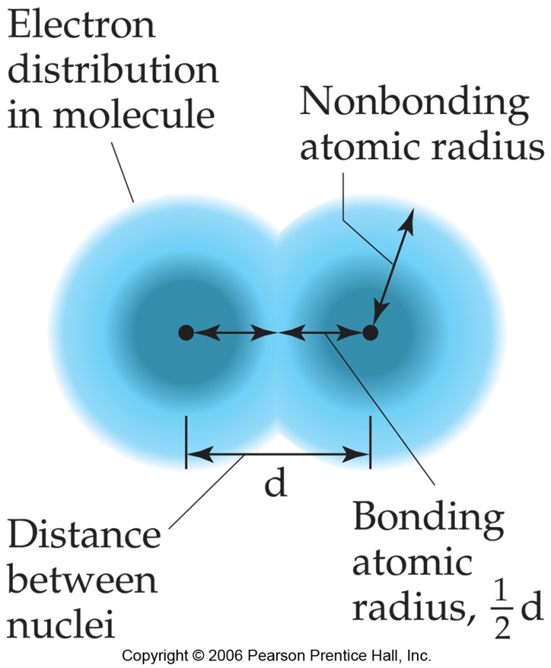
Sizes of Atoms
The bonding atomic radius is defined as one-half of the distance between covalently bonded nuclei.

Slide 10
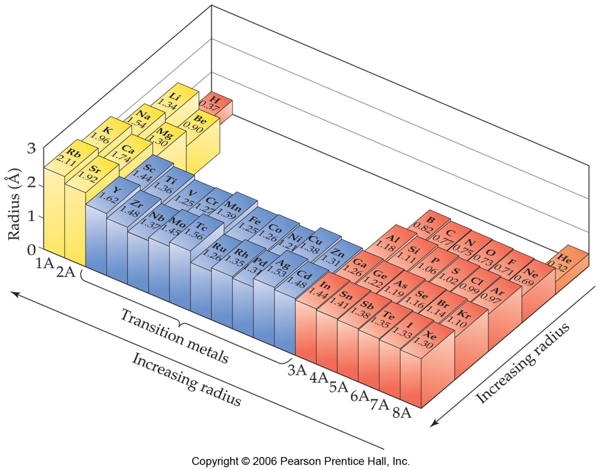
Sizes of Atoms
Bonding atomic radius tends to…
…decrease from left to right across a row
due to increasing nuclear charge.
…increase from top to bottom of a column
due to increasing energy levels.

Slide 11
Ionic Size
Cations form by losing electrons.
Cations are smaller that the atom they come from.
Metals form cations.
Cations of representative elements have noble gas configuration.
Ions are formed when an atom gains or loses electrons.

Slide 12
Formation of Cation
sodium atom
Na
sodium ion
Na⁺
e⁻
e⁻
e⁻
e⁻
e⁻
e⁻
e⁻
e⁻
e⁻
loss of
one valence
electron
11p⁺
e⁻
11p⁺
e⁻
e⁻
e⁻
e⁻
e⁻
e⁻
e⁻
e⁻
e⁻
e⁻
e⁻
e⁻

Slide 13
Ionic size
Anions form by gaining electrons.
Anions are bigger that the atom they come from.
Nonmetals form anions.
Anions of representative elements have noble gas configuration.

Slide 14
Formation of Anion
chlorine atom
Cl
chloride ion
Cl¹⁻
gain of
one valence
electron
e⁻
e⁻
e⁻
e⁻
e⁻
e⁻
e⁻
e⁻
e⁻
e⁻
e⁻
e⁻
e⁻
e⁻
e⁻
17p⁺
e⁻
17p⁺
e⁻
e⁻
e⁻
e⁻
e⁻
e⁻
e⁻
e⁻
e⁻
e⁻
e⁻
e⁻
e⁻
e⁻
e⁻
e⁻
e⁻
e⁻
e⁻
e⁻

Slide 15
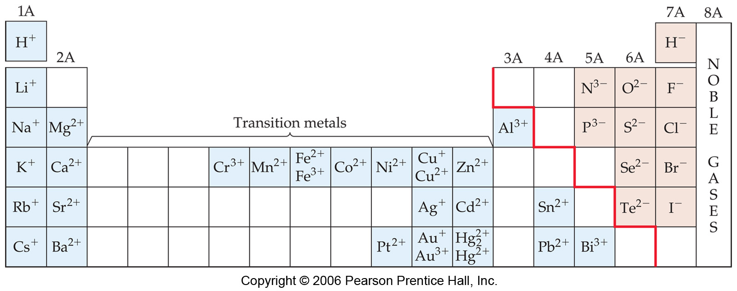
Metals versus Nonmetals
Metals tend to form cations.
Nonmetals tend to form anions.

Slide 16
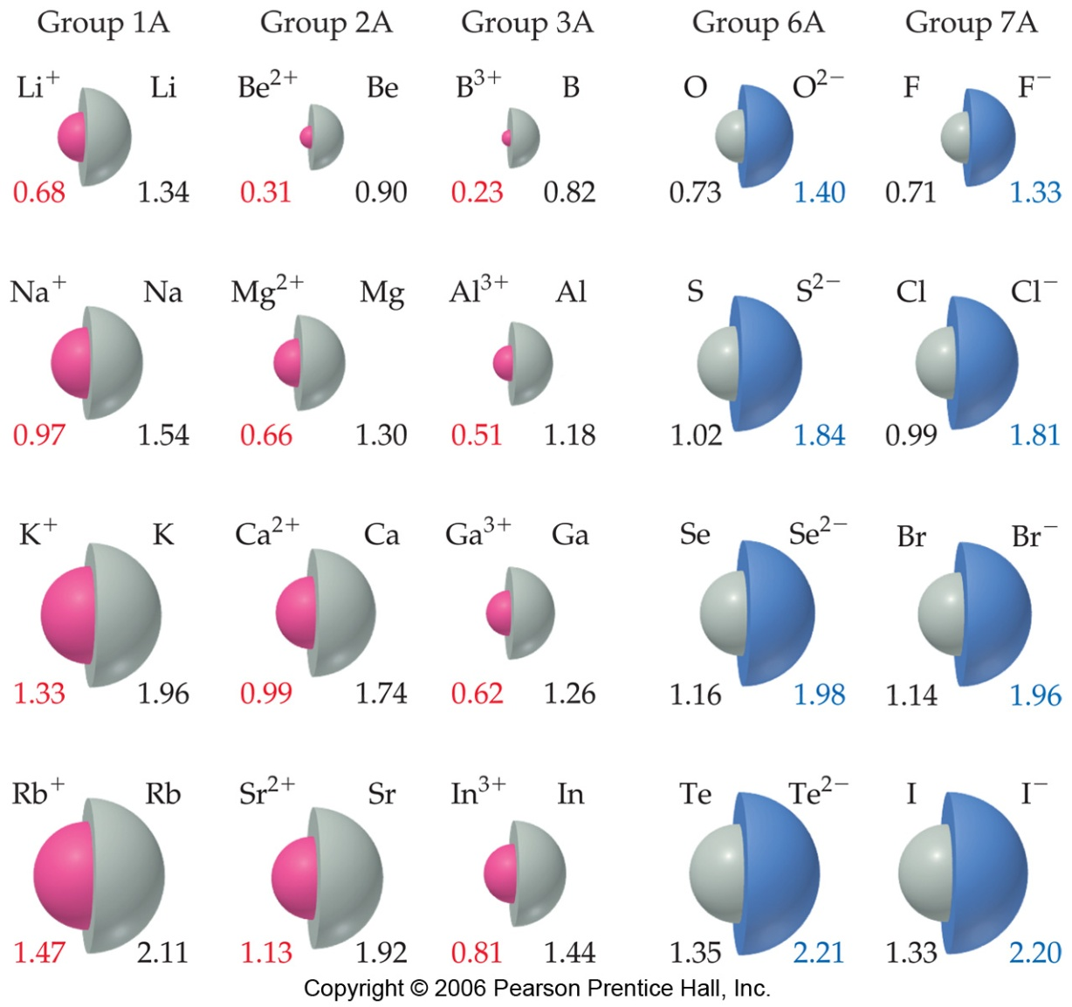
Sizes of Ions
Ionic size depends upon:
Nuclear charge.
Number of electrons.
Orbitals in which electrons reside.

Slide 17
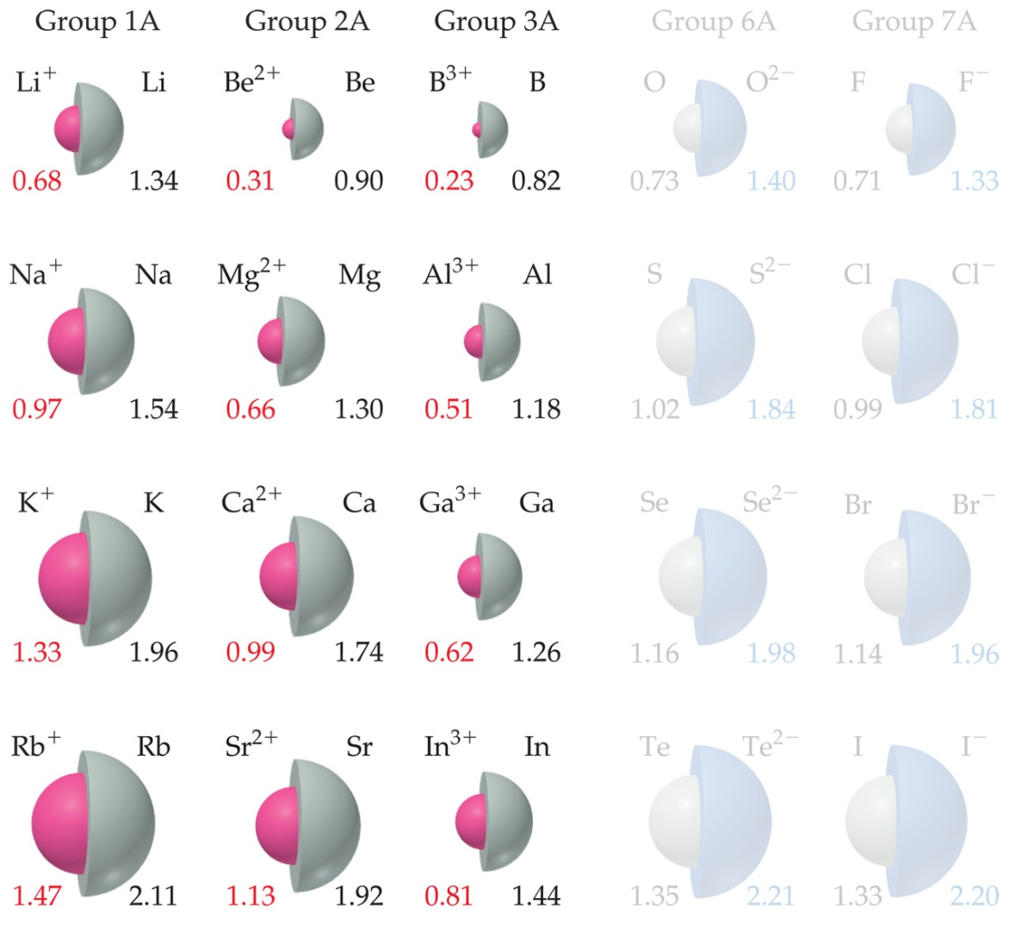
Sizes of Ions
Cations are smaller than their parent atoms.
Cations from when an atom loses electrons
The outermost electron is removed and repulsions are reduced.

Slide 18
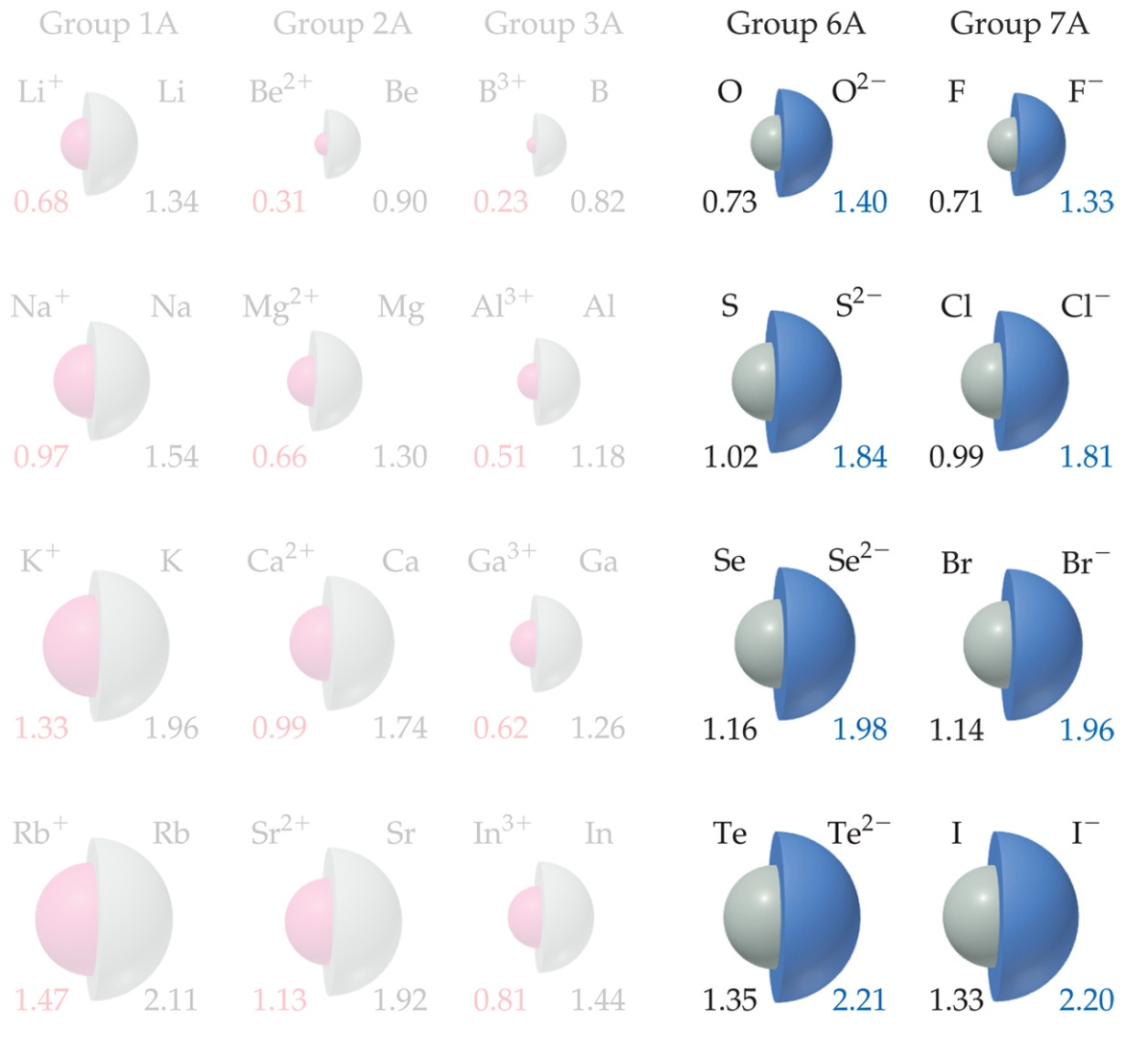
Sizes of Ions
Anions are larger than their parent atoms.
Anions are formed when an atom gains electrons
Electrons are added and repulsions are increased.

Slide 19

Sizes of Ions
Ions increase in size as you go down a column.
Due to increasing value of n.

Slide 20
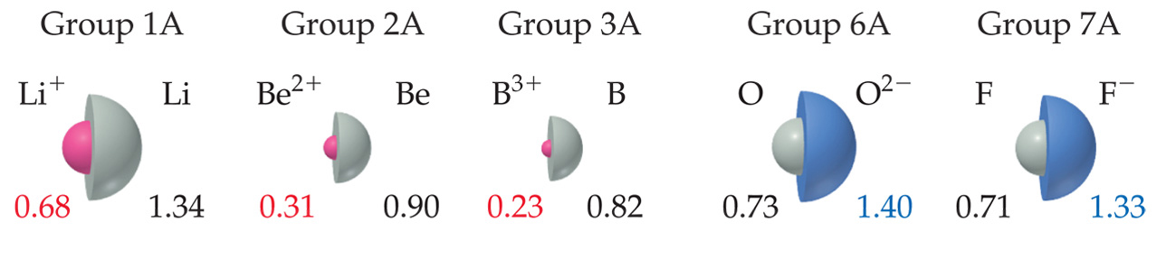
Sizes of Ions
In an isoelectronic series, ions have the same number of electrons.
Ionic size decreases with an increasing nuclear charge.

Slide 21
Ionization Energy
Amount of energy required to remove an electron from the ground state of a gaseous atom or ion.
First ionization energy is that energy required to remove first electron.
Second ionization energy is that energy required to remove second electron, etc.

Slide 22
Trends in Ionization Energy
Increases across a period.
Nuclear charge increases and so does electrons.
Attraction to nucleus increases, so it takes more energy to remove electron from atom
Decreases down group
Size of atom increases but energy levels shield electrons (outermost electrons are further from the nucleus) so nucleus has less effect on electrons so it takes less energy to remove electrons from the atom.

Slide 23
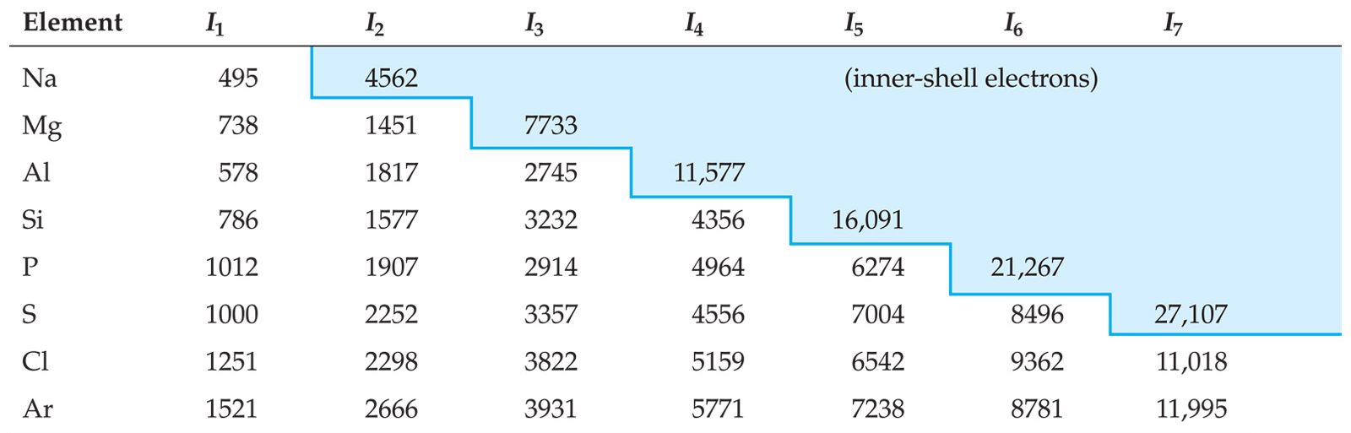
Ionization Energy
It requires more energy to remove each successive electron.
When all valence electrons have been removed, the ionization energy takes a quantum leap.

Slide 24
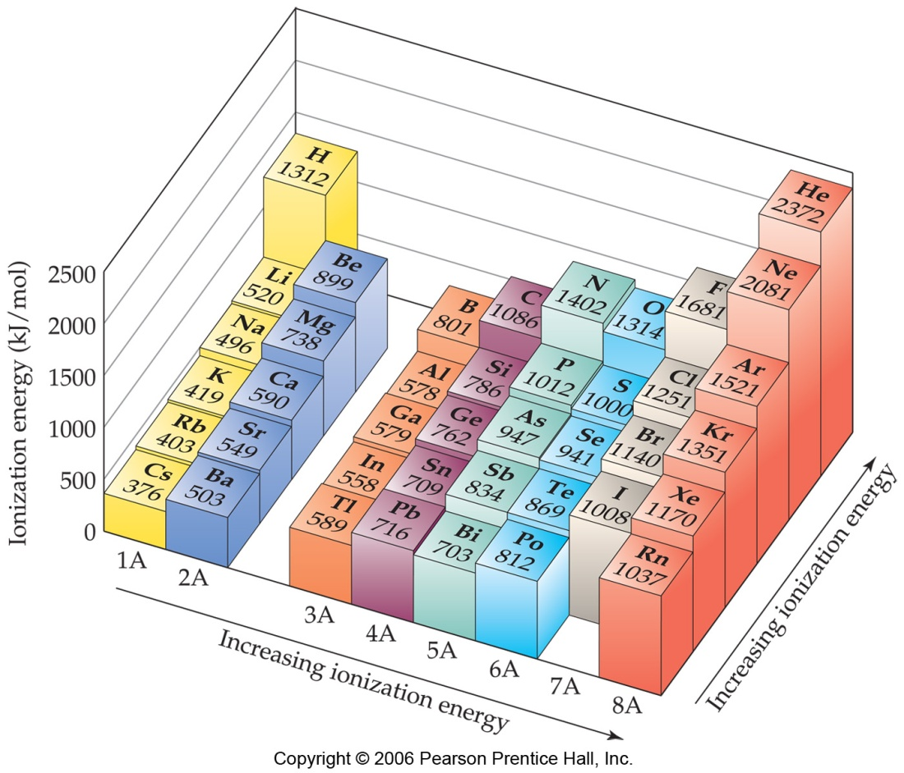
Trends in First Ionization Energies
As one goes down a column, less energy is required to remove the first electron.
For atoms in the same group, nuclear charge is essentially the same, but the valence electrons are farther from the nucleus.
Helium has largest ionization energy.
Cesium has smallest ionization energy.

Slide 25
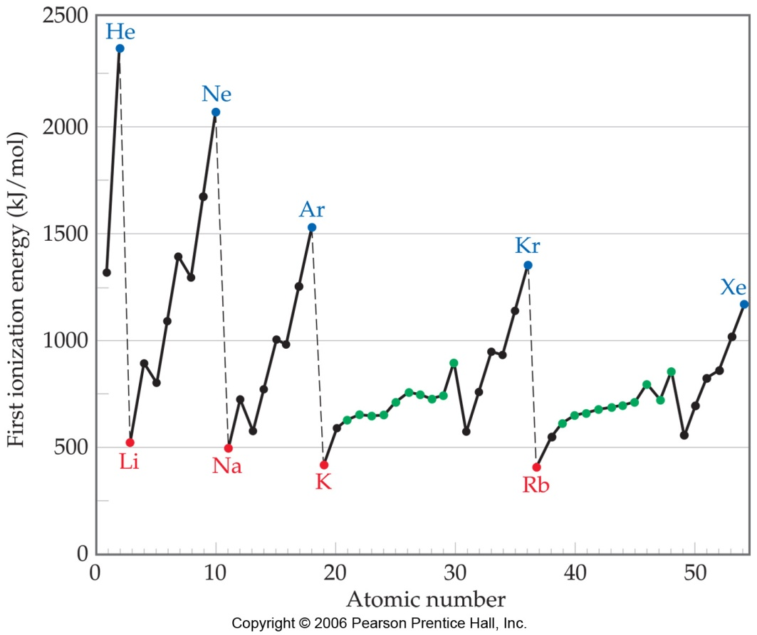
Trends in First Ionization Energies
Generally, as one goes across a row, it gets harder to remove an electron.
As you go from left to right, Z_{eff} increases.

Slide 26
Trends in Electronegativity
Electronegativity is a property that allows you to predict the type of bond that will form during a reaction.
It is the ability of an atom of an element to attract electrons when the atom is in a compound.

Slide 27
Trends in Electronegativity
Electronegativity values decrease from top to bottom within a group.
Cesium least electronegative element.
Electronegativity values for representative elements (1A-7A) tend to increase across period
Fluorine most electronegative
Noble gases are not electronegative

Slide 28
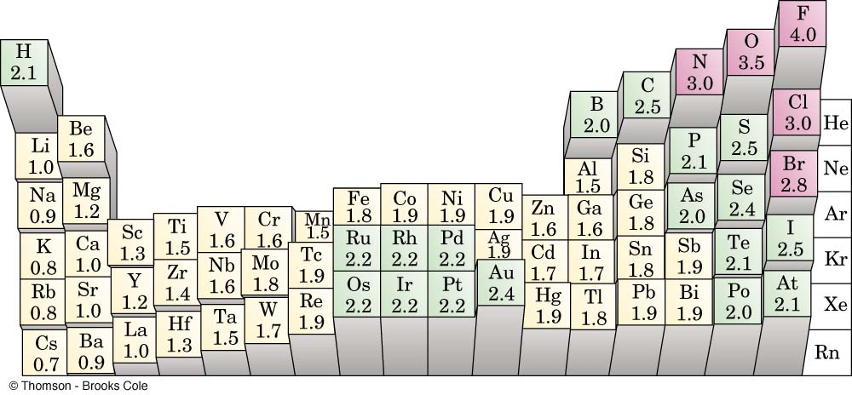
The Periodic Table and Electronegativity

Slide 29
Metallic Characteristics
Metallic character increases with increased reactivity. Therefore, alkali metals are more metallic since they are the most reactive metals.
metallic character increases
nonmetallic character increases
metallic character increases
nonmetallic character increases
Notes:
• Elements with the highest ionization energies are those with the most negative electron affinities, which are located in the upper-right corner of the periodic table.
• Elements with the lowest ionization energies are those with the least negative electron affinities and are located in the lower-left corner of the periodic table.
• The tendency of an element to gain or lose electrons is important in determining its chemistry.
• Various methods have been developed to describe this tendency quantitatively.
• The most important method is called electronegativity (χ), defined as the relative ability of an atom to attract electrons to itself in a chemical compound.

Slide 30
Summary of Periodic Trends
Shielding is constant
Atomic radius decreases
Ionization energy increases
Electronegativity increases
Nuclear charge increases
Nuclear charge increases
Shielding increases
Atomic radius increases
Ionic size increases
Ionization energy decreases
Electronegativity decreases
1A
0
2A
3A
4A
5A
6A
7A
Ionic size (cations) Ionic size (anions)
decreases decreases
Notes:
• Elements with the highest ionization energies are those with the most negative electron affinities, which are located in the upper-right corner of the periodic table.
• Elements with the lowest ionization energies are those with the least negative electron affinities and are located in the lower-left corner of the periodic table.
• The tendency of an element to gain or lose electrons is important in determining its chemistry.
• Various methods have been developed to describe this tendency quantitatively.
• The most important method is called electronegativity (χ), defined as the relative ability of an atom to attract electrons to itself in a chemical compound.
Rules for assigning oxidation states are based on the relative electronegativities of the elements — the more-electronegative element in a binary compound is assigned a negative oxidation state
Electronegativity values used to predict bond energies, bond polarities, and the kinds of reactions that compounds undergo
Trends in periodic properties:
1. Atomic radii decrease from lower left to upper right in the periodic table.
2. Ionization energies become more positive, electron affinities become more negative, and electronegativities increase from the lower left to the upper right.

