Slide 1


Bonds
Covalent Bonds

Slide 2
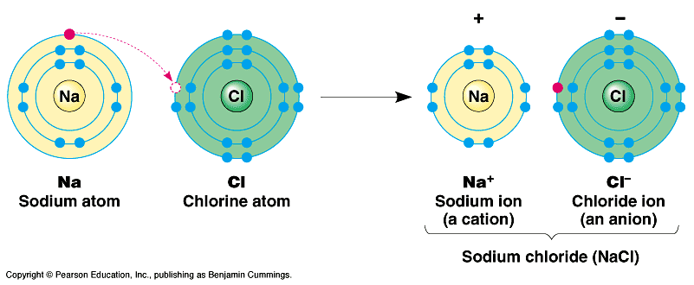
In the last unit, we learned about electrons being transferred (“given up” or “stolen away”) Remember valence electrons are the electrons located in the outer shell.
This type of “tug of war” between a METAL and a NONMETAL is called an IONIC BOND, which results in a SALT being formed

Slide 3


What did the atom of fluorine
say to the atom of
sodium?
You complete me.

Slide 4
Ionic Compounds
Ionic compounds- formed joining metal cations and nonmetal anions- they are electrically neutral
Usually solid crystals
Melt at high temperatures

Slide 5
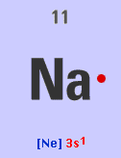
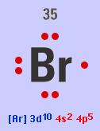
Covalent Bonding
Covalent bond is the sharing of the VALENCE
ELECTRONS of each atom in a bond
Recall: Electrons are divided between core and valence electrons.
ATOM core valence
Na 1s² 2s² 2p⁶ 3s¹ [Ne] 3s¹
Br [Ar] 3d¹⁰ 4s² 4p⁵ [Ar] 3d¹⁰ 4s² 4p⁵
Br Br

Slide 6
Covalent (Molecular) compounds
Made of molecules.
Made by joining nonmetal atoms together into molecules.
can’t be held together because of opposite charges.
can’t use charges (oxidation numbers) to figure out how many of each atom

Slide 7
Covalent (Molecular) compounds
Properties of molecular compounds
  Low melting and boiling points
  Usually gas or liquid
  Composed of two or more nonmetals
  O₂, O₃, H₂O, CO₂

Slide 8
Ionic versus Covalent Bonds
 | IONIC | COVALENT
Bonded Name | Salt | Molecule
Bonding Type | Transfer e⁻ | Share e⁻
Types of Elements | Metal & Nonmetal | Nonmetals
Physical State | Solid | Solid, Liquid, or Gas
Melting Point | High (above 300ºC) | Low (below 300 ºC)
Solubility | Dissolves in Water | Varies
Conductivity | Good | Poor

Slide 9
Chemical Bonding
Covalent Bonds
…atoms share electrons to get a full valence shell
2s² 2p²
C
1s²
(4 v.e–)
F
2s² 2p⁵
(7 v.e–)
1s²
both need 8 valence electrons for a full outer shell
(octet rule)

Slide 10
Covalent bonding
Fluorine has seven valence electrons
A second F atom also has seven
By sharing electrons
Both end with full orbitals (stable octets)
F
F
8 Valence electrons
8 Valence electrons

Slide 11
Covalent Bonding
n = 2
-
-
n = 1
-
-
-
-
-
-
-
+
-
-
-
-
-
-
-
-
-
-
-
-
-
-
-
-
-
-
-
O
[He]2s²2p⁴
O
[He]2s²2p⁴
O₂
Sharing of electrons to achieve a stable octet (8 electrons in valence shell).

Slide 12
Lewis Structure
carbon tetrafluoride (CF₄)
x
x
x
x
x
F
x
x
F
x
x
x
x
x
o
x
x
x
x
o
x
x
x
x
x
x
x
o
C
x
F
x
x
F
o
C
x
F
x
x
F
C
F
x
o
x
x
x
o
x
x
x
o
x
x
x
x
o
x
x
x
x
x
x
x
x
F
x
x
F
x
x
x
x
x
x
x
x
x
covalent compounds = molecular compounds
(have lower melting points than do ionic compounds)

Slide 13
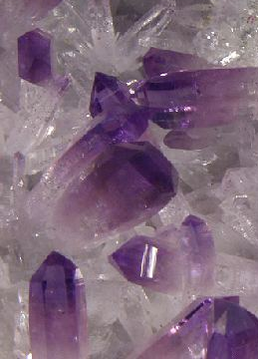
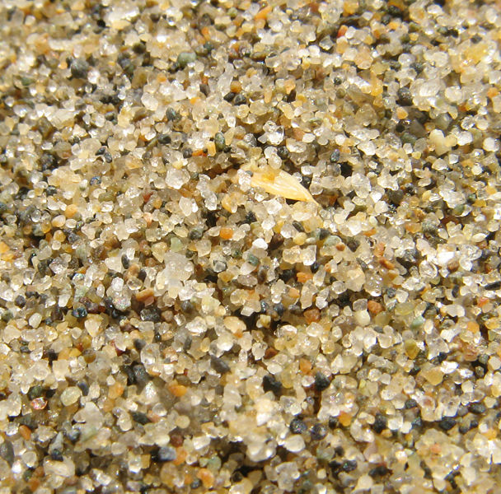
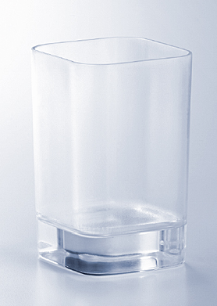
Covalent/Molecular Compound
A compound containing atoms of two or more elements that are bonded together by sharing electrons.
Silicon dioxide, SiO₂, is a molecular compound. It is also a mineral called quartz (left).
Quartz is found in nearly every type of rock. Most sand grains (center) are bits of quartz.
Glass is made from sand.
Notes:
Quartz (silicon dioxide) is the most common mineral species in the earth's crust.
http://www.minvision.com/mvpics/0275331001148477692730993.jpg
http://ftp.gnome.org/pub/GNOME/teams/art.gnome.org/backgrounds/NATURE-QuartzSand_1024x768.jpg
http://en.wikipedia.org/wiki/Image:Third_beach_sand.jpg

Slide 14
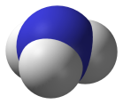

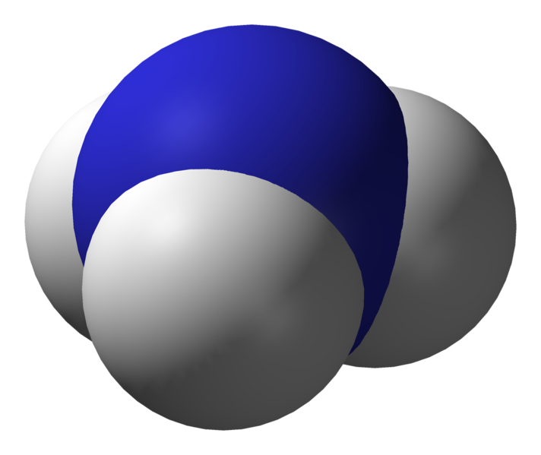
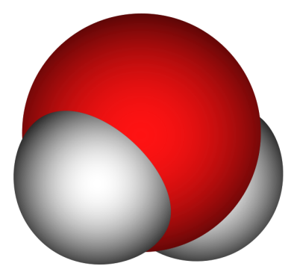



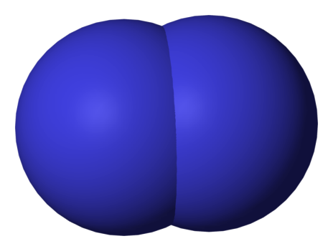




Types of Bonds
Covalent Bonding - True Molecules
Nitrogen
Water
Ammonia
Diatomic
Molecule

Slide 15
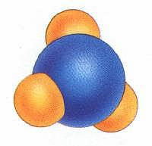
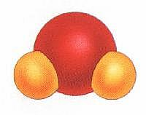
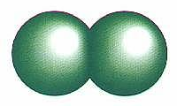
Types of Bonds
Covalent Bonding - True Molecules
Chlorine
Water
Ammonia
Diatomic
Molecule
Courtesy Christy Johannesson www.nisd.net/communicationsarts/pages/chem

Slide 16
Covalent vs. Ionic
Different
Alike
Different
Chemical
Bonds
Share
electrons
(polar vs. nonpolar)
Transfer
electrons
(ions formed)
+ / -
Topic
Topic
Between
Two
Nonmetals
Electrons
are
involved
Between
Metal and
Nonmetal
Covalent
Ionic
Weak
Bonds
(low melting point)
Strong
Bonds
(high melting point)

Slide 17
Covalent Nomenclature

Slide 18
Name → Formula?
No Prefixes?
Prefixes?
Ionic
Covalent
Determine the ions present
and the charge on each (Roman Numeral = cation charge, otherwise use PT)
Balance formula (criss-cross)
Reduce subscripts (if needed)
FORGET CHARGES!!!
Use prefixes to determine subscripts
Do NOT reduce subscripts!

Slide 19
Writing Formulas of Covalent Molecules
Covalent Molecules
contain two types of nonmetals
Key: FORGET CHARGES
What to do:
Use Greek prefixes to indicate how many atoms
of each element, but don’t use “mono” on first element.
1 – mono 6 – hexa
2 – di 7 – hepta
3 – tri 8 – octa
4 – tetra 9 – nona
5 – penta 10 – deca

Slide 20
Writing Formulas of Covalent Molecules
EXAMPLES:
carbon dioxide
CO
dinitrogen trioxide
N₂O₅
carbon tetrachloride
NI₃
CO₂
carbon monoxide
N₂O₃
dinitrogen pentoxide
CCl₄
nitrogen triiodide

Slide 21
Binary Compounds
Containing Two Nonmetals (Type III Compounds)
As₂S₃
________________ diarsenic trisulfide
________________ sulfur dioxide
P₂O₅ ____________________
________________ carbon dioxide
N₂O₅ ____________________
H₂O ____________________
SO₂
diphosphorus pentoxide
CO₂
dinitrogen pentoxide
dihydrogen monoxide

Slide 22
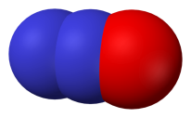
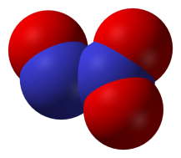
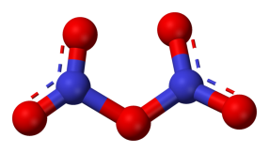
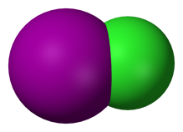
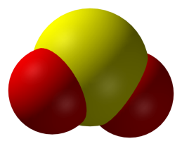
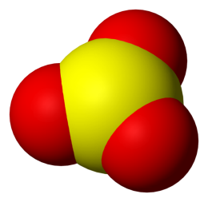
Binary Molecular Compounds
N₂O dinitrogen monoxide
N₂O₃ dinitrogen trioxide
N₂O₅ dinitrogen pentoxide
ICl iodine monochloride
ICl₃ iodine trichloride
SO₂ sulfur dioxide
SO₃ sulfur trioxide
Notes:
http://en.wikipedia.org/wiki/Image:Sulfur-dioxide-3D-vdW.png
http://en.wikipedia.org/wiki/Image:Sulfur-trioxide-3D-vdW.png
http://en.wikipedia.org/wiki/Image:Iodine-monochloride-3D-vdW.png
http://en.wikipedia.org/wiki/Image:Nitrous-oxide-3D-vdW.png
http://en.wikipedia.org/wiki/Image:Dinitrogen-trioxide-3D-vdW.png
http://en.wikipedia.org/wiki/Image:Dinitrogen-pentoxide-3D-balls.png
Technical Note: Iodine trichloride is actually a dimer with the formula I₂Cl₆

